Slide 1
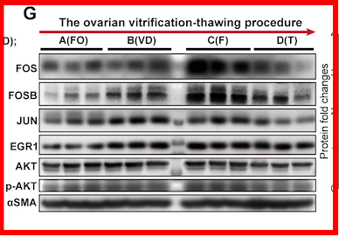
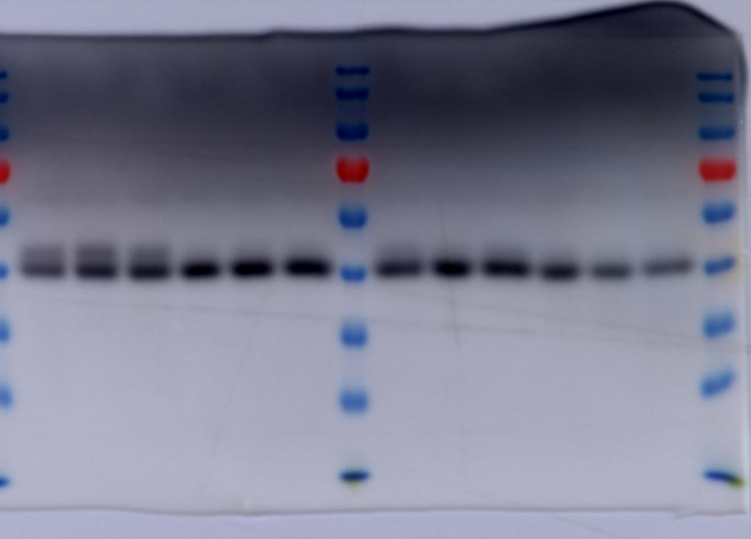
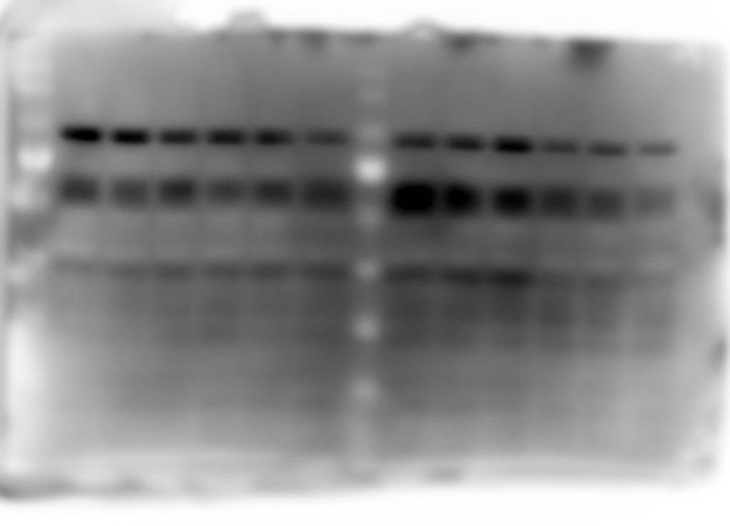
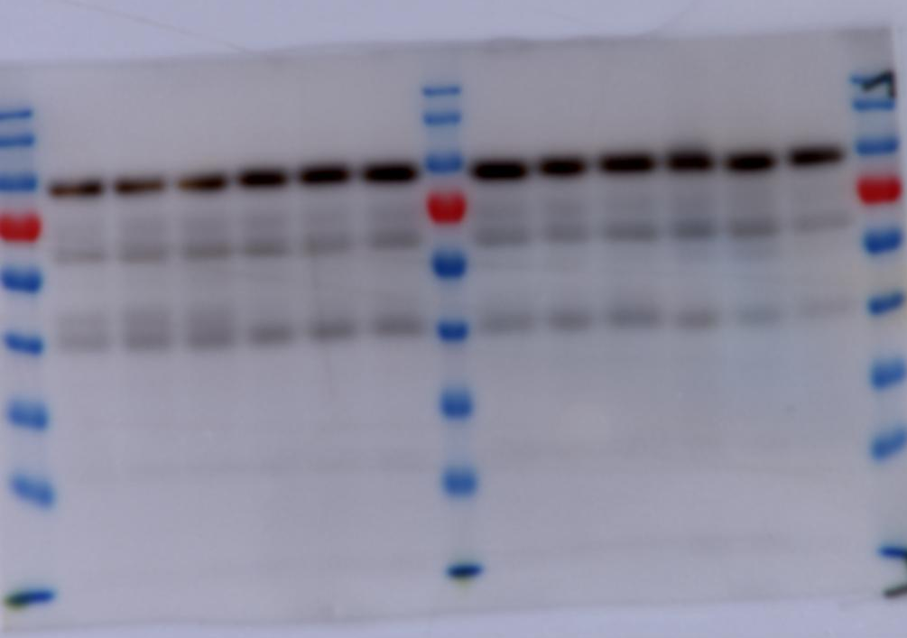
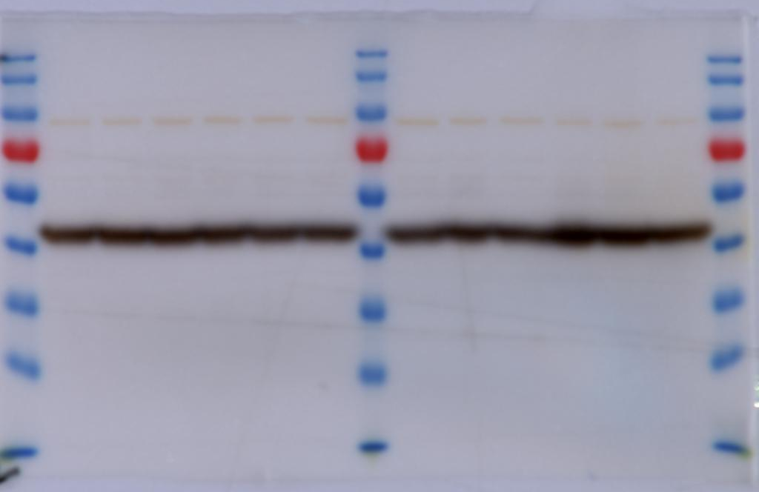
Uncropped gels/blots For Figure 6G
pAKT
60kDa
JUN
48kDa
A(FO)
B(VD)
C(F)
D(T)
EGR1
78kDa
FOS
62kDa
αSMA
42kDa
AKT
60kDa
FOSB
48kDa

Slide 2
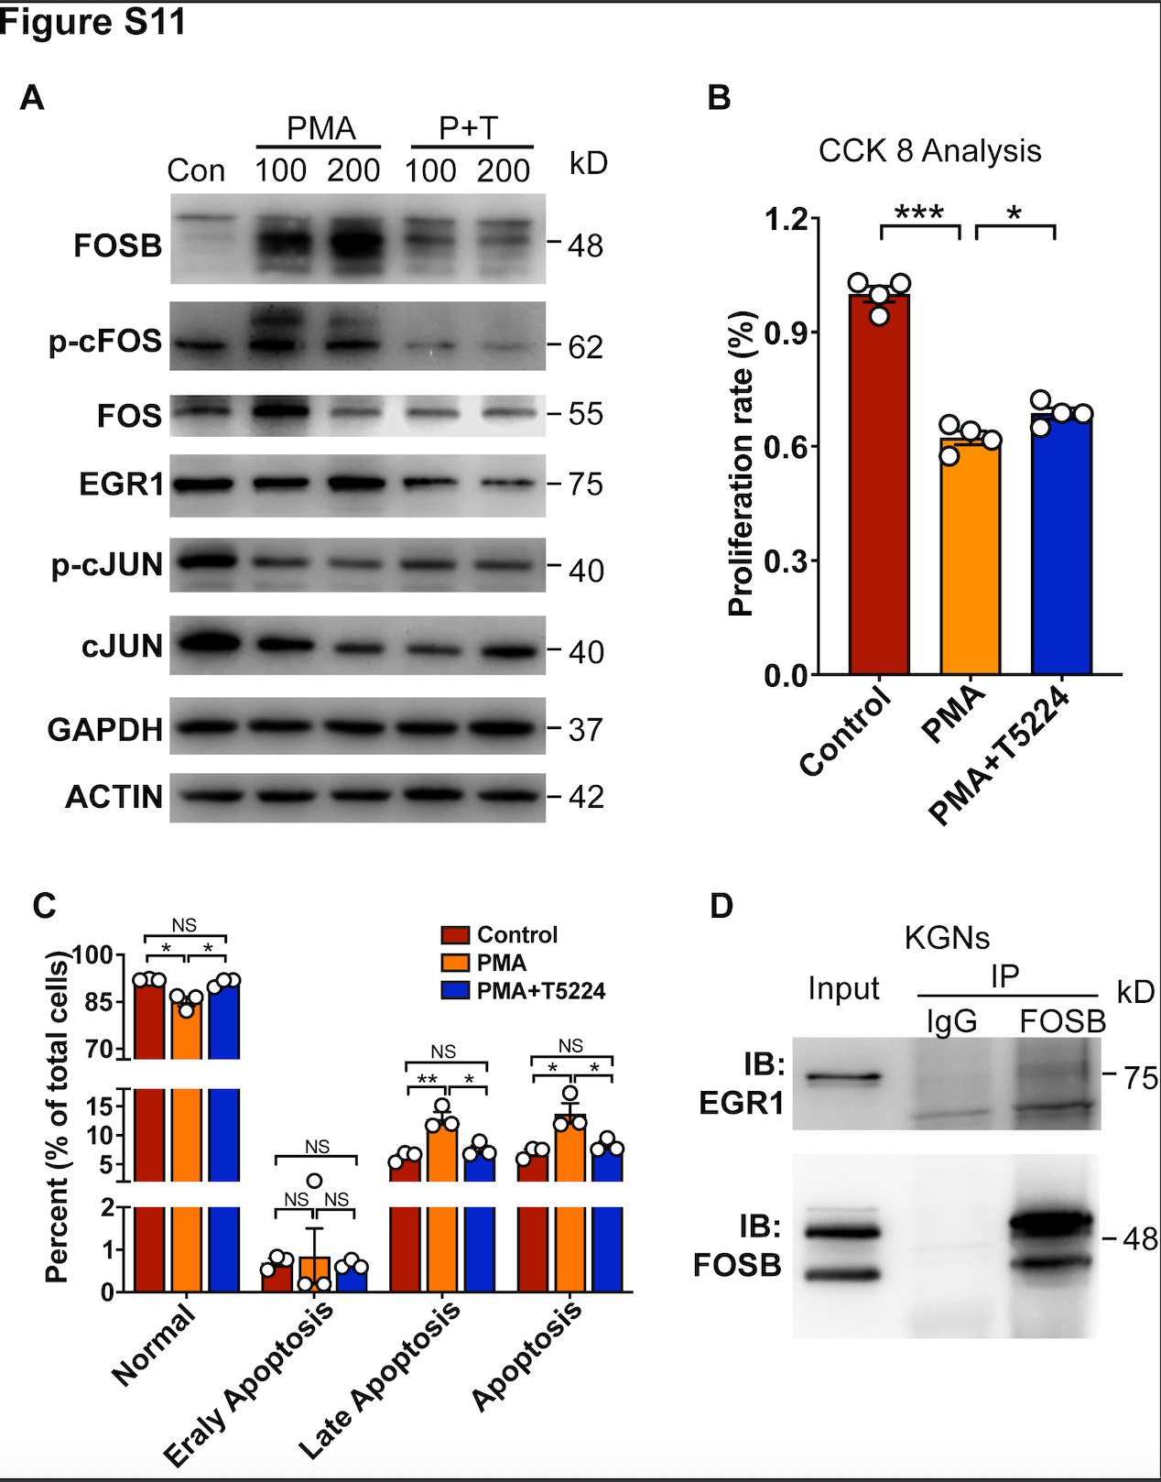
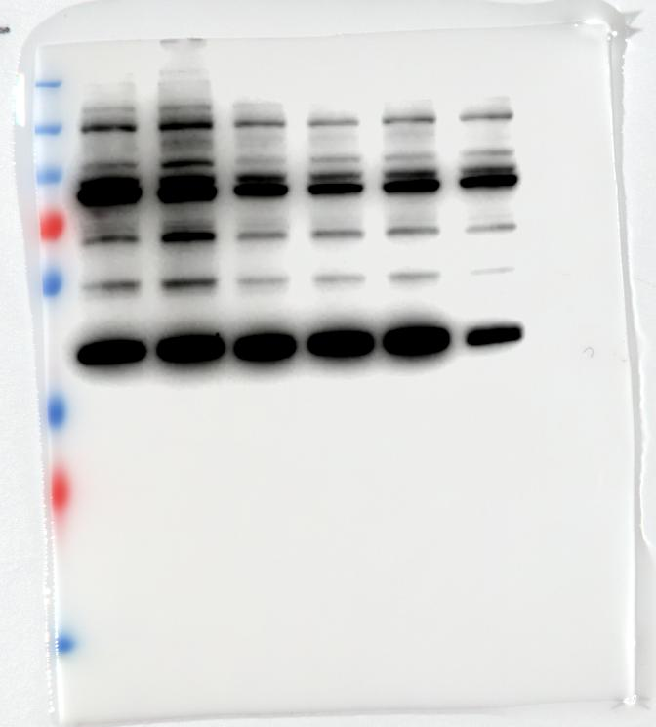
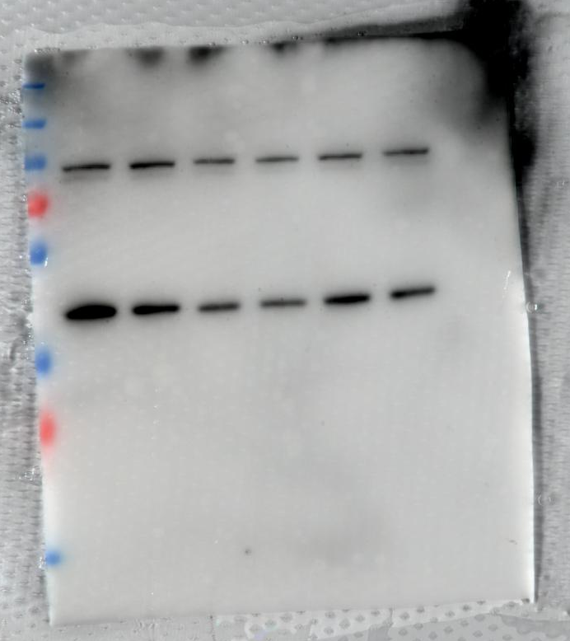
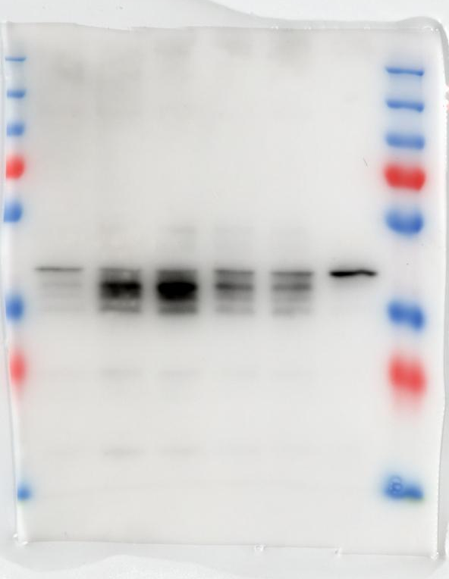
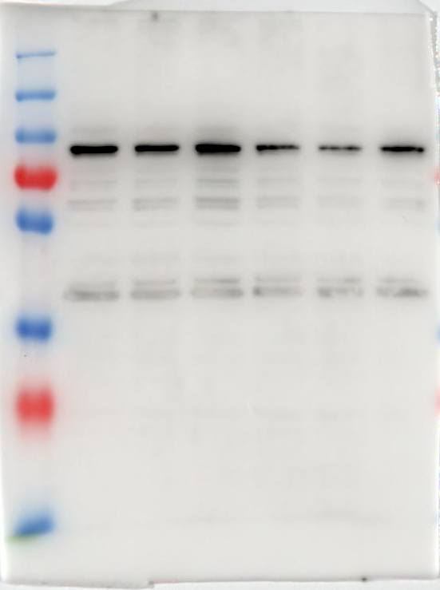
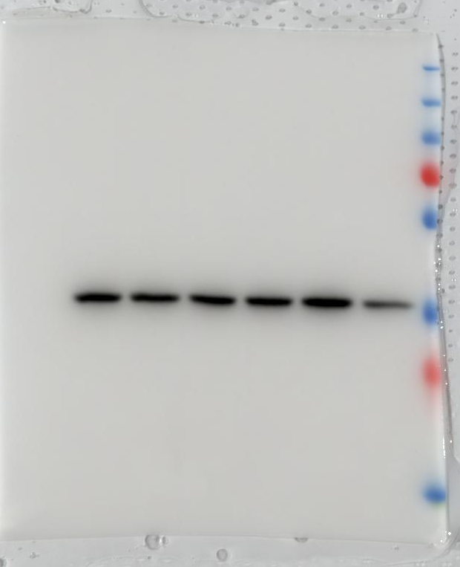
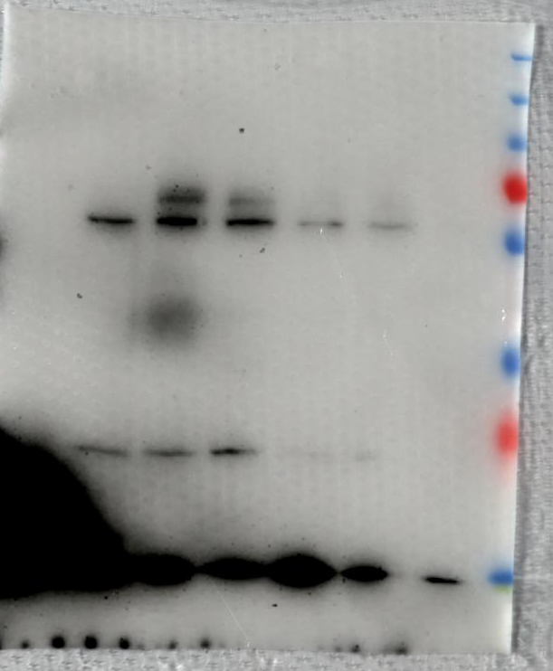
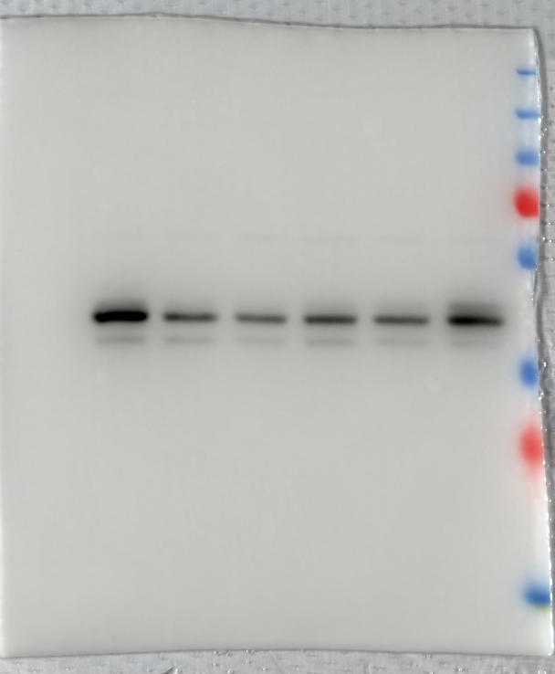
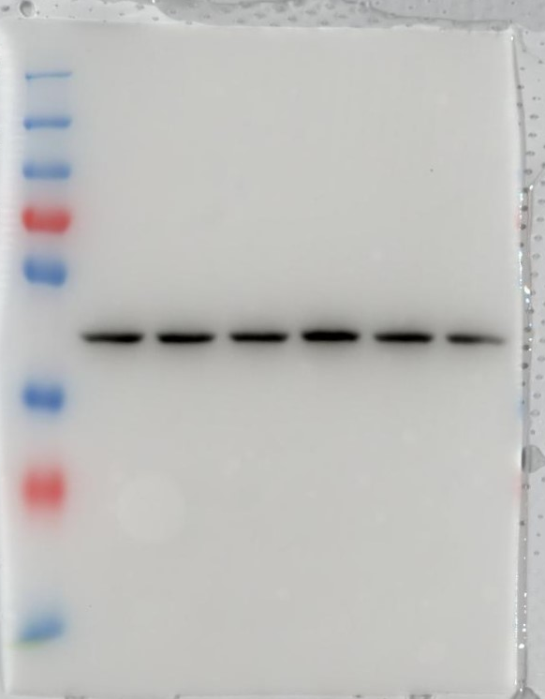
Uncropped gels/blots For Figure S11A
FOS
62kDa
JUN
40kDa
PMA PMA+T
Con 100 200 100 200
EGR1
78kDa
FOSB
48kDa
GAPDH
37kDa
pFOS
62kDa
p-cJUN
40kDa
ACTIN
42kDa

Slide 3
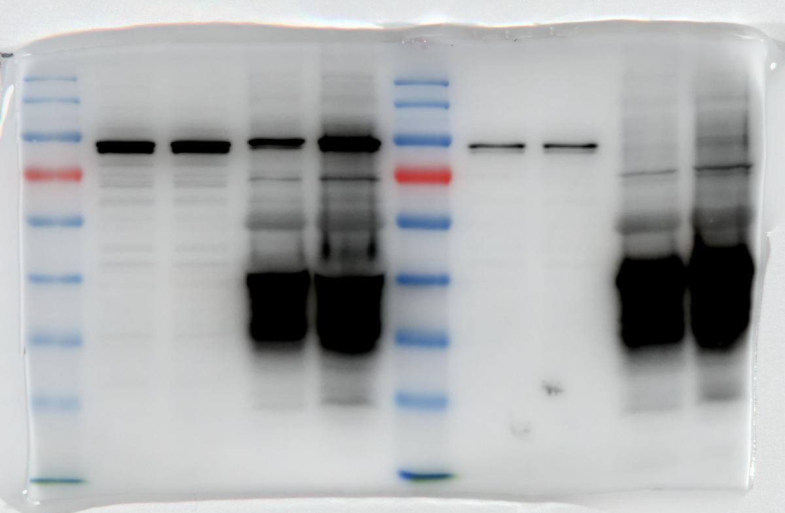
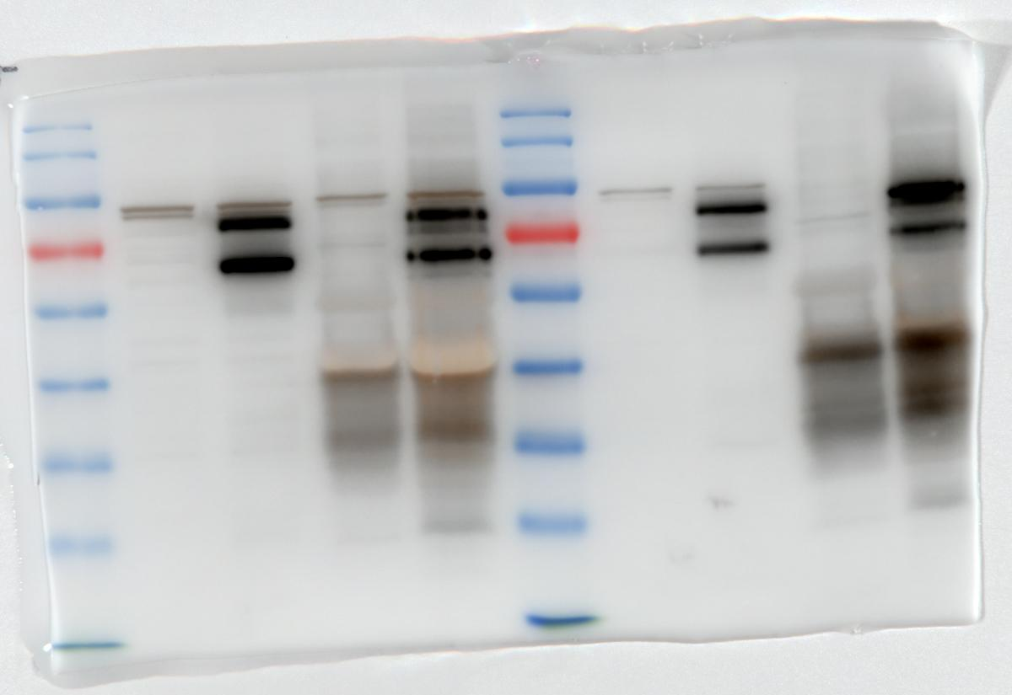
Uncropped gels/blots For Figure S11D
EGR1
FOSB
75kDa
+27kDa(EGFP)
48kDa
+27kDa(EGFP)

