Slide 1
Supplementary Table 1 : Statistical comparaison group between each group Control (Ct, CtSwPre, CtSwPre). Comparisons were made using Kruskal-Wallis test.

Slide 2
Supplementary Table 2: Statistical comparaison group between Vac and VacSwPre and Vac vs VacSwPost.
Comparisons were made using Mann-Whitney test.

Slide 3
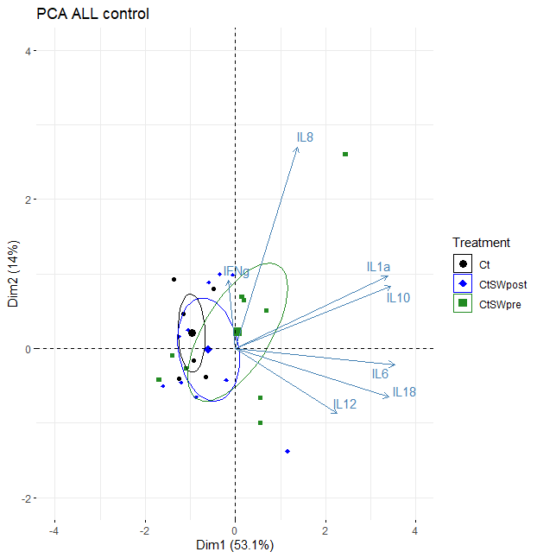
PCA unvaccinated group at 6 dvp
Ct
CtSwPost
CtSwPre
Supplementary Figure 1: Principal component analysis (PCA) of the unvaccinated group at 6 days post-vaccination (dpv) based on cytokine concentrations.
PCA of the control group according to treatment: no seaweed supplementation (Ct), seaweed supplementation from 1 to 5 dpv (CtSwPost), and seaweed supplementation at –1, 1, and 2 dpv (CtSwPre). Each symbol represents one animal, colored by treatment group: Ct (black circle), CtSwPost (blue diamond), and CtSwPre (green square). Ellipses indicate the distribution of each group. Blue arrows represent cytokine variables (IL-1α, IL-6, IL-8, IL-10, IL-12, IL-18, IFN-γ) contributing to the variance in the principal components (Dim1: 53.1%; Dim2: 14%).

Slide 4
Supplementary Figure 2: Area under the curve (AUC) of equivalent TCID₅₀/mL in the vaccinated group from days 4 to 8 post-vaccination (dpv).
Vaccinated pigs received either no supplementation (Vac, grey), seaweed supplementation from 1 to 5 dpv (VacSwPost, blue), or seaweed supplementation at –1, 1, and 2 dpv (VacSwPre, green). Each symbol represents one animal. Serum PRRSV viral loads are expressed as the AUC of equivalent TCID₅₀/mL between days 4 and 8 (mean ± SD).

