Slide 1
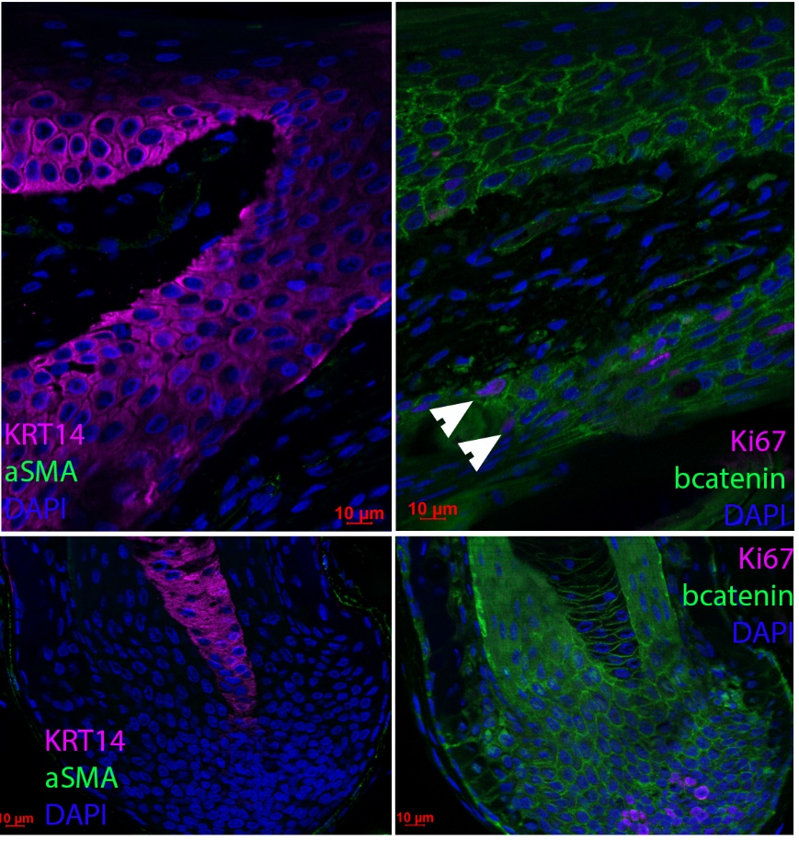
a c
b d
a c b

