Slide 1
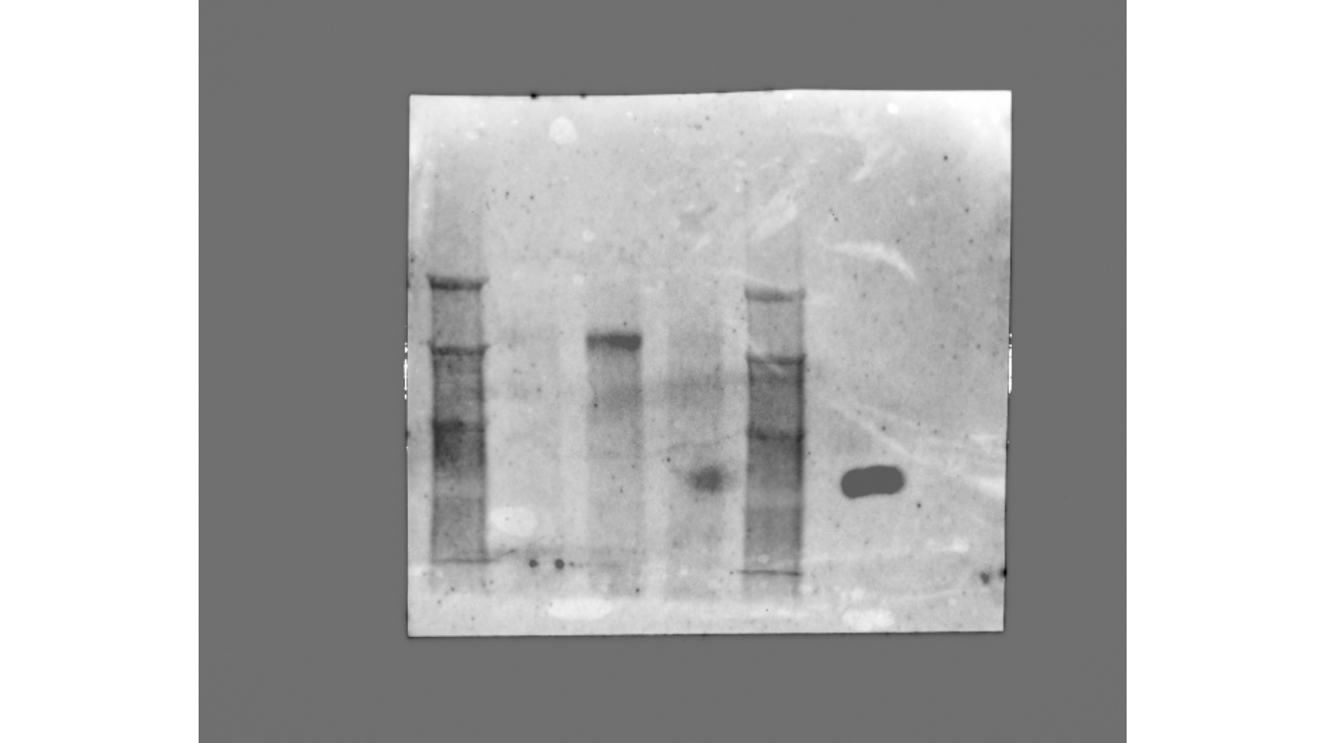
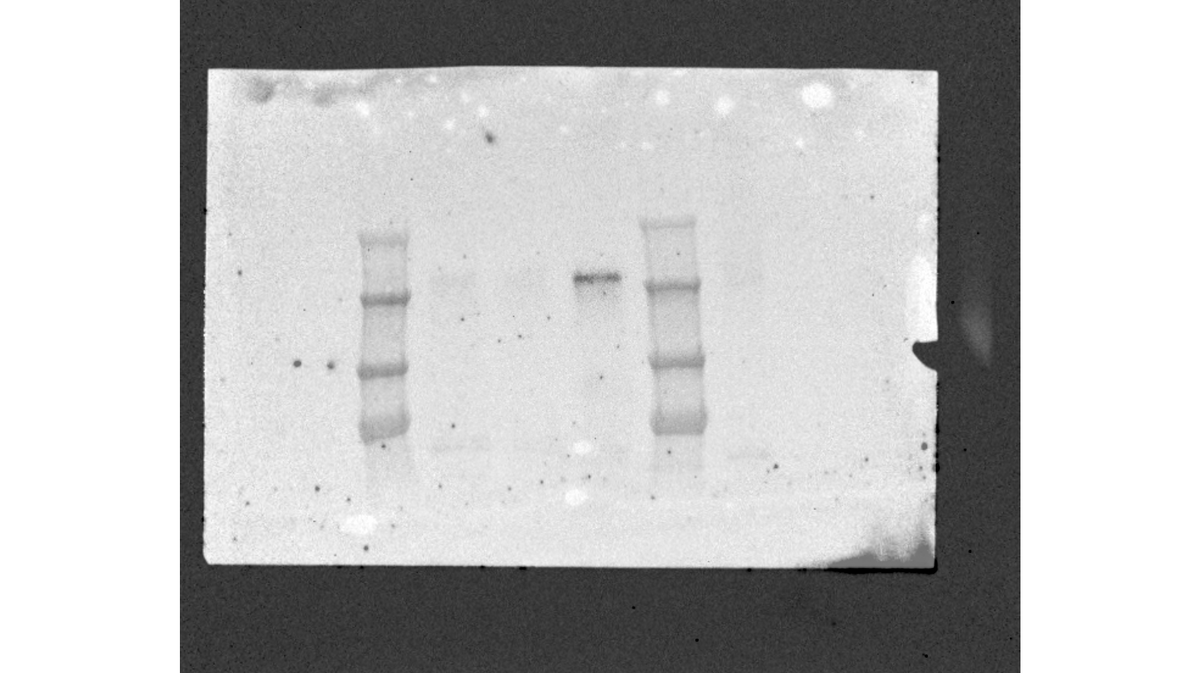
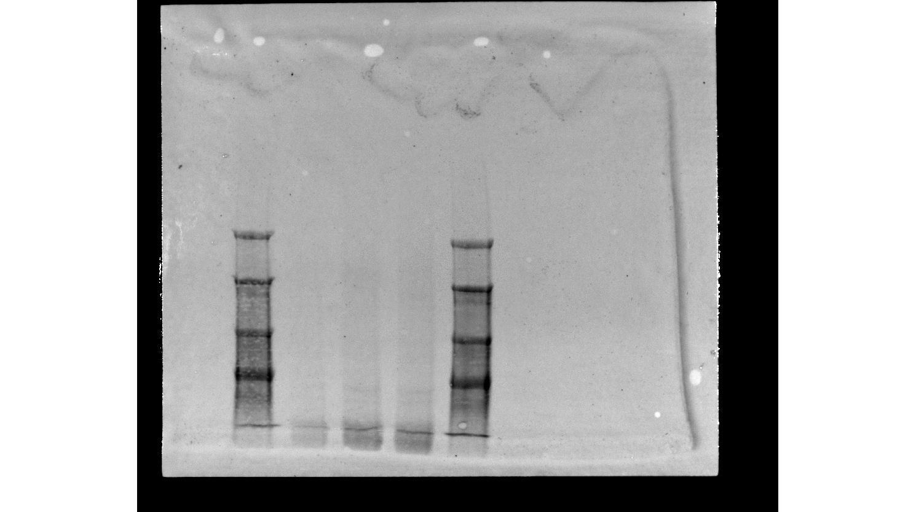
Aff11
Aff2
Aff11
C
EGFR– C-Term
Aff2
EGFR– N-Term
C
250 kDa
250 kDa
150 kDa
150 kDa
100 kDa
100 kDa
75 kDa
75 kDa
Ponceau red staining
Aff11
Aff2
C
250 kDa
150 kDa
100 kDa
75 kDa

