Slide 1
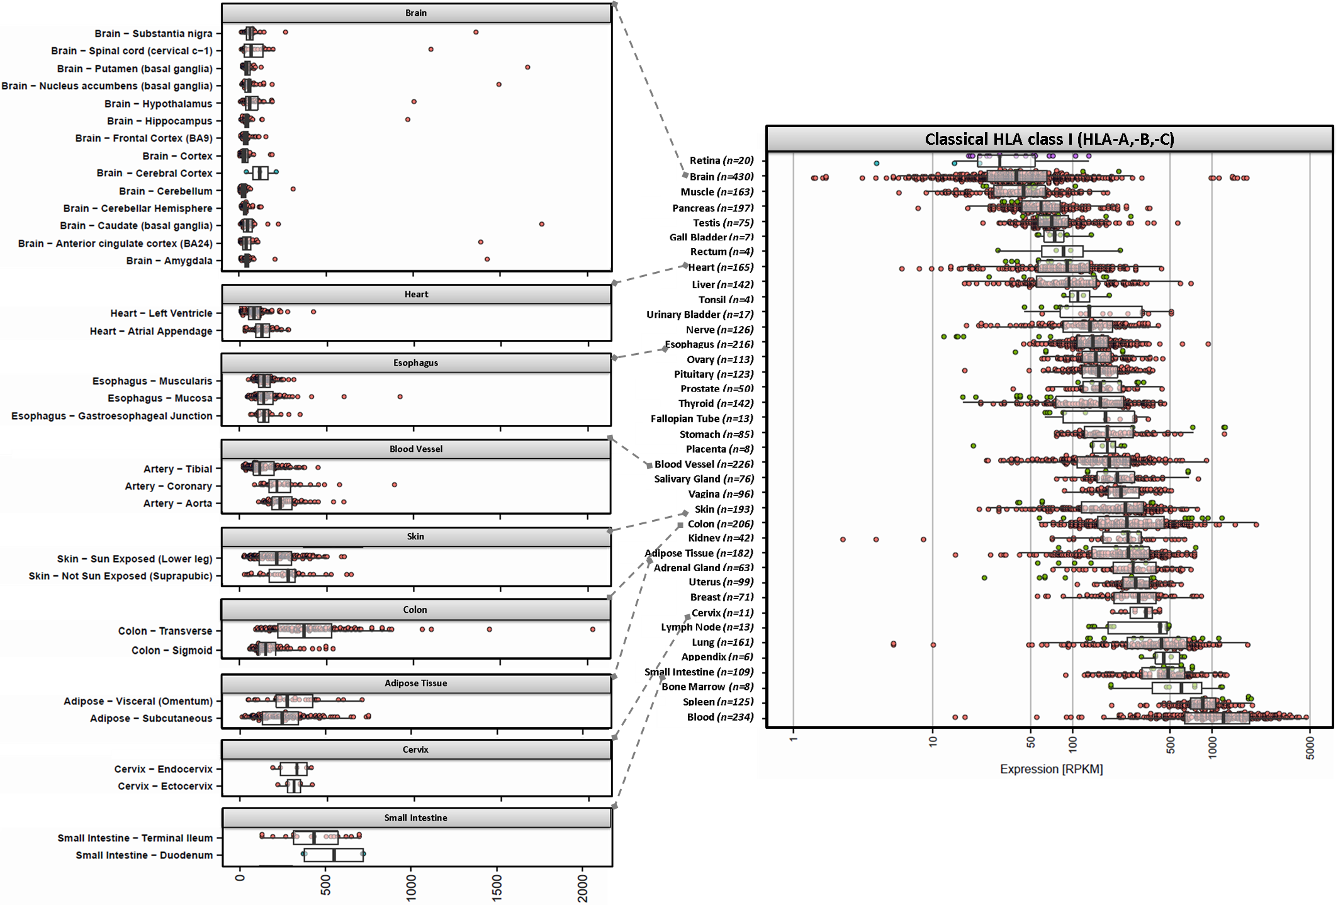
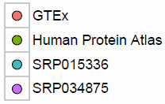
Figure S1
A.

Slide 2
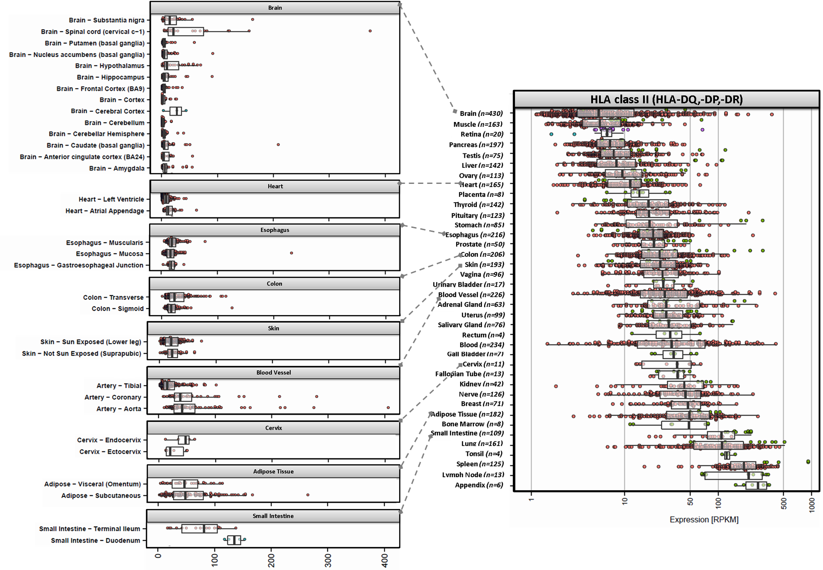
B.

Slide 3
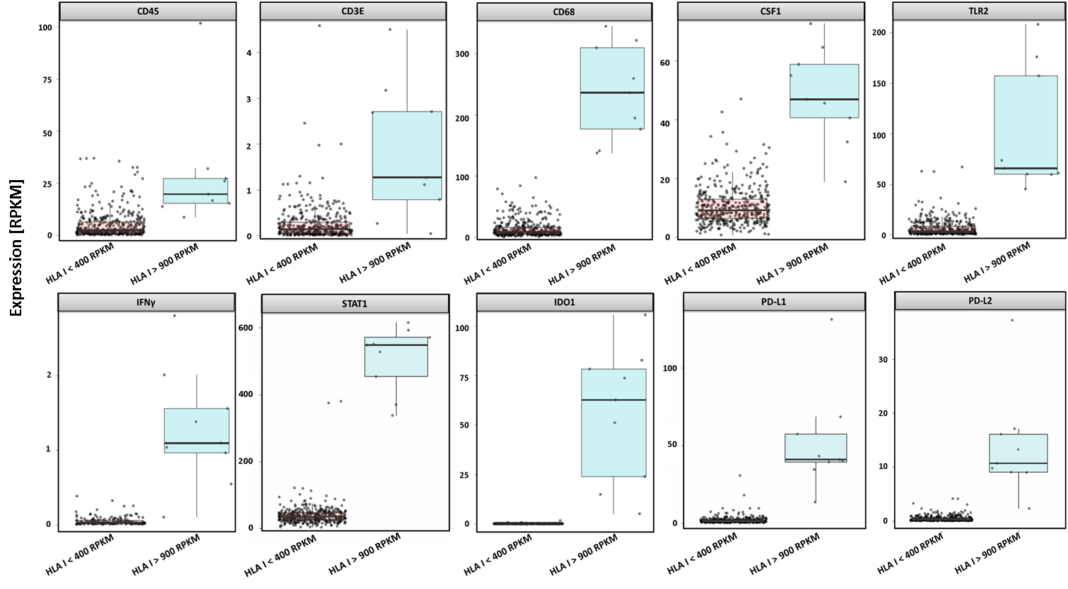
Figure S2
p<0.01
p<0.001
p<0.001
p<0.001
p<0.001
p<0.001
p<0.001
p<0.001
p<0.001
p<0.001

Slide 4
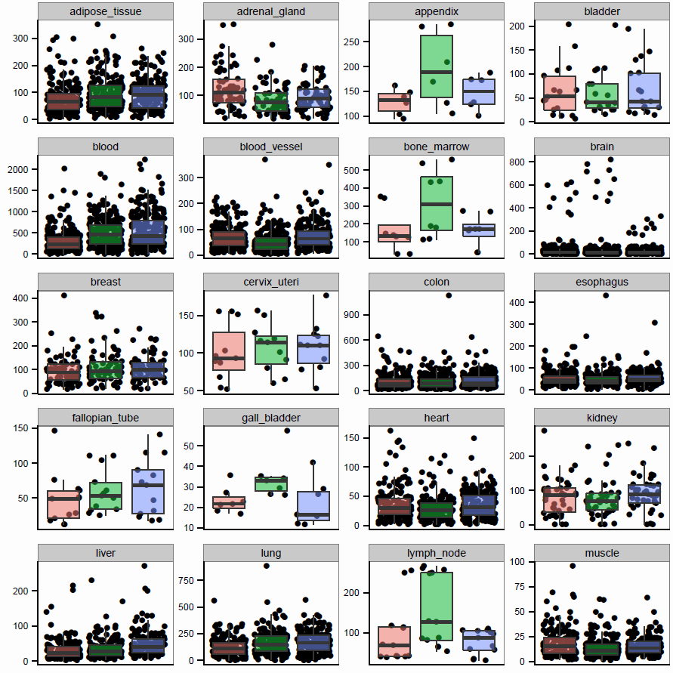
Figure S3
A.

Slide 5
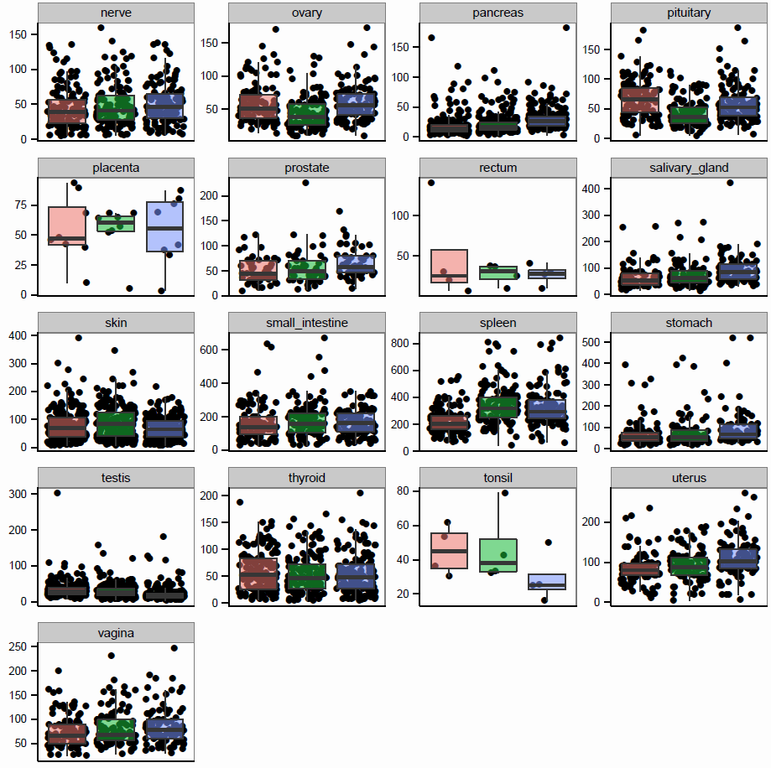
A B C
A B C
A B C
A B C

Slide 6
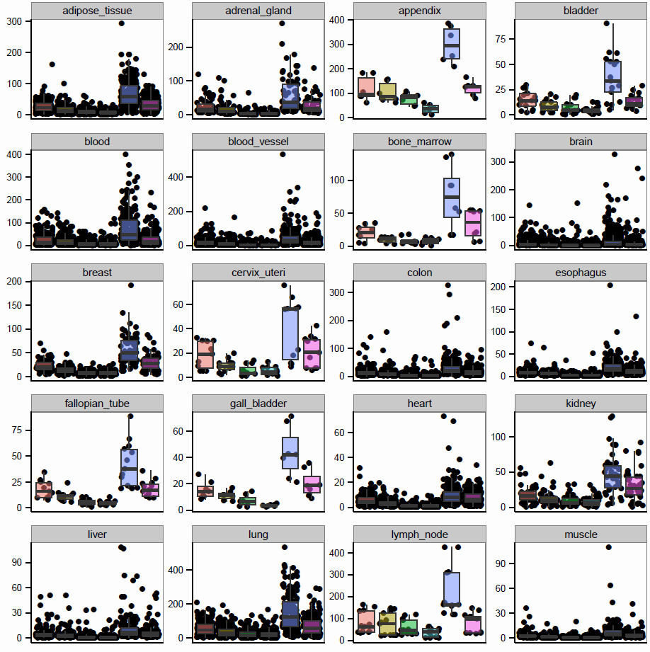
B.

Slide 7
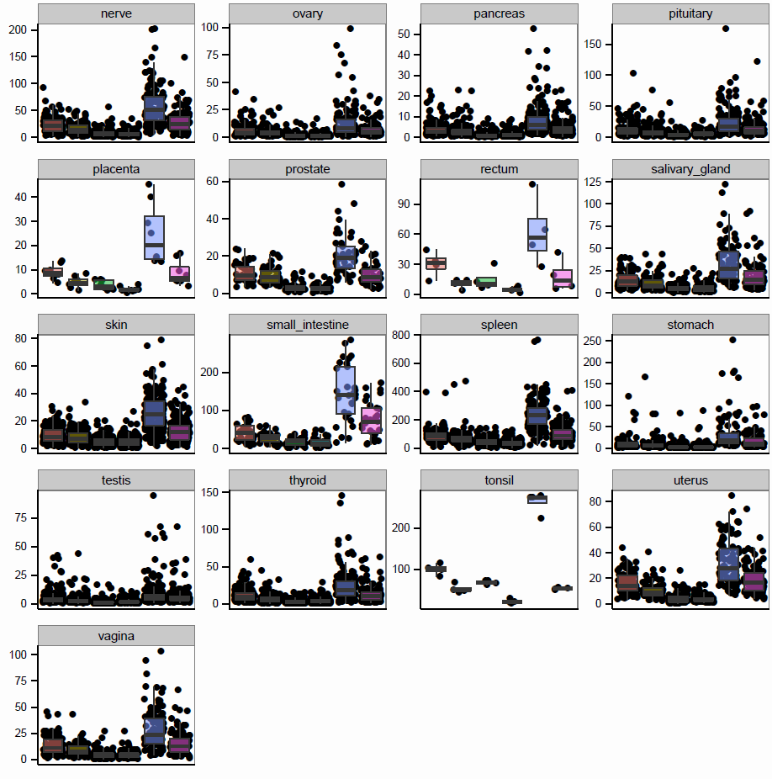
DPA1
DRA
DRA
DRA
DPB1
DQA1
DQB1
DRB1
DPA1
DPB1
DQA1
DQB1
DRB1
DPA1
DPB1
DQA1
DQB1
DRB1
DPA1
DRA
DPB1
DQA1
DQB1
DRB1

Slide 8
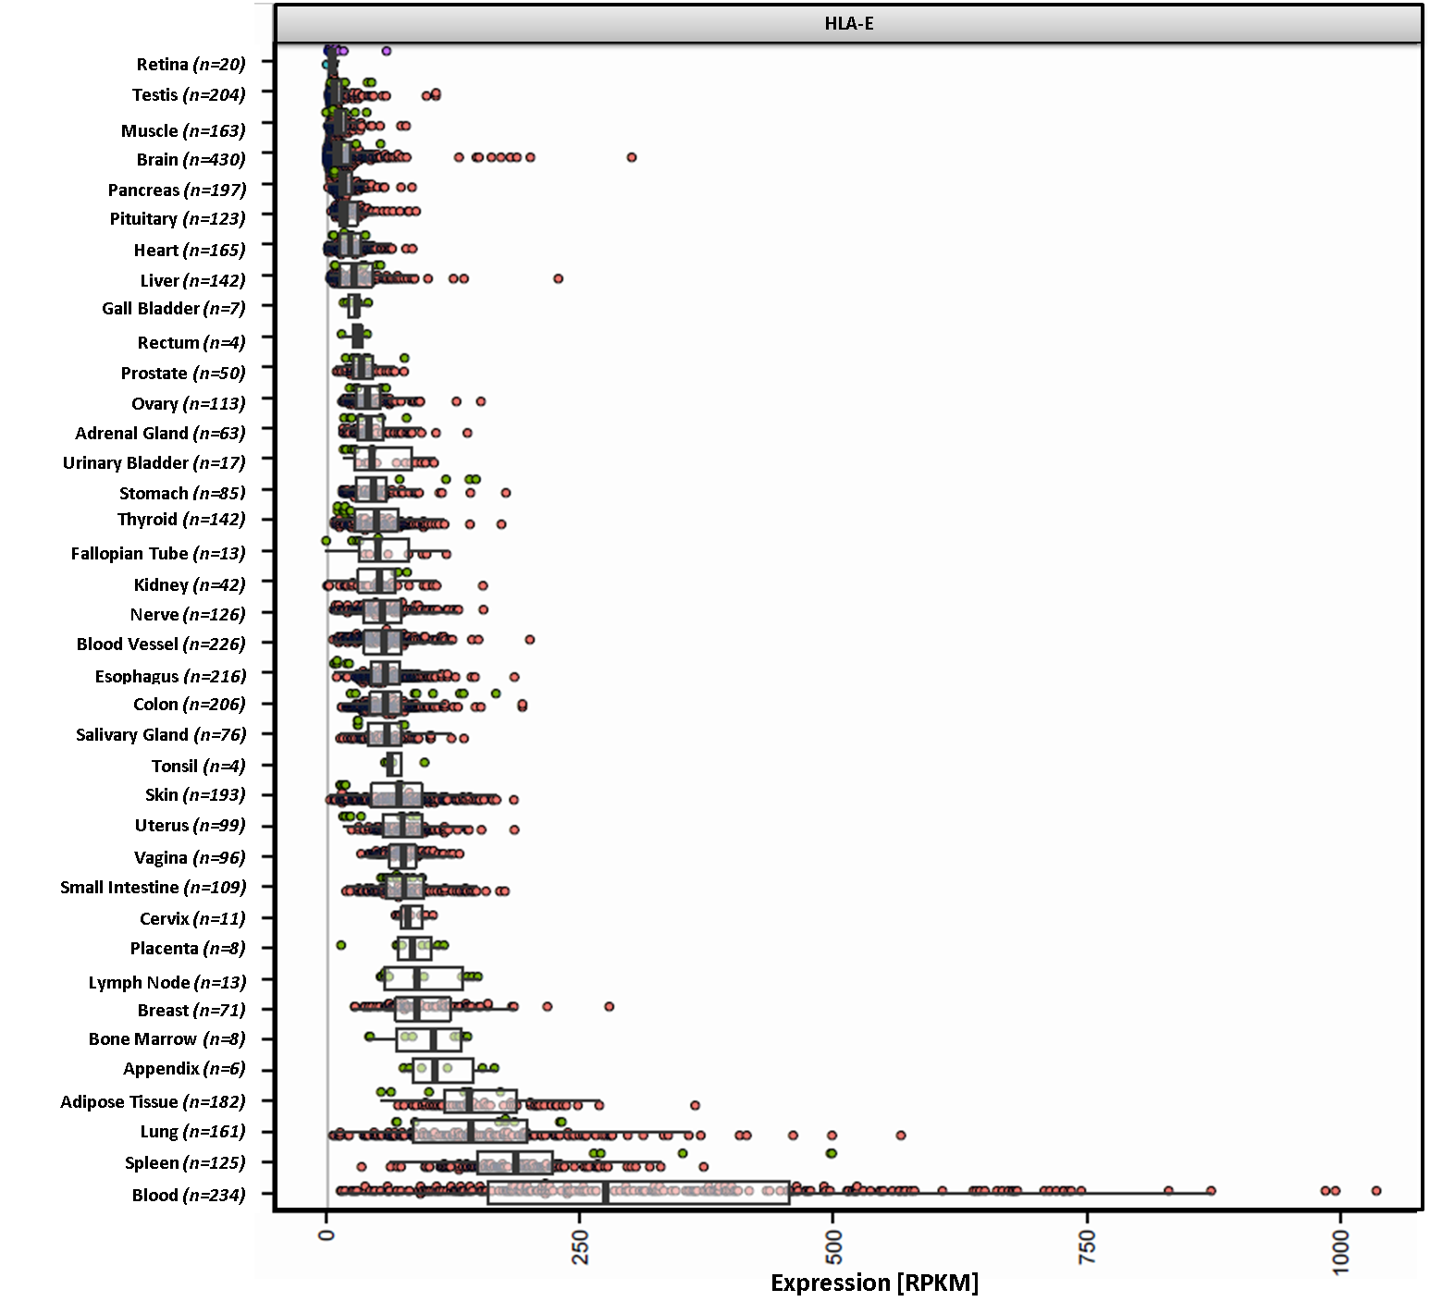
Figure S4
A.

Slide 9
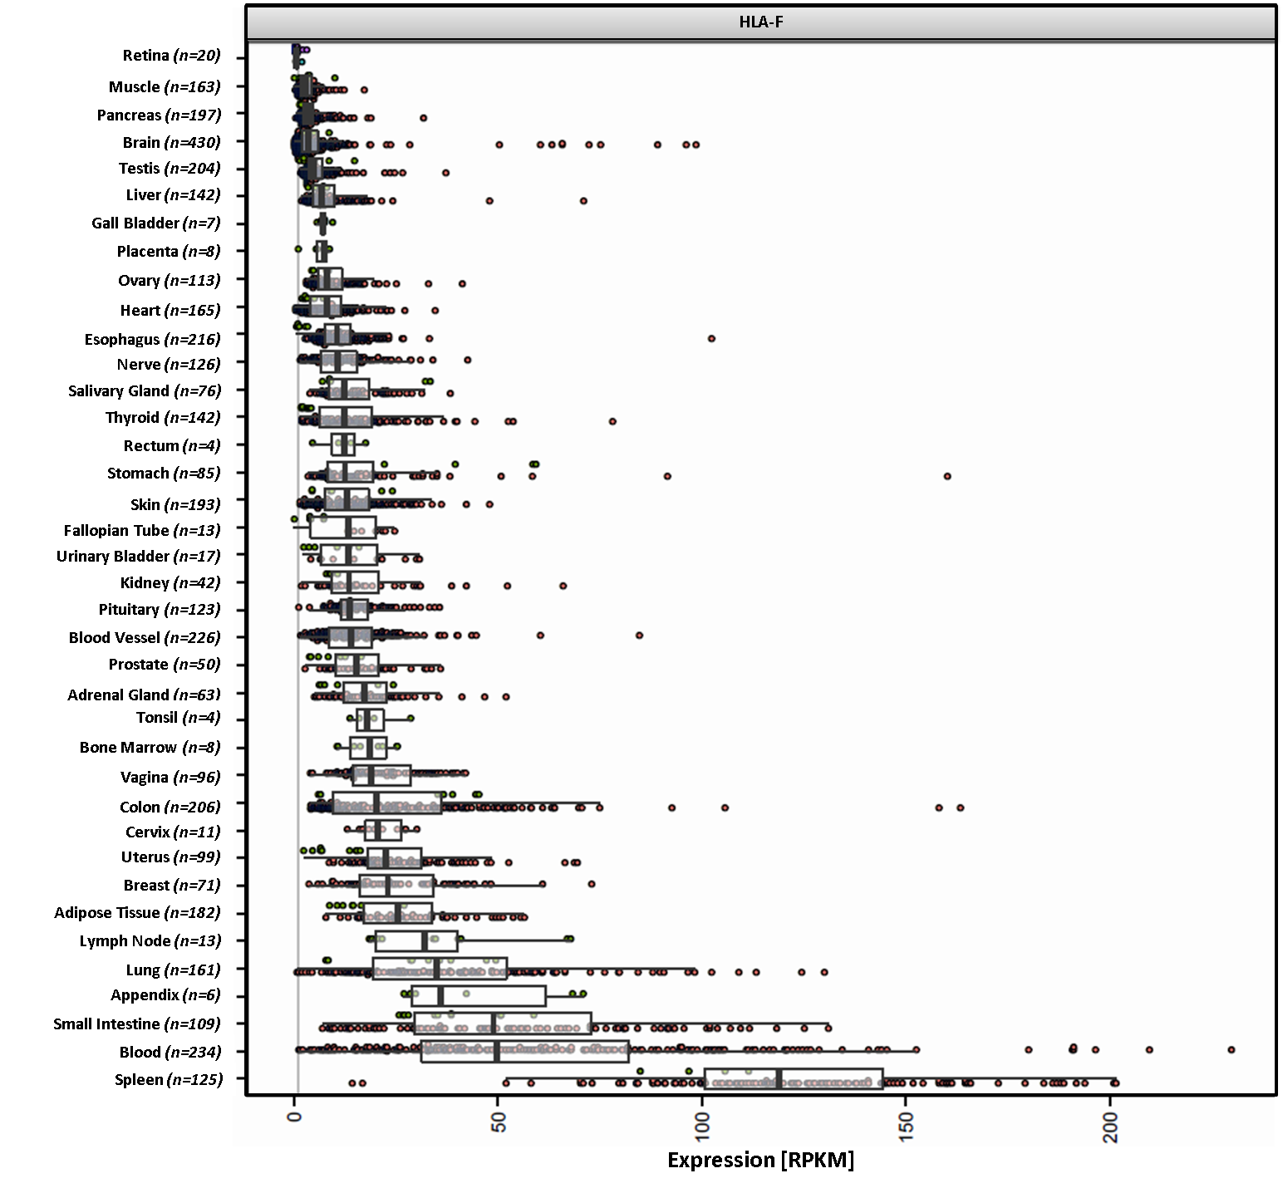
B.

Slide 10
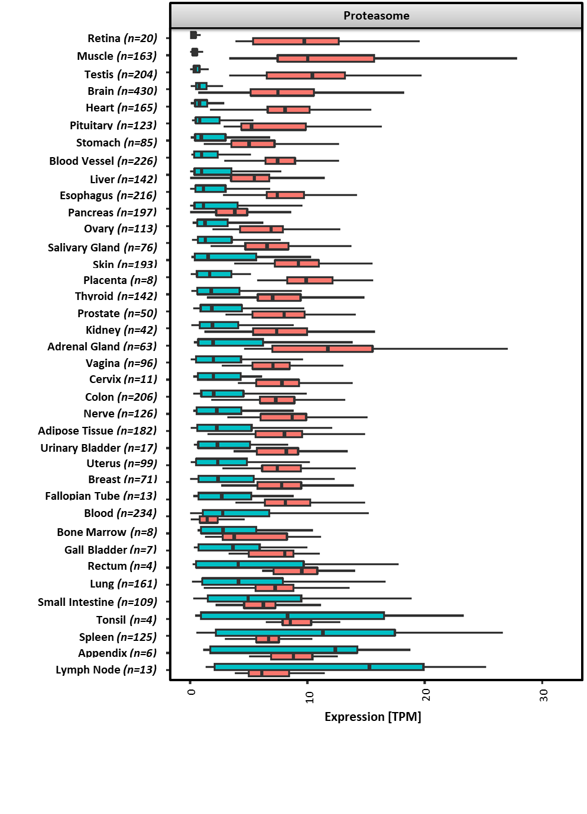

Figure S5
Constitutive
Immuno

Slide 11
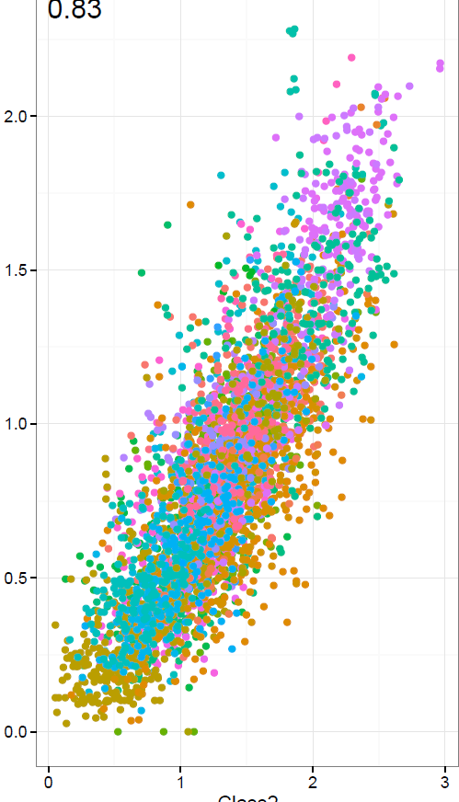
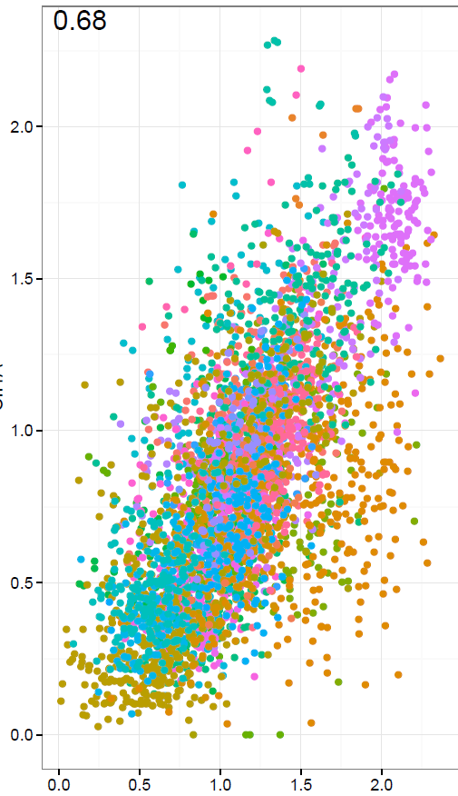
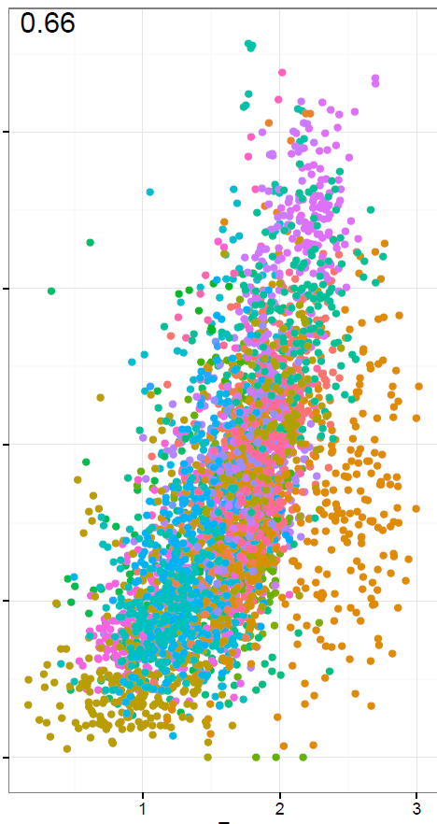
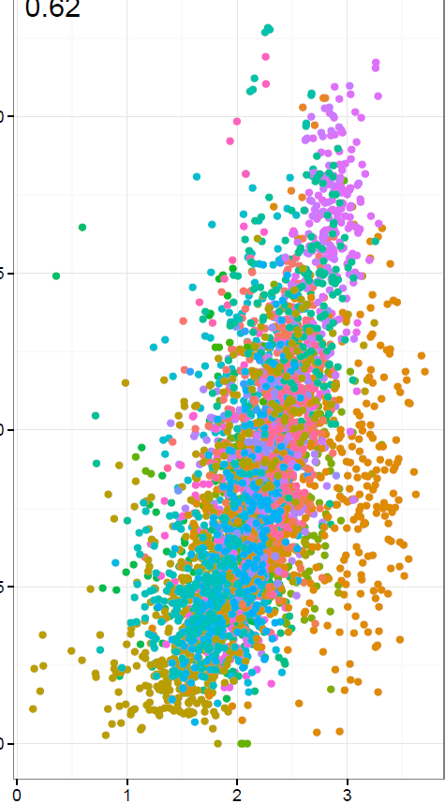
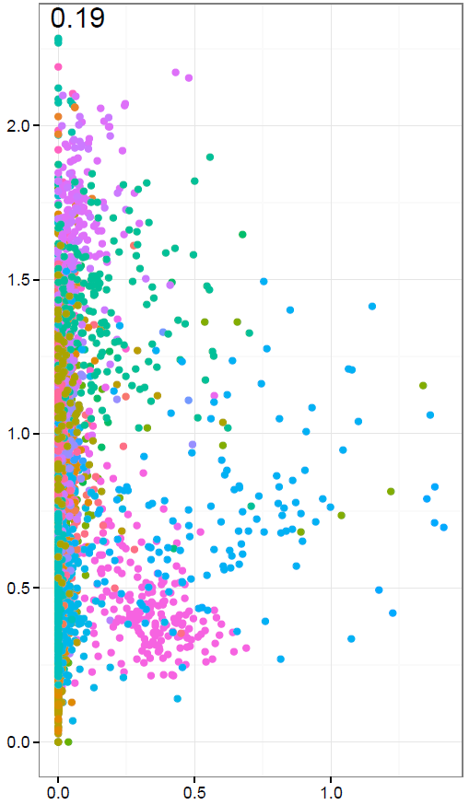
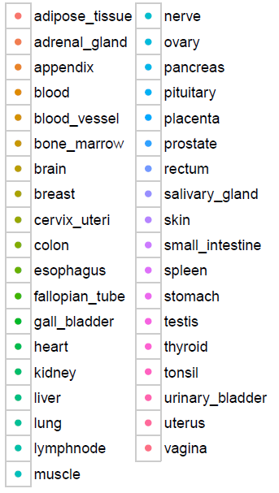
Figure S6
R=0.83
R=0.68
R=0.66
R=0.62
R=0.19
2
1.5
Expression CIITA [log10(RPKM)]
1
0.5
0
0
1
2
3
0
0.5
1
1.5
2
0
1
2
3
0
1
2
3
0
0.5
1
Expression HLA II [log10(RPKM)]
Expression HLA-F [log10(RPKM)]
Expression HLA-E [log10(RPKM)]
Expression classical HLA I [log10(RPKM)]
Expression HLA-G [log10(RPKM)]

Slide 12
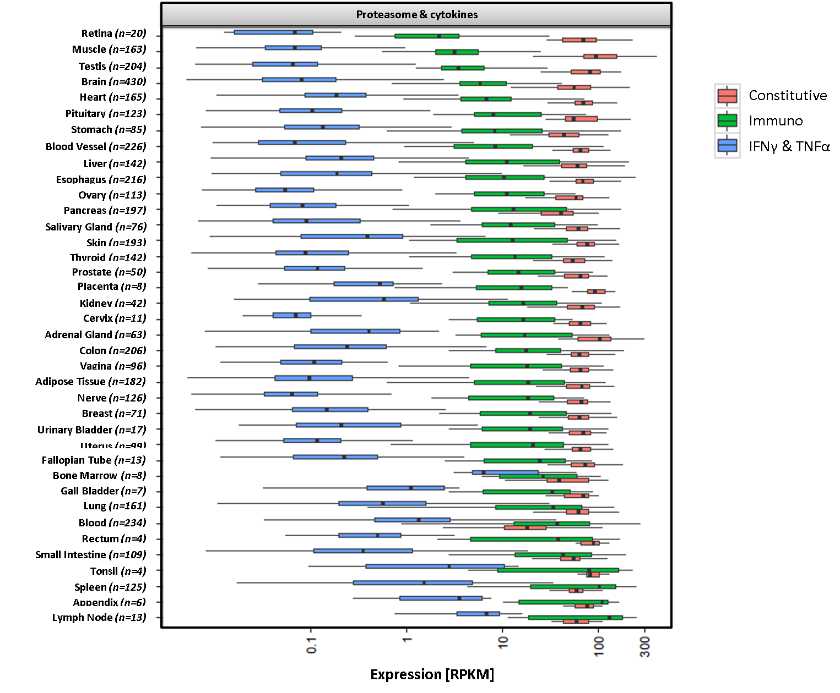
Figure S7

Slide 13
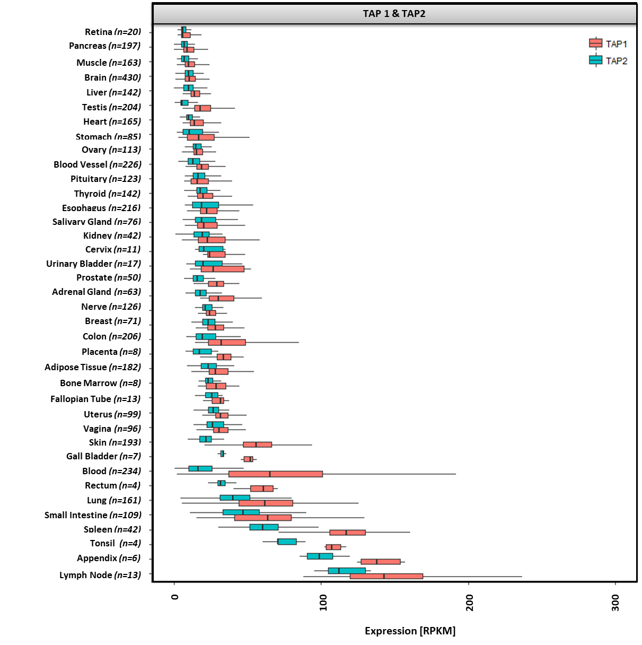
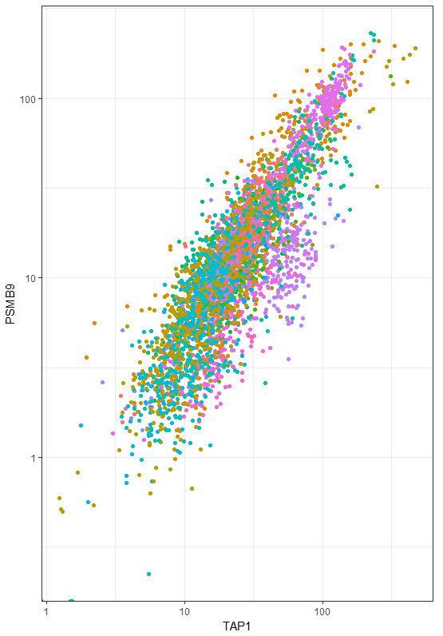
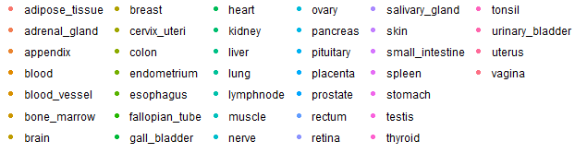
A.
B.
R=0.85
100
10
Expression PSMB9 [RPKM]
1
1
100
10
Expression TAP1 [RPKM]
Figure S8

