Slide 1
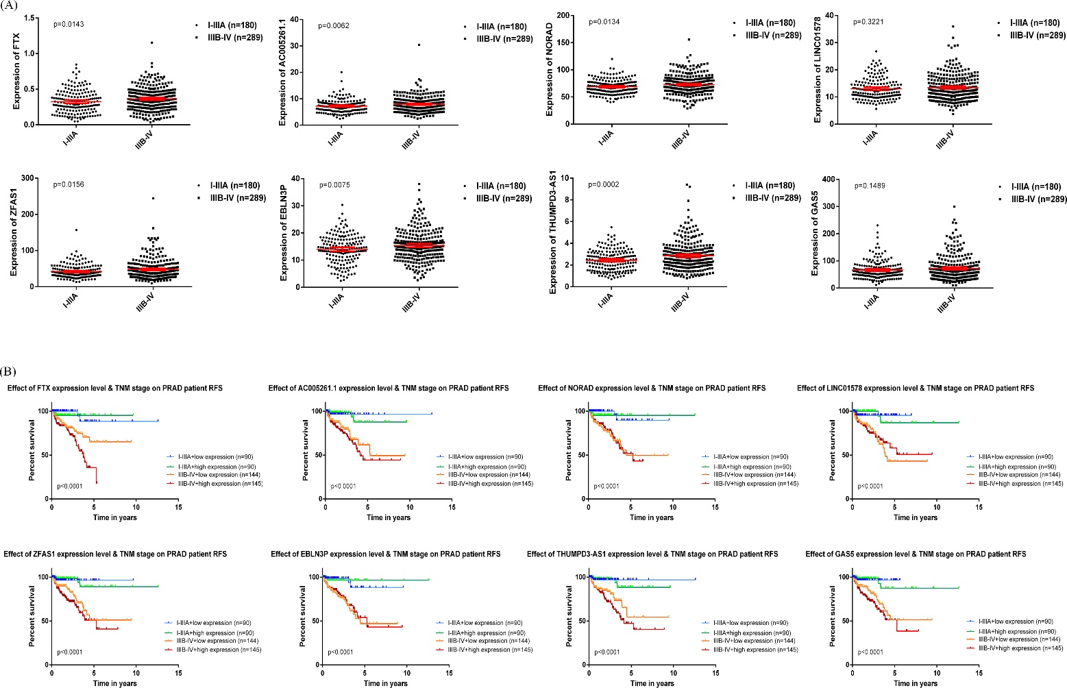
Supplemental Figure 2 Hub lncRNAs validation in tumor tissues from TCGA-PRAD data (A)The expression levels of the 8 hub lncRNAs in I-IIIA stage and IIIB-IV stage group of PCa. (B) RFS curve of the 8 hub lncRNAs in PCa based on Kaplan–Meier analysis and log-rank test. Patients were divided into the high expression level and the low expression level based on the median value in I-IIIA stage or IIIB-IV stage group.

