Slide 1
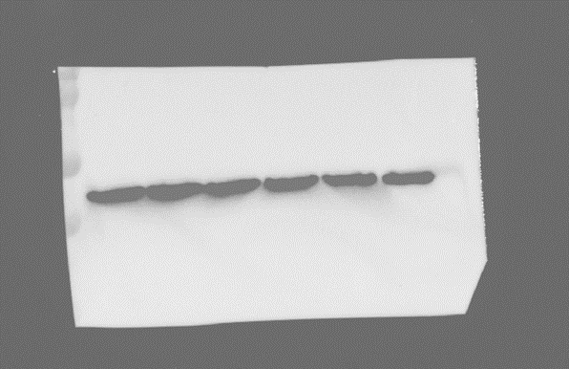
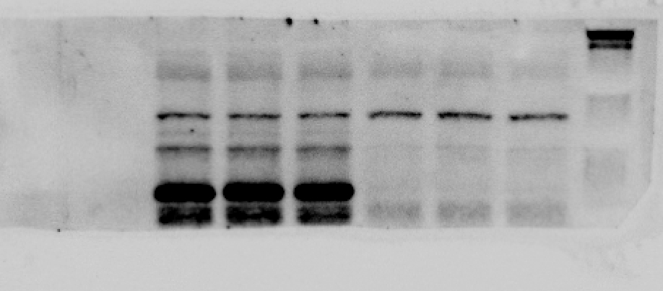
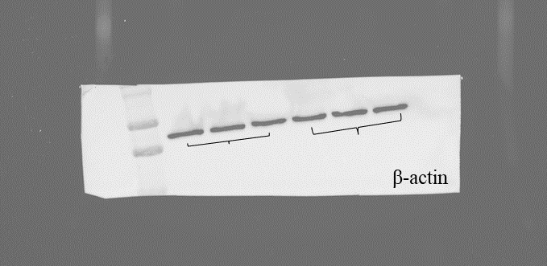
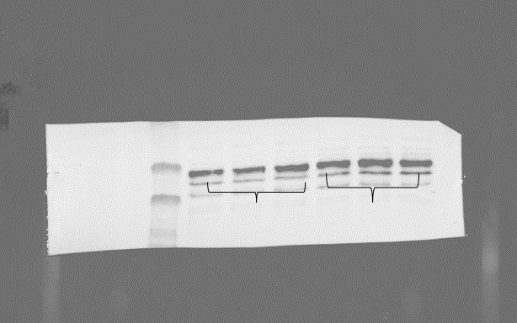
β-actin
PGC1-α
DOMS
Non-DOMS
DOMS
Non-DOMS
AMPK
Non-DOMS
DOMS
Non-DOMS
DOMS

