Slide 1
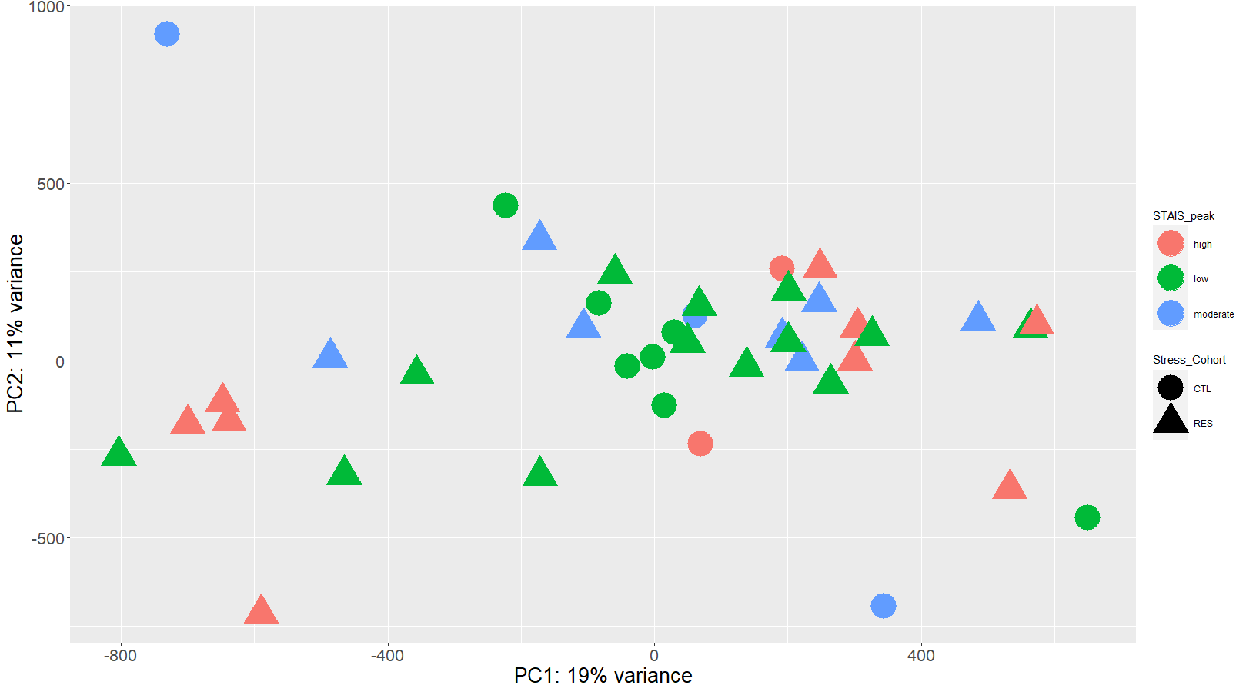
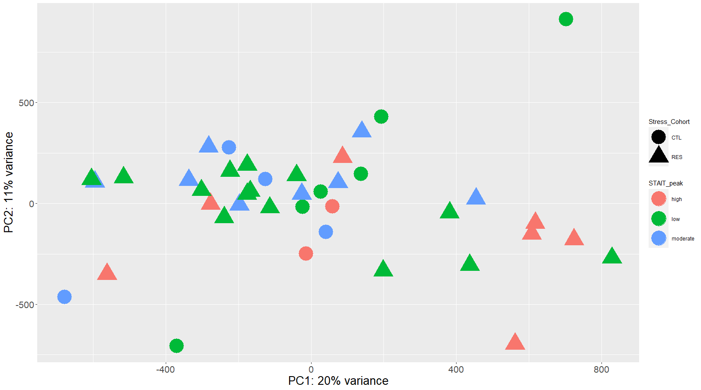
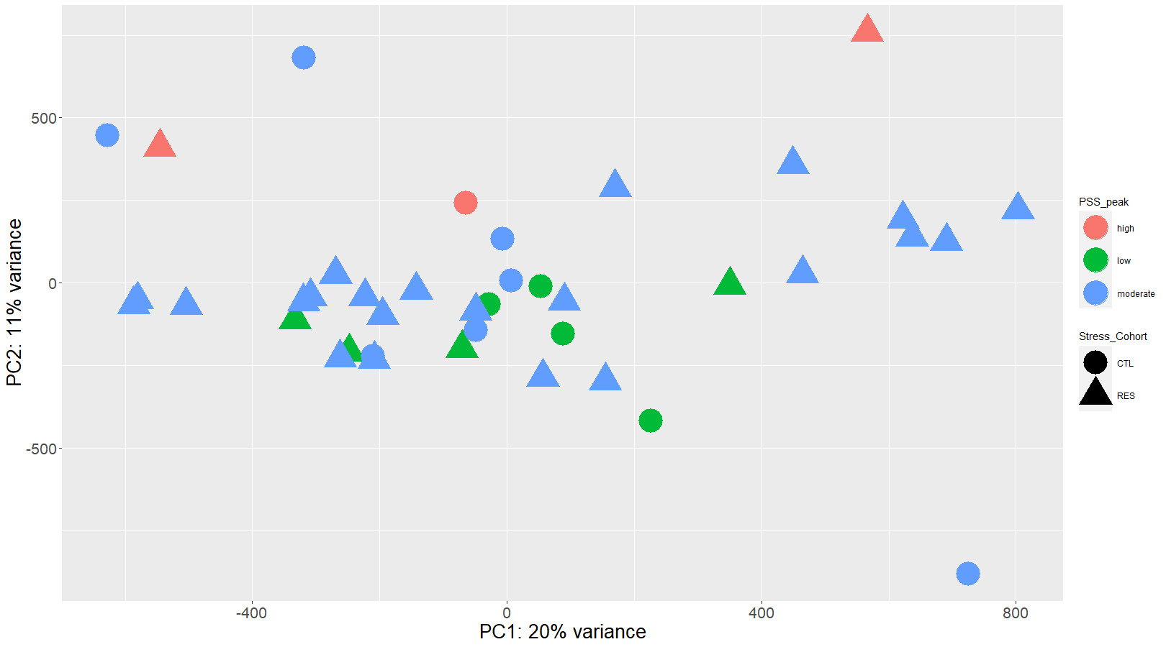
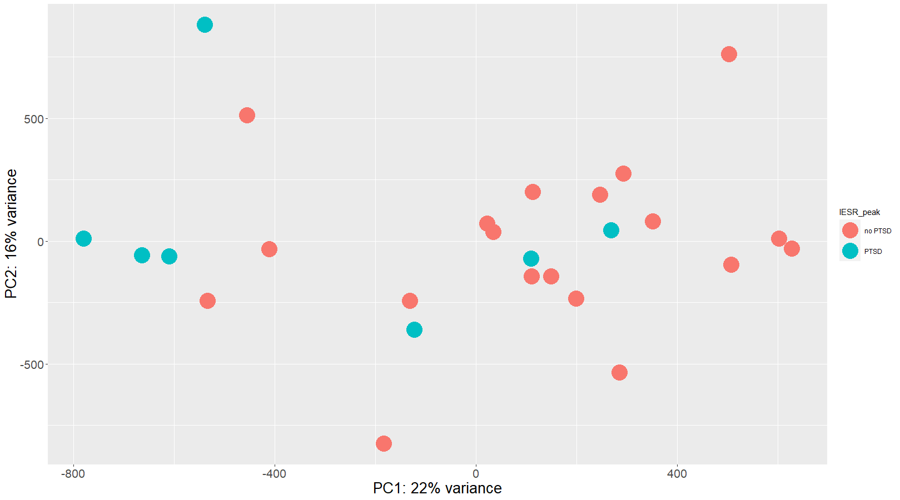
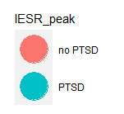
Supplemental Figure S2
A
STAI-S
B
STAI-T
C
PSS
D
IESR
Supplemental Figure S2. Principal Component Analysis of differentially methylated sites for each maternal psychological status assessment instrument: A) STAI-S, B) STAI-T, D) PSS, and D) IESR (for RES only). A-C) triangles represent RES while circles represent CTL; all scores (STAI-S, STAI-T, PSS) are broken down in the following: “low” is green, “moderate” is blue, and “high” is red. D) IES-R scores are dichotomized into “no PTSD” (red) and “PTSD” (teal).There were no differential methylation sites associated with any maternal mental health metric at a statistical threshold of FDR p < 0.05 and log₂ fold-change of 2> or <-2.
Notes:
Supplemental Figure S2. Principal Component Analysis of differentially methylated sites for each maternal psychological status assessment instrument: A) STAI-S, B) STAI-T, D) PSS, and D) IESR (for RES only). A-C) triangles represent RES while circles represent CTL; all scores (STAI-S, STAI-T, PSS) are broken down in the following: “low” is green, “moderate” is blue, and “high” is red. D) IES-R scores are dichotomized into “no PTSD” (red) and “PTSD” (teal).There were no differential methylation sites associated with any maternal mental health metric at a statistical threshold of FDR p < 0.05 and log₂ fold-change of 2> or <-2.

