Slide 1
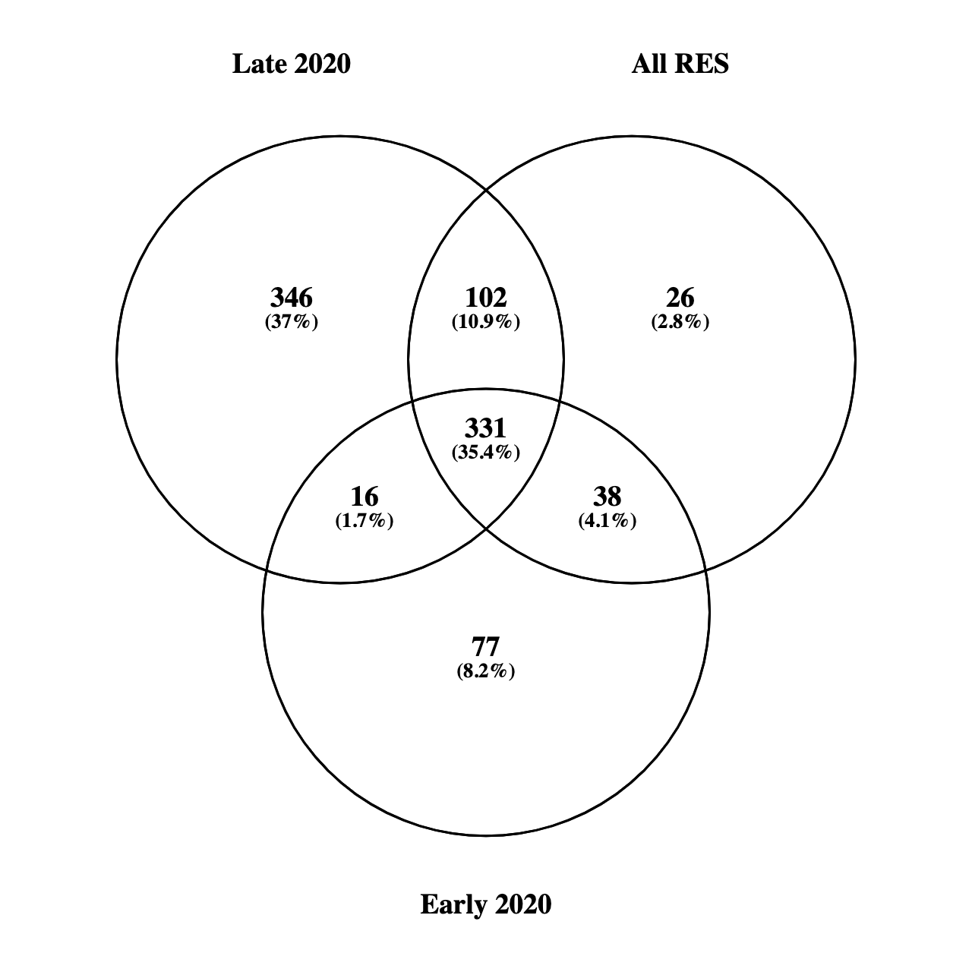
Supplemental Figure 4
Supplemental Figure S4. Venn diagram of unique and overlapping differentially methylated genes between early and late 2020 pandemic RES subcohorts. Annotated gene lists were input into Venny 2.1 to determine different and overlapping DNA methylation signatures between cohorts. Resultant gene lists from each grouping can be found in Supplemental Table S5.
Notes:
Supplemental Figure S4. Venn diagram of unique and overlapping differentially methylated genes between early and late 2020 pandemic RES subcohorts. Annotated gene lists were input into Venny 2.1 to determine different and overlapping DNA methylation signatures between cohorts. Resultant gene lists from each grouping can be found in Supplemental Table S5.

