Slide 1
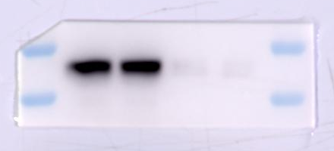
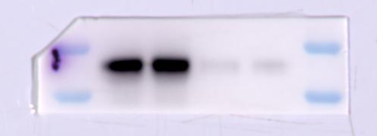
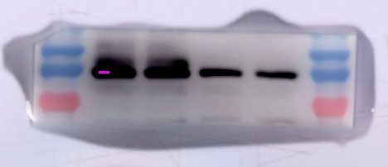
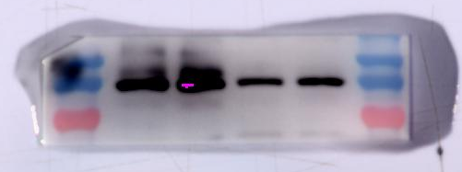
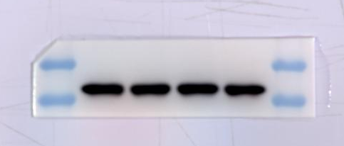
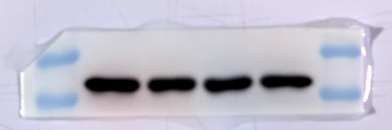
Figure 6G: Western blot analysis of indicated protein expression levels.
WT
sgSEC61G
WT
sgSEC61G
IB: SEC61G
12 kDa
6 kDa
IB: β-Catenin
130 kDa
100 kDa
70 kDa
IB: β-actin
55 kDa
40 kDa

