Slide 1
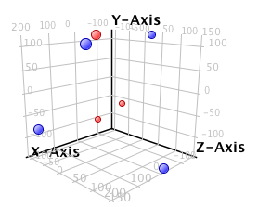
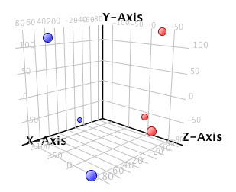
Supplemental data Figure 1.
3D PCA scores
Freshly isolated BECs
ALI cultured BECs
Red: snBA
Blue; stBA
Red: control
Blue; IL-13

