Slide 1
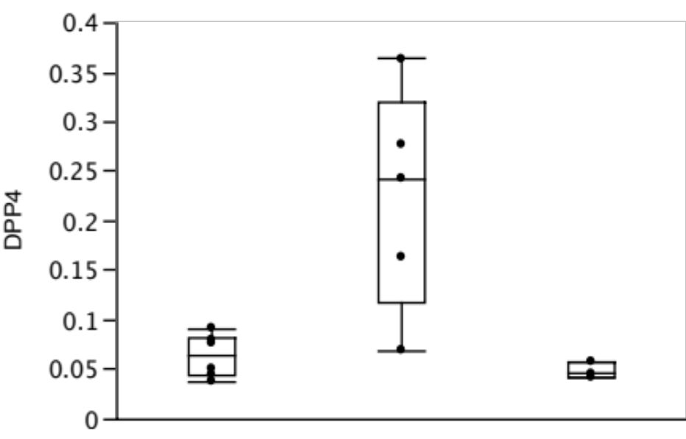
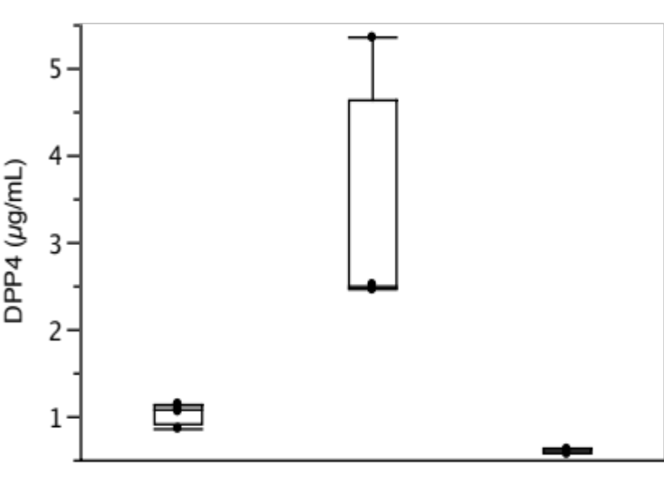
Supplemental Data Figure 2.
*
*
DPP4 mRNA/GAPDH mRNA
DPP4 (ng/ml)
Medium alone
IL-13
(10ng/ml)
MF(10µM)
+
IL-13
(10ng/ml)
Medium alone
IL-13
(10ng/ml)
MF(10µM)
+
IL-13
(10ng/ml)
*P<0.01 vs medium alone, MF+ IL-13 (N=4)

