Slide 1
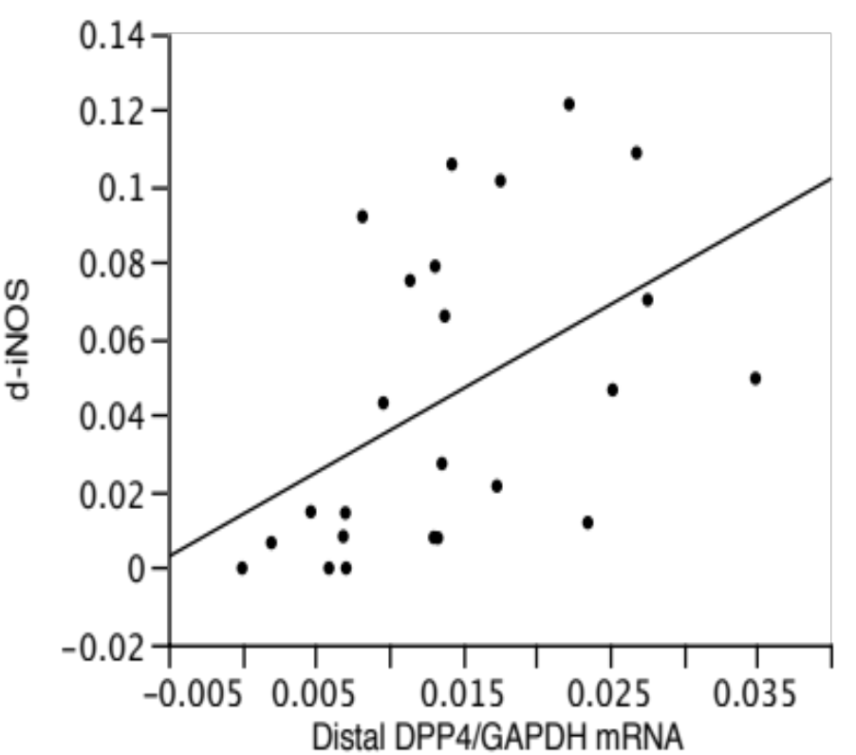
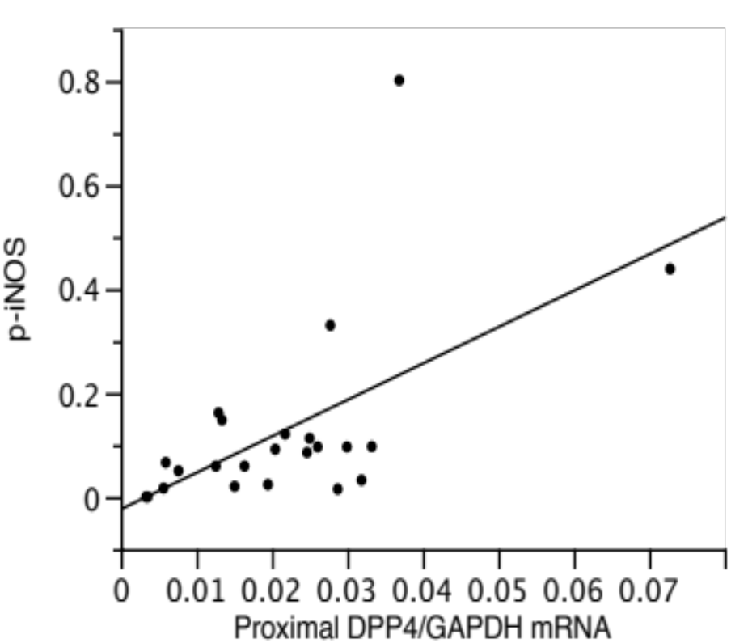
Supplemental data Figure 4
R=0.48
N=24
P=0.0176
R=0.59
N=23
P=0.0033
Distal iNOS mRNA/GAPDH mRNA
Proximal iNOS mRNA/GAPDH mRNA
Distal DPP4 mRNA/GAPDH mRNA
Proximal DPP4 mRNA/GAPDH mRNA

