Slide 1
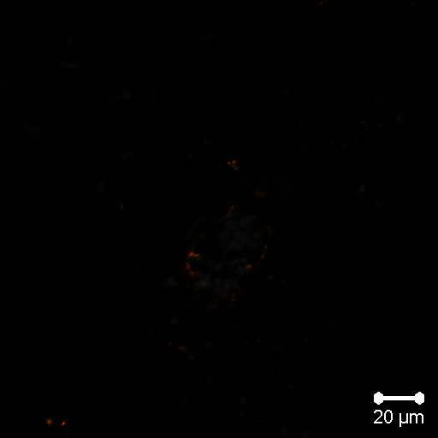
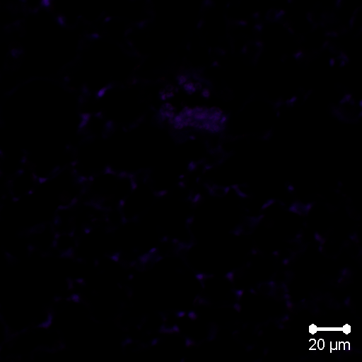
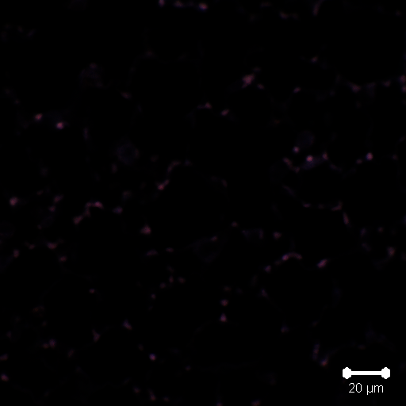
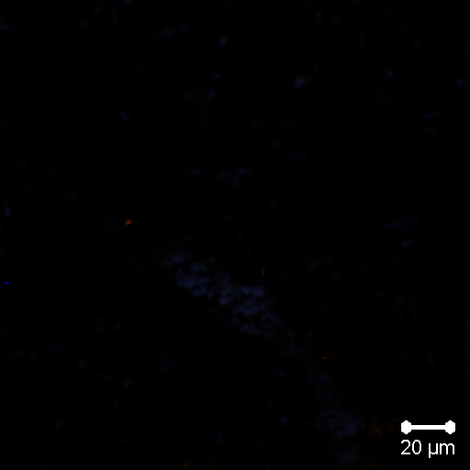
Supplemental Figure 1
Saline
ODE
WT
BCR KO
Notes:
Supplemental Figure 1. Merged confocal images of isotype control antibodies with all 3 channels on each lung tissue section from WT and BCR KO mice treated repetitively with saline or ODE. Zenon 405 labeled rabbit IgG (401 nm to 421 nm) as control for MAA staining, mouse IgM+ anti-mouse IgM Cy3 (550 nm to 570 nm) as control for CIT staining, and ALEXA FLUOR® 594 Conjugated Rabbit IgG as control for CD68 macrophage staining.

Slide 2
Supplemental Figure 1. Merged confocal images of isotype control antibodies with all 3 channels on each lung tissue section from WT and BCR KO mice treated repetitively with saline or ODE. Zenon 405 labeled rabbit IgG (401 nm to 421 nm) as control for MAA staining, mouse IgM+ anti-mouse IgM Cy3 (550 nm to 570 nm) as control for CIT staining, and ALEXA FLUOR® 594 Conjugated Rabbit IgG as control for CD68 macrophage staining.

