Slide 1
Fig-5-D
Western blot original image Repeat 1
FZD3-75kd
GAPDH-37kd

Slide 2
Fig-5-D
Western blot original image Repeat 2
FZD3-75kd
GAPDH-37kd

Slide 3
Fig-5-D
Western blot original image Repeat 3
FZD3-75kd
GAPDH-37kd

Slide 4
Fig-6-A Cutting film
Western blot original image Repeat 1-3
Repeat1
Repeat2
Repeat3
FZD3-75kd
FZD3-75kd
FZD3-75kd
GAPDH-37kd
GAPDH-37kd
GAPDH-37kd

Slide 5
Fig-6-A Whole film
Western blot original image Repeat 1-3
Repeat1
Repeat2
Repeat3

Slide 6
Fig-6-B Cutting film
Western blot original image Repeat 1-3
Repeat1
Repeat2
Repeat3
FZD3-75kd
FZD3-75kd
FZD3-75kd
GAPDH-37kd
GAPDH-37kd
GAPDH-37kd

Slide 7
Fig-6-B Whole film
Western blot original image Repeat 1-3
Repeat1
Repeat2
Repeat3

Slide 8
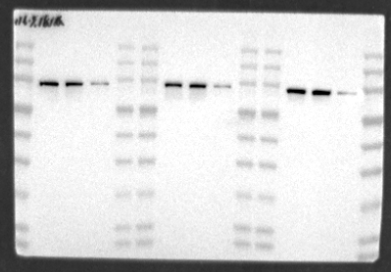
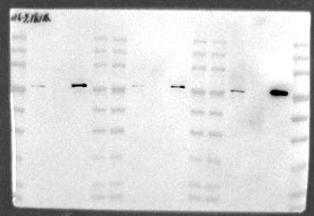
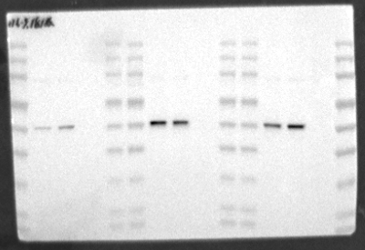
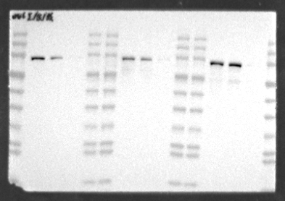
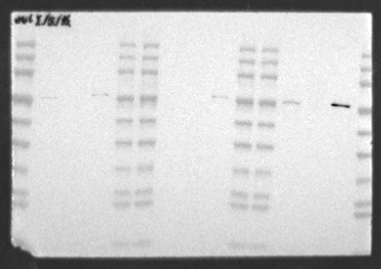
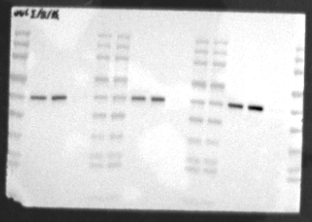
Fig-8-D HCT-116 NCI-H446
Western blot original image Repeat 1-3
β-catenin 85kd
Lamin b1 70kd
β-tubulin 55kd
HCT-116
β-catenin 85kd
Lamin b1 70kd
β-tubulin 55kd
NCI-H446

Slide 9
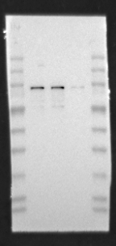
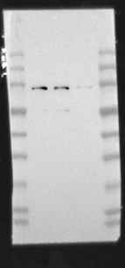
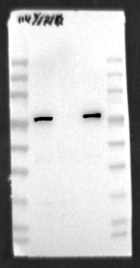
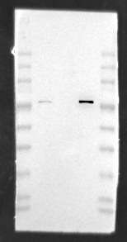

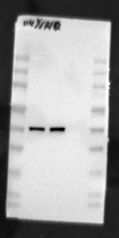
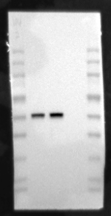
Fig-8-D NCI-H114
Western blot original image Repeat 1-3
β-catenin 85kd
Lamin b1 70kd
β-tubulin 55kd

Slide 10
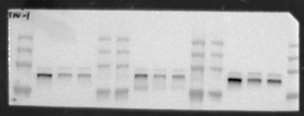
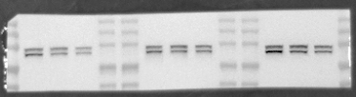
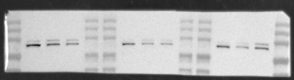
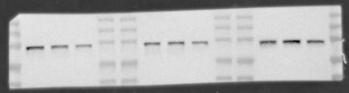
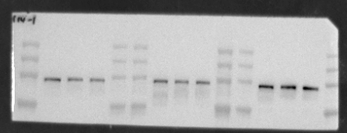
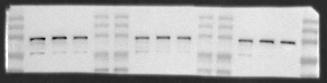
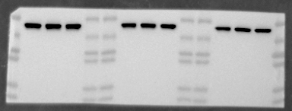
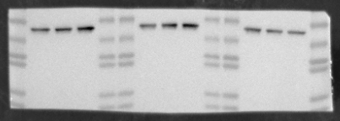
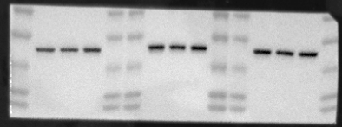
Fig-8-E
Western blot original image Repeat 1-3
FZD3 75kd
FZD3 75kd
FZD3 75kd
β-catenin 85kd
β-catenin 85kd
β-catenin 85kd
GAPDH 37kd
GAPDH 37kd
GAPDH 37kd
HCT-116
NCI-H114
NCI-H446

Slide 11
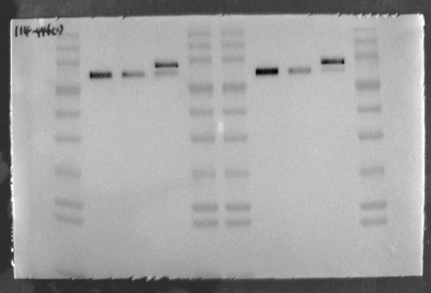
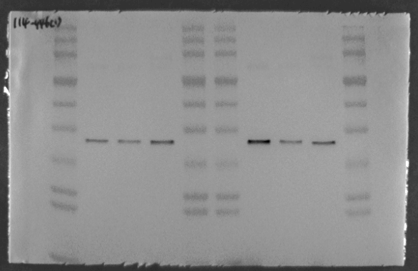
Fig-S2-C
Western blot original image Repeat 1
FZD3 75kd
FZD3 75kd
GAPDH 37kd
GAPDH 37kd
NCI-H114
NCI-H446
NCI-H114
NCI-H446

Slide 12
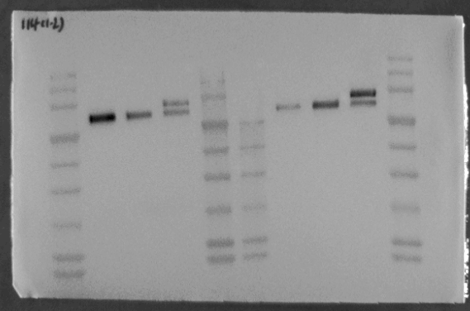
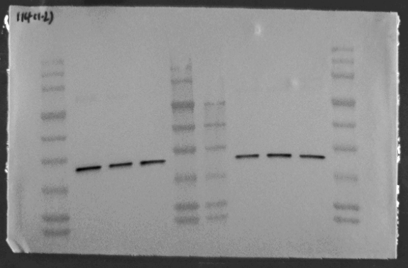
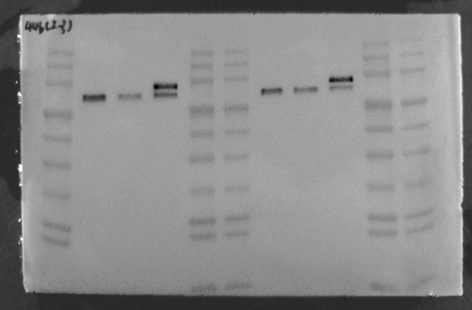
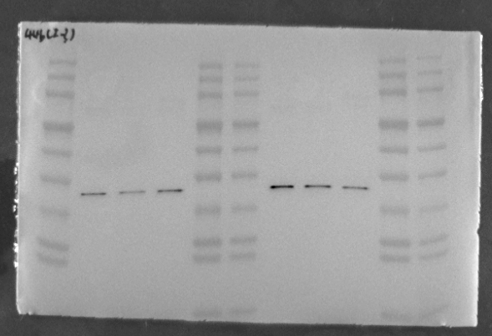
Fig-S2-C
Western blot original image Repeat 2-3
FZD3 75kd
GAPDH 37kd
NCI-H114
FZD3 75kd
GAPDH 37kd
NCI-H446

