Slide 1
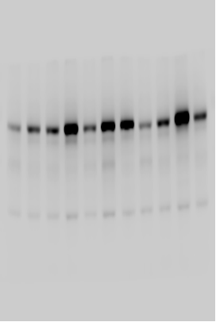
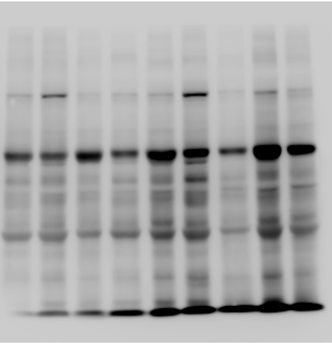
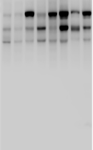
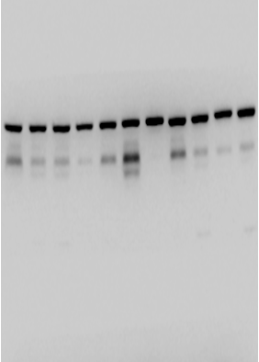
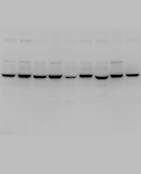
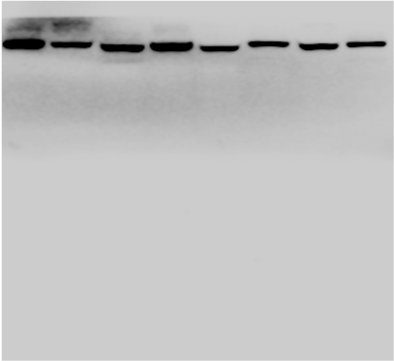
Figure 3-1
Lung tissue
Hyperoxia | - | - | + | +
JWH133 | - | + | - | +
Hyperoxia | - | - | + | +
JWH133 | - | + | - | +
Hyperoxia | - | - | + | +
JWH133 | - | + | - | +
180
70
NF - κB (65)
130
55
100
100
40
70
70
NF - κB (65)
NF - κB (65)
35
55
55
25
40
40
35
35
15
25
Hyperoxia | - | - | + | +
JWH133 | - | + | - | +
Hyperoxia | - | - | + | +
JWH133 | - | + | - | +
Hyperoxia | - | - | + | +
JWH133 | - | + | - | +
180
70
130
Lamin B1 (65)
100
55
70
100
Lamin B1 (65)
70
40
55
35
Lamin B1 (65)
55
40
25
40
35
35
25
15

Slide 2
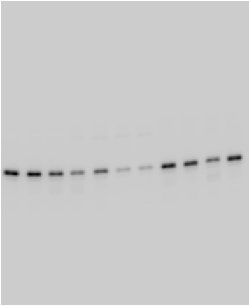
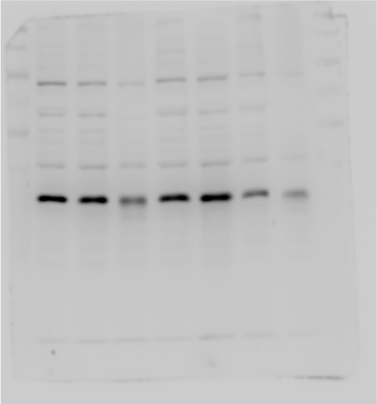
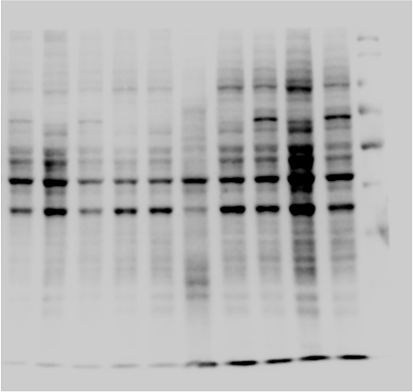
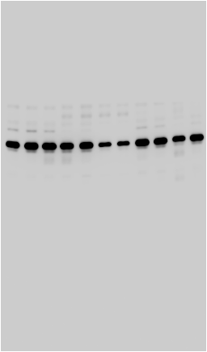
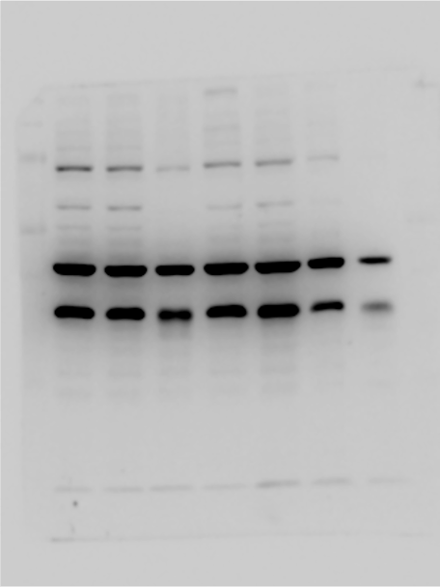
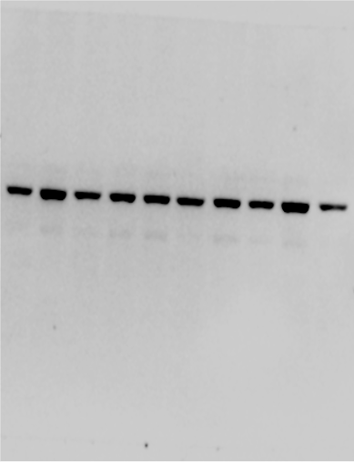
Figure 3-2
Lung tissue
Hyperoxia | - | - | + | +
JWH133 | - | + | - | +
Hyperoxia | - | - | + | +
JWH133 | - | + | - | +
Hyperoxia | - | - | + | +
JWH133 | - | + | - | +
180
180
180
130
130
130
100
100
100
70
70
70
55
55
55
40
40
IκB – α (37)
40
35
IκB – α (37)
IκB – α (37)
35
35
25
25
25
15
15
15
Hyperoxia | - | - | + | +
JWH133 | - | + | - | +
Hyperoxia | - | - | + | +
JWH133 | - | + | - | +
Hyperoxia | - | - | + | +
JWH133 | - | + | - | +
180
180
180
130
130
130
100
100
100
70
70
70
55
55
55
β - actin (42)
β - actin (42)
40
40
β - actin (42)
40
35
35
35
25
25
25
15
15
15

Slide 3
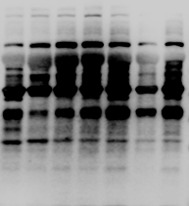
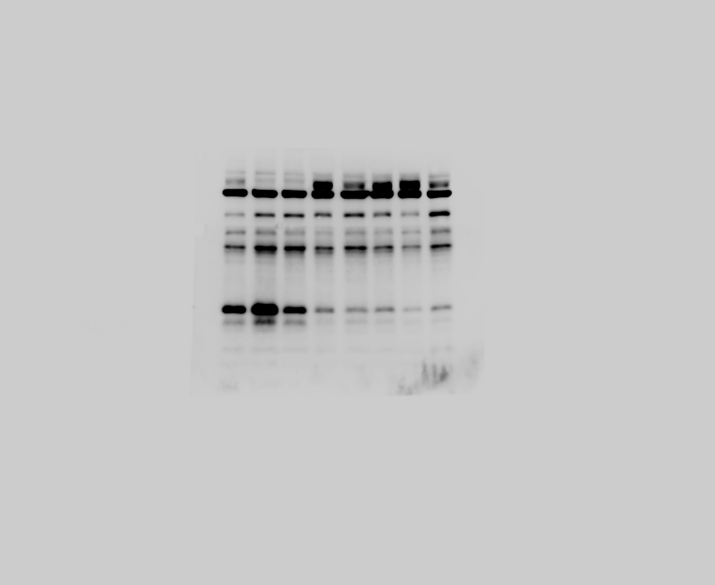
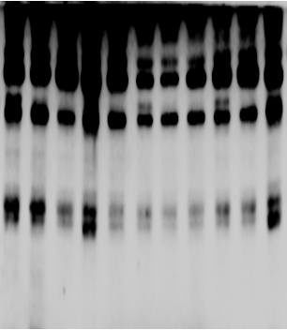
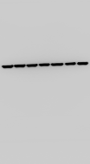
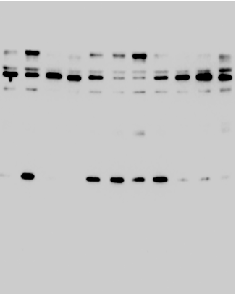
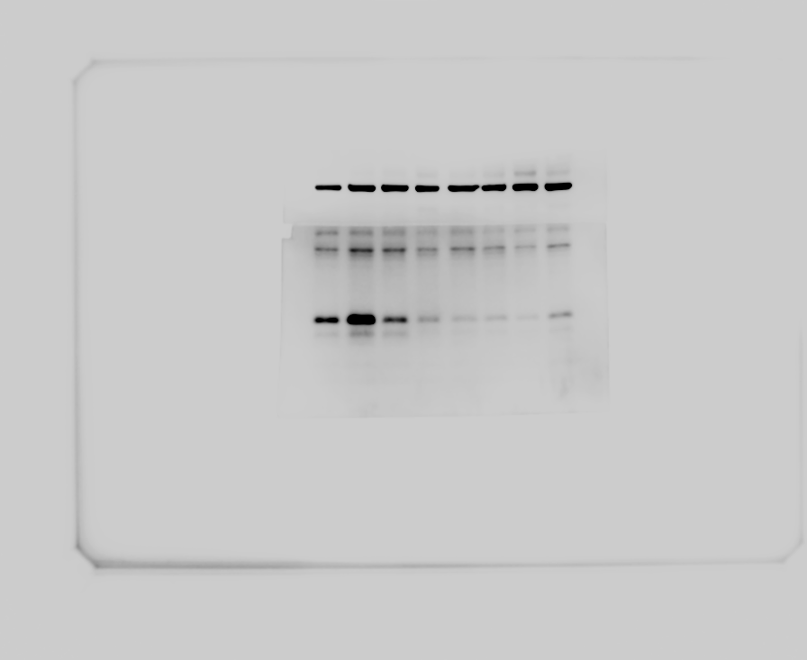
Figure 3-3
Lung tissue
Hyperoxia | - | - | + | +
JWH133 | - | + | - | +
Hyperoxia | - | - | + | +
JWH133 | - | + | - | +
180
Hyperoxia | - | - | + | +
JWH133 | - | + | - | +
130
70
100
70
55
55
55
40
40
40
35
35
35
Bcl - 2 (26)
Bcl - 2 (26)
25
25
Bcl - 2 (26)
25
15
15
Hyperoxia | - | - | + | +
JWH133 | - | + | - | +
Hyperoxia | - | - | + | +
JWH133 | - | + | - | +
Hyperoxia | - | - | + | +
JWH133 | - | + | - | +
180
130
70
100
55
55
70
β - actin (42)
β - actin (42)
55
40
40
35
40
35
β - actin (42)
35
25
25
25
15
15

Slide 4
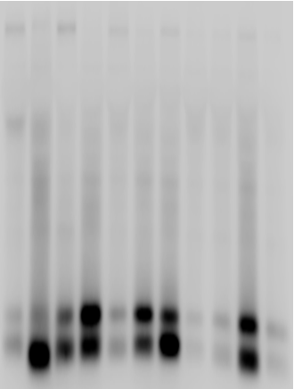

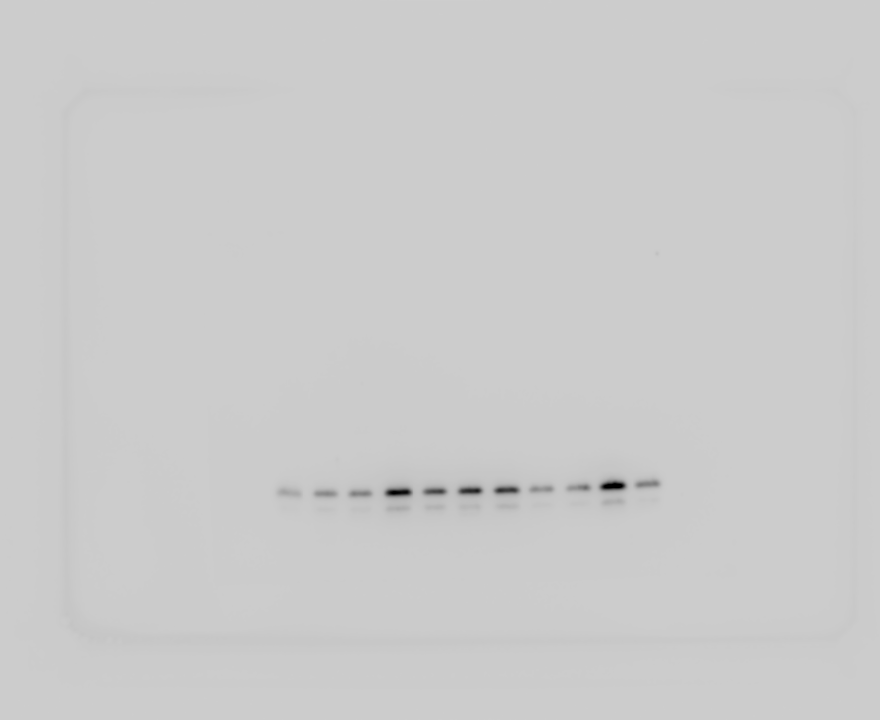
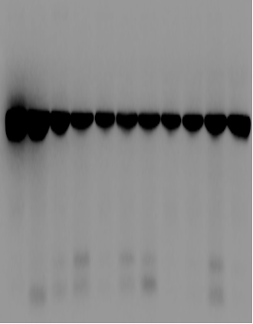
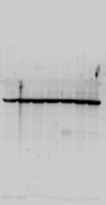
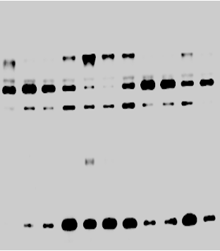
Figure 3-4
Lung tissue
Hyperoxia | - | - | + | +
JWH133 | - | + | - | +
Hyperoxia | - | - | + | +
JWH133 | - | + | - | +
Hyperoxia | - | - | + | +
JWH133 | - | + | - | +
180
180
180
130
130
130
100
100
100
70
70
70
55
55
55
40
40
40
35
35
35
25
25
25
Cleaved caspase - 3
(17,19)
Cleaved caspase - 3
(17,19)
Cleaved caspase - 3
(17,19)
15
15
15
Hyperoxia | - | - | + | +
JWH133 | - | + | - | +
Hyperoxia | - | - | + | +
JWH133 | - | + | - | +
Hyperoxia | - | - | + | +
JWH133 | - | + | - | +
180
180
130
130
130
100
100
100
70
70
70
55
55
55
β - actin (42)
β - actin (42)
β - actin (42)
40
40
40
35
35
35
25
25
25
15
15
15

Slide 5


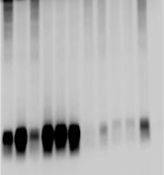
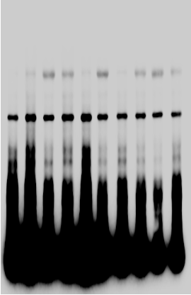
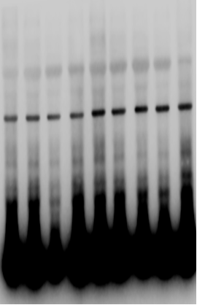
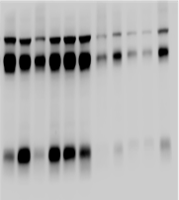
Figure 4-1
Lung tissue
Hyperoxia | - | - | + | +
JWH133 | - | + | - | +
Hyperoxia | - | - | + | +
JWH133 | - | + | - | +
Hyperoxia | - | - | + | +
JWH133 | - | + | - | +
180
180
55
130
130
100
100
40
70
70
55
55
35
40
40
25
35
35
25
25
GPx4 (19)
GPx4 (19)
GPx4 (19)
15
15
15
Hyperoxia | - | - | + | +
JWH133 | - | + | - | +
Hyperoxia | - | - | + | +
JWH133 | - | + | - | +
Hyperoxia | - | - | + | +
JWH133 | - | + | - | +
180
55
180
130
β - actin (42)
130
100
40
100
70
70
55
35
55
β - actin (42)
β - actin (42)
40
40
35
25
35
25
25
15
15
15

Slide 6
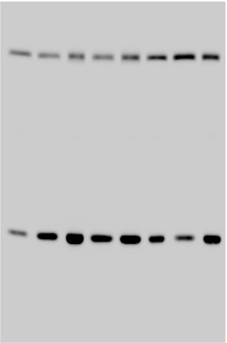
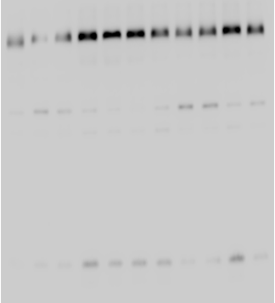
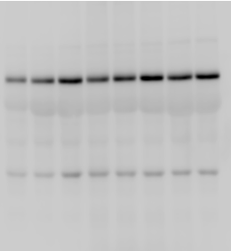
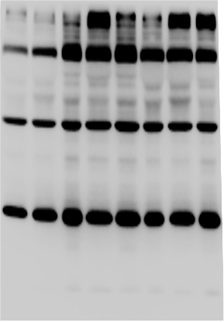
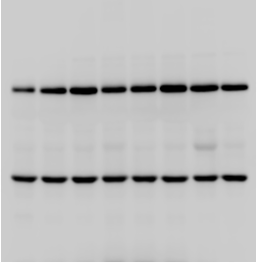
Figure 4-2
Lung tissue
Hyperoxia | - | - | + | +
JWH133 | - | + | - | +
Hyperoxia | - | - | + | +
JWH133 | - | + | - | +
Hyperoxia | - | - | + | +
JWH133 | - | + | - | +
130
130
130
ACSL4(79)
100
100
70
ACSL4(79)
70
100
55
55
ACSL4(79)
70
40
40
55
35
35
40
25
25
15
15
Hyperoxia | - | - | + | +
JWH133 | - | + | - | +
Hyperoxia | - | - | + | +
JWH133 | - | + | - | +
Hyperoxia | - | - | + | +
JWH133 | - | + | - | +
130
100
130
130
70
100
70
100
55
55
β - actin (42)
β - actin (42)
β - actin (42)
70
40
40
55
35
35
25
25
40
15
15

Slide 7
Fig 5 B and C, lung tissue

Slide 8
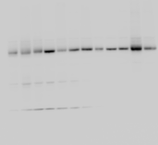
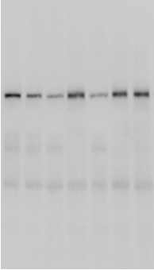
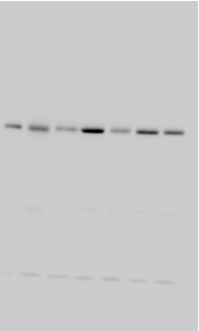
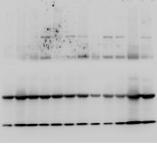
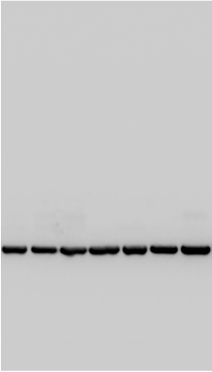
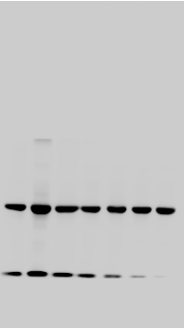
Figure 6-1
Cell
Hyperoxia | - | - | - | + | + | + | +
JWH133 | - | + | - | - | + | - | +
GPX4 siRNA | - | - | + | - | - | + | +
Hyperoxia | - | - | - | + | + | + | +
JWH133 | - | + | - | - | + | - | +
GPX4 siRNA | - | - | + | - | - | + | +
Hyperoxia | - | - | - | + | + | + | +
JWH133 | - | + | - | - | + | - | +
GPX4 siRNA | - | - | + | - | - | + | +
180
180
180
130
130
130
100
100
100
ACSL4(79)
70
ACSL4(79)
ACSL4(79)
70
70
55
55
55
40
40
40
35
35
35
Hyperoxiac | - | - | - | + | + | + | +
JWH133 | - | + | - | - | + | - | +
GPX4 siRNA | - | - | + | - | - | + | +
Hyperoxiac | - | - | - | + | + | + | +
JWH133 | - | + | - | - | + | - | +
GPX4 siRNA | - | - | + | - | - | + | +
Hyperoxia | - | - | - | + | + | + | +
JWH133 | - | + | - | - | + | - | +
GPX4 siRNA | - | - | + | - | - | + | +
180
180
180
130
130
130
100
100
100
70
70
70
55
55
55
β - actin (42)
β - actin (42)
40
β - actin (42)
40
40
35
35
35

Slide 9

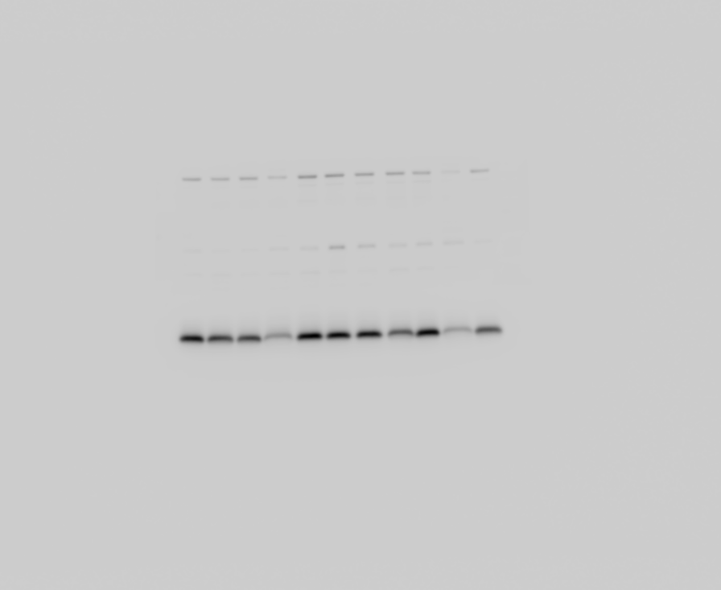

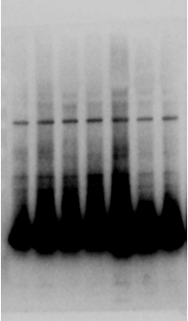
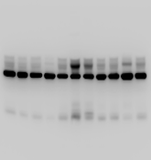
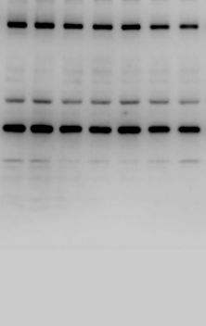
Figure 6-2
Cell
Hyperoxia | - | - | - | + | + | + | +
JWH133 | - | + | - | - | + | - | +
GPX4 siRNA | - | - | + | - | - | + | +
Hyperoxia | - | - | - | + | + | + | +
JWH133 | - | + | - | - | + | - | +
GPX4 siRNA | - | - | + | - | - | + | +
Hyperoxia | - | - | - | + | + | + | +
JWH133 | - | + | - | - | + | - | +
GPX4 siRNA | - | - | + | - | - | + | +
180
180
180
130
130
130
100
100
100
70
70
70
55
55
55
40
40
40
35
35
35
25
25
25
GPx4 (19)
GPx4 (19)
GPx4 (19)
15
15
15
Hyperoxia | - | - | - | + | + | + | +
JWH133 | - | + | - | - | + | - | +
GPX4 siRNA | - | - | + | - | - | + | +
Hyperoxia | - | - | - | + | + | + | +
JWH133 | - | + | - | - | + | - | +
GPX4 siRNA | - | - | + | - | - | + | +
Hyperoxia | - | - | - | + | + | + | +
JWH133 | - | + | - | - | + | - | +
GPX4 siRNA | - | - | + | - | - | + | +
180
180
180
130
130
130
100
100
100
70
70
70
55
55
55
β - actin (42)
β - actin (42)
β - actin (42)
40
40
40
35
35
35
25
25
25
15
15
15

Slide 10
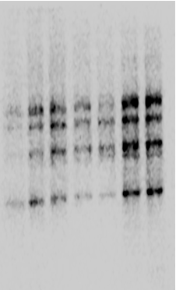
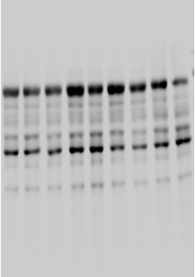
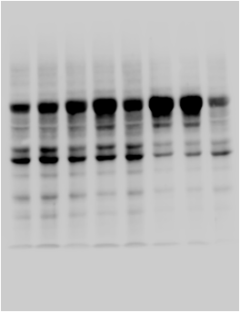
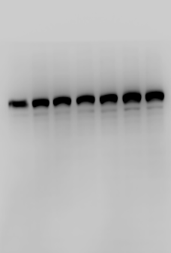
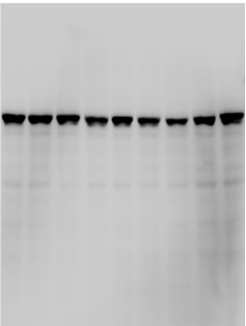
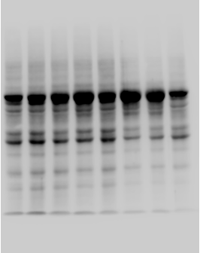
Figure 7-1
Cell
Hyperoxia | - | - | - | + | + | + | +
JWH133 | - | + | - | - | + | - | +
GPX4 siRNA | - | - | + | - | - | + | +
Hyperoxia | - | - | - | + | + | + | +
JWH133 | - | + | - | - | + | - | +
GPX4 siRNA | - | - | + | - | - | + | +
Hyperoxia | - | - | - | + | + | + | +
JWH133 | - | + | - | - | + | - | +
GPX4 siRNA | - | - | + | - | - | + | +
180
180
130
180
130
100
130
100
70
100
pNF - κB (65)
70
pNF - κB (65)
70
55
pNF - κB (65)
55
55
40
40
40
35
35
35
25
25
25
Hyperoxia | - | - | - | + | + | + | +
JWH133 | - | + | - | - | + | - | +
GPX4 siRNA | - | - | + | - | - | + | +
Hyperoxia | - | - | - | + | + | + | +
JWH133 | - | + | - | - | + | - | +
GPX4 siRNA | - | - | + | - | - | + | +
Hyperoxia | - | - | - | + | + | + | +
JWH133 | - | + | - | - | + | - | +
GPX4 siRNA | - | - | + | - | - | + | +
180
180
130
180
130
100
130
100
70
100
NF - κB (65)
70
NF - κB (65)
NF - κB (65)
70
55
55
55
40
40
40
35
35
35
25
25
25
20230427-cell

Slide 11
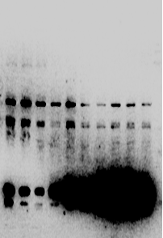
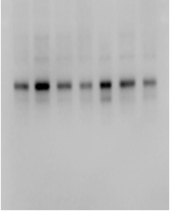




Figure 7-2
Cell
Hyperoxia | - | - | - | + | + | + | +
JWH133 | - | + | - | - | + | - | +
GPX4 siRNA | - | - | + | - | - | + | +
Hyperoxia | - | - | - | + | + | + | +
JWH133 | - | + | - | - | + | - | +
GPX4 siRNA | - | - | + | - | - | + | +
Hyperoxia | - | - | - | + | + | + | +
JWH133 | - | + | - | - | + | - | +
GPX4 siRNA | - | - | + | - | - | + | +
180
180
130
130
180
100
100
130
70
70
100
55
55
70
40
40
55
35
40
35
IκB – α (37)
IκB – α (37)
IκB – α (37)
35
25
25
25
15
15
15
Hyperoxia | - | - | - | + | + | + | +
JWH133 | - | + | - | - | + | - | +
GPX4 siRNA | - | - | + | - | - | + | +
Hyperoxia | - | - | - | + | + | + | +
JWH133 | - | + | - | - | + | - | +
GPX4 siRNA | - | - | + | - | - | + | +
Hyperoxia | - | - | - | + | + | + | +
JWH133 | - | + | - | - | + | - | +
GPX4 siRNA | - | - | + | - | - | + | +
180
180
130
130
180
100
100
130
70
70
100
55
55
70
β - actin (42)
β - actin (42)
40
55
40
β - actin (42)
35
35
40
35
25
25
25
15
15
15

Slide 12






Figure 9-1
Lung tissue
Hyperoxia | - | - | - | + | + | + | +
JWH133 | - | + | - | - | + | - | +
GPX4 siRNA | - | - | + | - | - | + | +
Hyperoxia | - | - | - | + | + | + | +
JWH133 | - | + | - | - | + | - | +
GPX4 siRNA | - | - | + | - | - | + | +
Hyperoxia | - | - | - | + | + | + | +
JWH133 | - | + | - | - | + | - | +
GPX4 siRNA | - | - | + | - | - | + | +
180
180
180
130
130
130
100
100
100
70
70
70
NF - κB (65)
NF - κB (65)
NF - κB (65)
55
55
55
40
40
40
35
35
35
Hyperoxia | - | - | - | + | + | + | +
JWH133 | - | + | - | - | + | - | +
GPX4 siRNA | - | - | + | - | - | + | +
Hyperoxia | - | - | - | + | + | + | +
JWH133 | - | + | - | - | + | - | +
GPX4 siRNA | - | - | + | - | - | + | +
Hyperoxia | - | - | - | + | + | + | +
JWH133 | - | + | - | - | + | - | +
GPX4 siRNA | - | - | + | - | - | + | +
180
180
180
130
130
130
100
100
100
70
Lamin B1 (65)
70
70
Lamin B1 (65)
Lamin B1 (65)
55
55
55
40
40
40
35
35
35

Slide 13






Figure 9-2
Lung tissue
Hyperoxia | - | - | - | + | + | + | +
JWH133 | - | + | - | - | + | - | +
GPX4 siRNA | - | - | + | - | - | + | +
Hyperoxia | - | - | - | + | + | + | +
JWH133 | - | + | - | - | + | - | +
GPX4 siRNA | - | - | + | - | - | + | +
Hyperoxia | - | - | - | + | + | + | +
JWH133 | - | + | - | - | + | - | +
GPX4 siRNA | - | - | + | - | - | + | +
70
70
70
55
55
55
40
40
40
IκB – α (37)
IκB – α (37)
IκB – α (37)
35
35
35
Hyperoxia | - | - | - | + | + | + | +
JWH133 | - | + | - | - | + | - | +
GPX4 siRNA | - | - | + | - | - | + | +
Hyperoxia | - | - | - | + | + | + | +
JWH133 | - | + | - | - | + | - | +
GPX4 siRNA | - | - | + | - | - | + | +
Hyperoxia | - | - | - | + | + | + | +
JWH133 | - | + | - | - | + | - | +
GPX4 siRNA | - | - | + | - | - | + | +
70
70
70
55
55
55
β - actin (42)
β - actin (42)
β - actin (42)
40
40
40
35
35
35

Slide 14






Figure 9-3
Lung tissue
Hyperoxia | - | - | - | + | + | + | +
JWH133 | - | + | - | - | + | - | +
GPX4 siRNA | - | - | + | - | - | + | +
Hyperoxia | - | - | - | + | + | + | +
JWH133 | - | + | - | - | + | - | +
GPX4 siRNA | - | - | + | - | - | + | +
Hyperoxia | - | - | - | + | + | + | +
JWH133 | - | + | - | - | + | - | +
GPX4 siRNA | - | - | + | - | - | + | +
180
130
70
100
70
70
55
55
55
40
40
40
35
35
35
Bcl - 2 (26)
Bcl - 2 (26)
Bcl - 2 (26)
25
25
25
Hyperoxia | - | - | - | + | + | + | +
JWH133 | - | + | - | - | + | - | +
GPX4 siRNA | - | - | + | - | - | + | +
Hyperoxia | - | - | - | + | + | + | +
JWH133 | - | + | - | - | + | - | +
GPX4 siRNA | - | - | + | - | - | + | +
Hyperoxia | - | - | - | + | + | + | +
JWH133 | - | + | - | - | + | - | +
GPX4 siRNA | - | - | + | - | - | + | +
180
70
130
100
70
55
70
β - actin (42)
55
55
40
β - actin (42)
β - actin (42)
40
40
35
35
35
25
25
25

Slide 15






Figure 9-4
Lung tissue
Hyperoxia | - | - | - | + | + | + | +
JWH133 | - | + | - | - | + | - | +
GPX4 siRNA | - | - | + | - | - | + | +
Hyperoxia | - | - | - | + | + | + | +
JWH133 | - | + | - | - | + | - | +
GPX4 siRNA | - | - | + | - | - | + | +
Hyperoxia | - | - | - | + | + | + | +
JWH133 | - | + | - | - | + | - | +
GPX4 siRNA | - | - | + | - | - | + | +
180
180
130
130
180
100
100
130
70
70
100
55
55
70
40
40
55
40
35
35
35
25
25
25
Cleaved caspase - 3
(17,19)
Cleaved caspase - 3
(17,19)
Cleaved caspase - 3
(17,19)
15
15
15
Hyperoxia | - | - | - | + | + | + | +
JWH133 | - | + | - | - | + | - | +
GPX4 siRNA | - | - | + | - | - | + | +
Hyperoxia | - | - | - | + | + | + | +
JWH133 | - | + | - | - | + | - | +
GPX4 siRNA | - | - | + | - | - | + | +
Hyperoxia | - | - | - | + | + | + | +
JWH133 | - | + | - | - | + | - | +
GPX4 siRNA | - | - | + | - | - | + | +
180
130
180
180
100
130
130
70
100
100
55
70
70
β - actin (42)
55
55
40
β - actin (42)
β - actin (42)
35
40
40
25
35
35
25
25
15
15
15

Slide 16






Figure 10
Hyperoxia | - | - | - | + | + | + | +
JWH133 | - | + | - | - | + | - | +
GPX4 siRNA | - | - | + | - | - | + | +
Hyperoxia | - | - | - | + | + | + | +
JWH133 | - | + | - | - | + | - | +
GPX4 siRNA | - | - | + | - | - | + | +
Hyperoxia | - | - | - | + | + | + | +
JWH133 | - | + | - | - | + | - | +
GPX4 siRNA | - | - | + | - | - | + | +
55
55
55
40
40
40
35
35
35
HO-1(32)
HO-1(32)
HO-1(32)
25
25
25
Hyperoxia | - | - | - | + | + | + | +
JWH133 | - | + | - | - | + | - | +
GPX4 siRNA | - | - | + | - | - | + | +
Hyperoxia | - | - | - | + | + | + | +
JWH133 | - | + | - | - | + | - | +
GPX4 siRNA | - | - | + | - | - | + | +
Hyperoxia | - | - | - | + | + | + | +
JWH133 | - | + | - | - | + | - | +
GPX4 siRNA | - | - | + | - | - | + | +
55
55
55
β - actin (42)
β - actin (42)
β - actin (42)
40
40
40
35
35
35
25
25
25

Slide 17
Supplementary Fig. 2A

