Slide 1
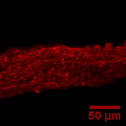
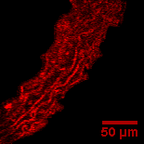
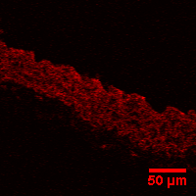
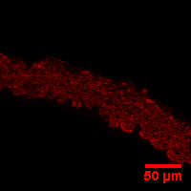
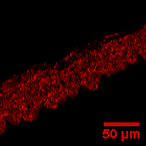
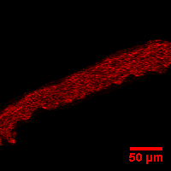
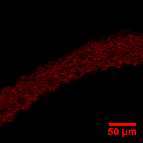
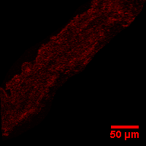
Supplementary Figure 1
DHE
DHE + TEMPOL
WT +Vehicle
Akita +Vehicle
WT +Vehicle
Akita +Vehicle
50 µm
50 µm
50 µm
50 µm
WT + DH404
Akita + DH404
WT + DH404
Akita + DH404
50 µm
50 µm
50 µm
50 µm

