Slide 1
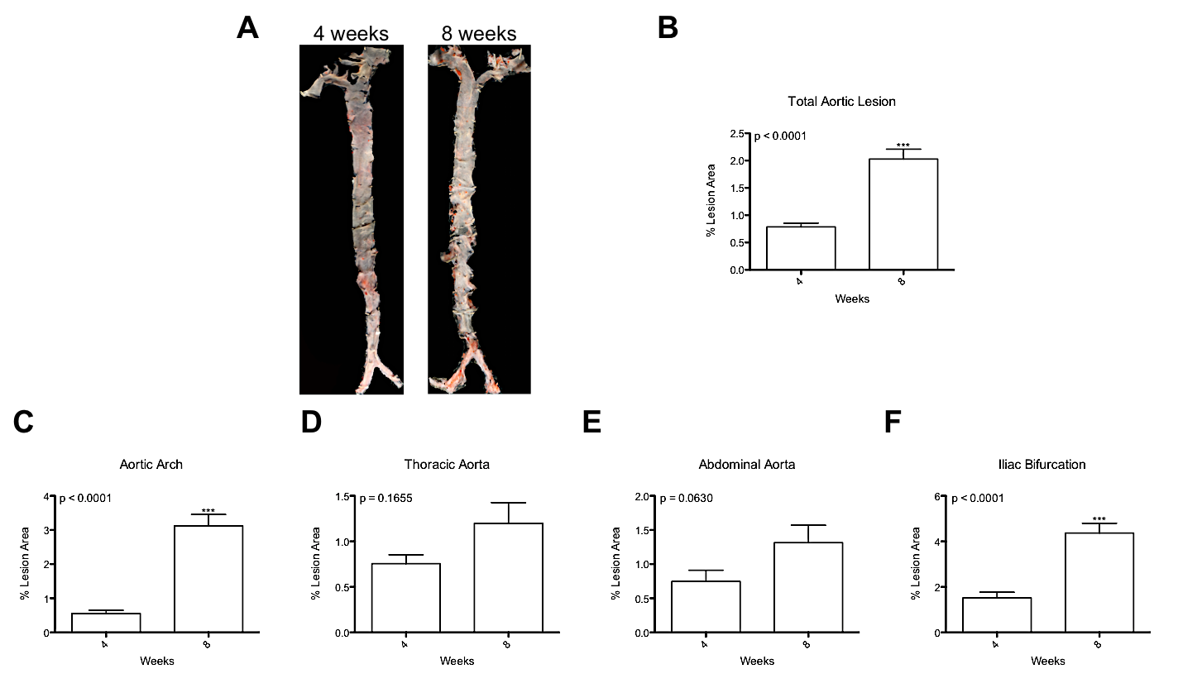
A
B
C
D
E
F
Figure S3

