Slide 1
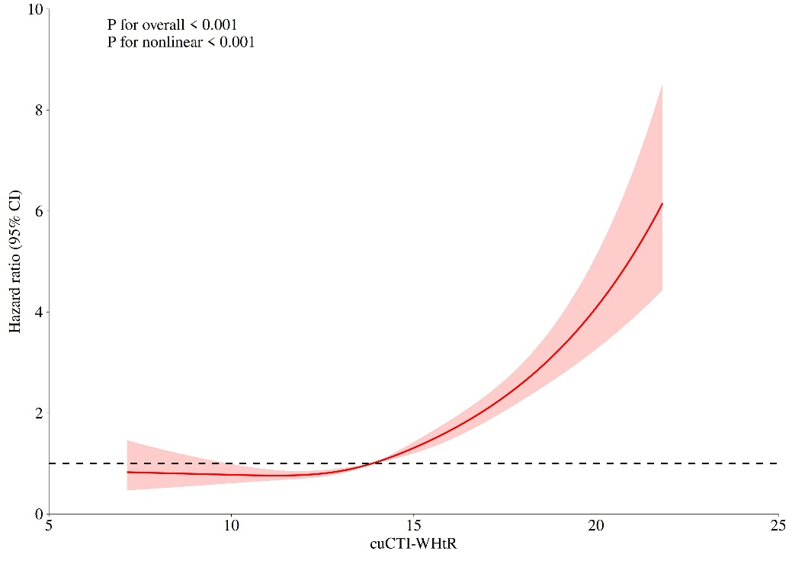
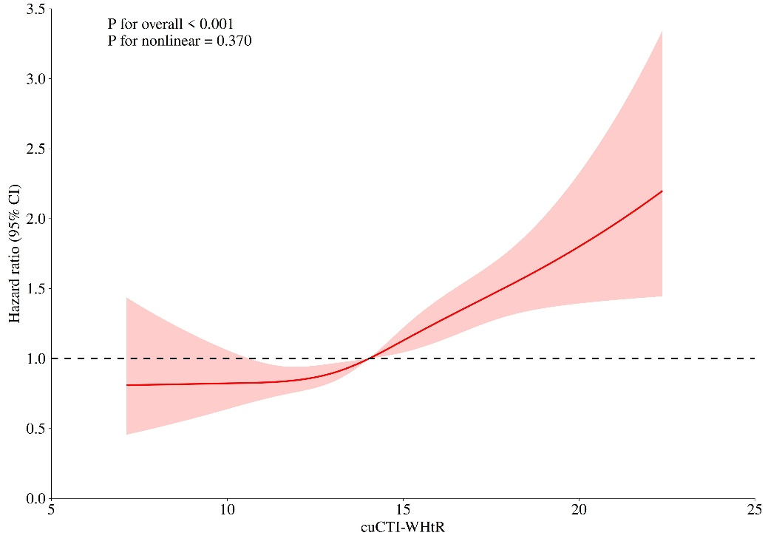
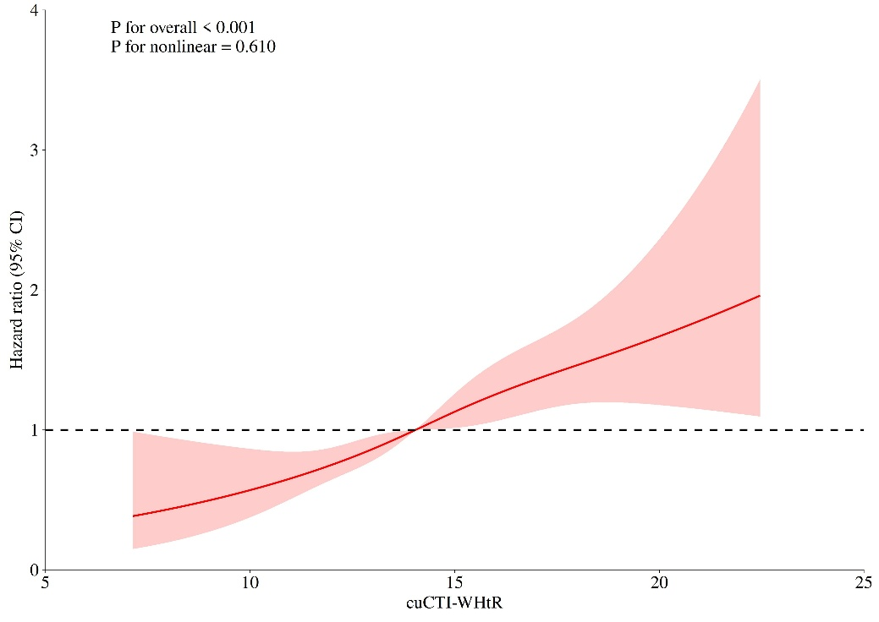
A
B
C
Supplementary Figure 2. RCS analysis exploring the relationship between cumulative CTI-WHtR and diabetes (A), heart disease (B), and stroke (C) .

