Slide 1
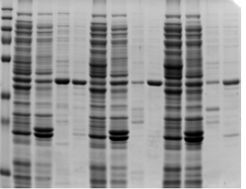
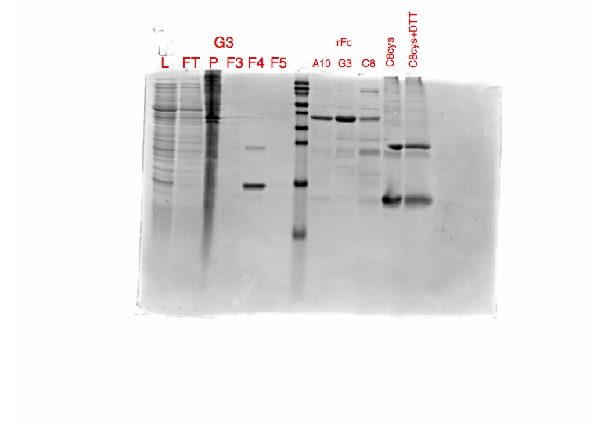
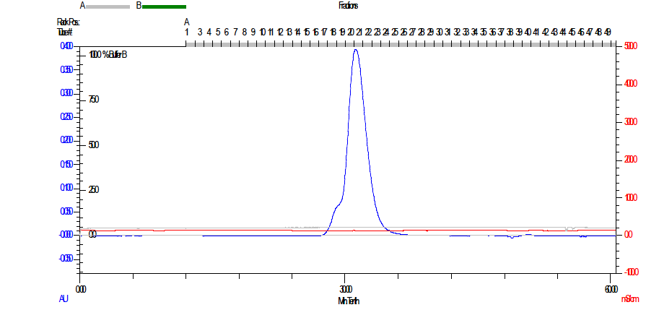
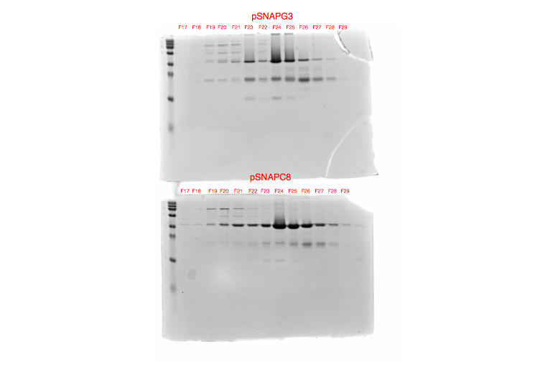
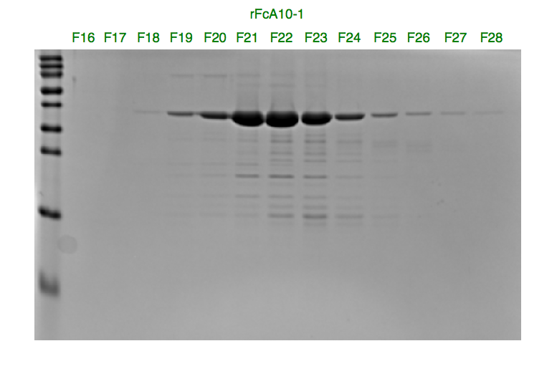
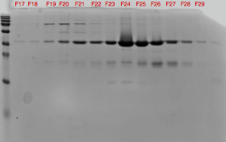
Suppl. Figure 3
a)
b)
M A10-Fc C8-Fc G3-Fc
A10-SNAP
L1 L2 B1 B2 L1 L2 B1 B2 L1 L2 B1 B2
M A10-Fc C8-Fc
50
55
35
Protein A
Affinity
Purification of Fc-VHHs
25
G3-SNAP
35
25
15
15
C8-SNAP
A10-Fc
SEC
C8-Fc
SEC
70
70
70
55
55
55
35
35
35
25
25
25
15
15
15
10
A10-SNAP SEC
A10-Fc
SEC
C8-Fc
SEC
10
10

