Slide 1
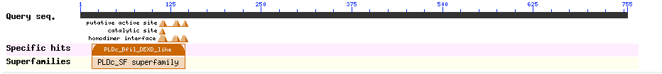
a
b
Figure S1. a trgA Basic Local Alignment Search Tool (BLAST) analysis ; b trgA and LreRMI locus structure

