Slide 1
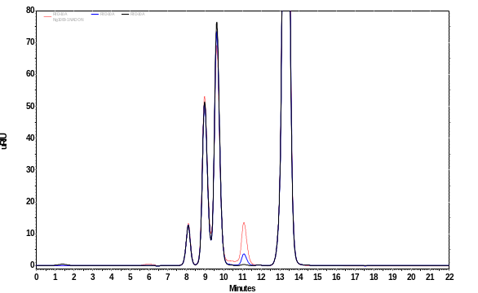
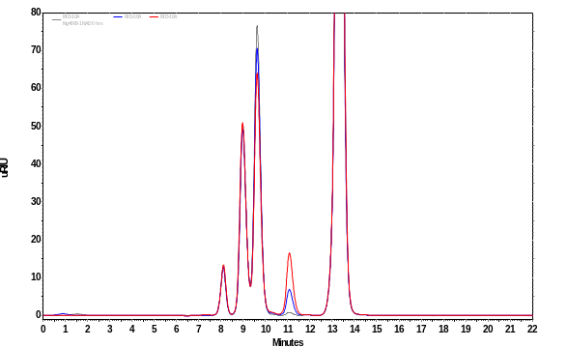
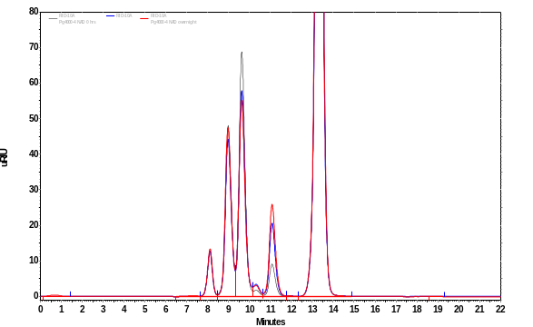
80
A
70
xylose
glycerol
60
50
glucose
mAU
40
30
20
xylitol
10
0
0
1
2
3
4
5
6
7
8
9
10
8
12
8
14
8
16
8
18
8
20
8
22
80
B
xylose
glycerol
70
60
50
glucose
mAU
40
30
20
xylitol
10
0
0
1
2
3
4
5
6
7
8
9
10
8
12
8
14
8
16
8
18
8
20
8
22
80
C
70
xylose
glycerol
60
50
glucose
mAU
40
30
xylitol
20
10
0
0
1
2
3
4
5
6
7
8
9
10
8
12
8
14
8
16
8
18
8
20
8
22
Minutes

