Slide 1
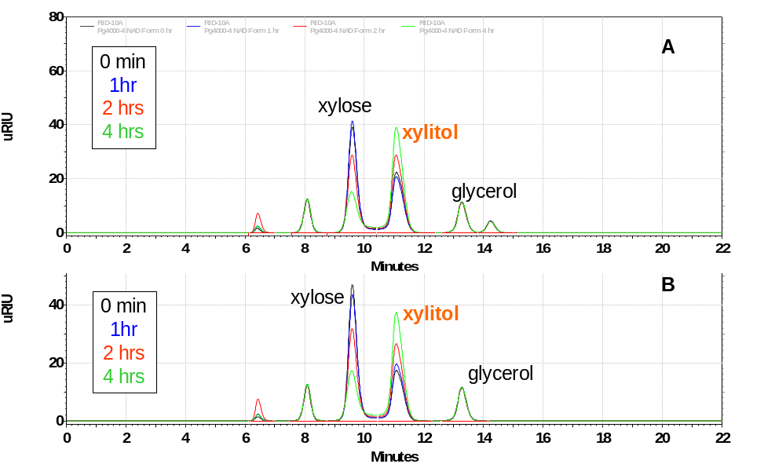
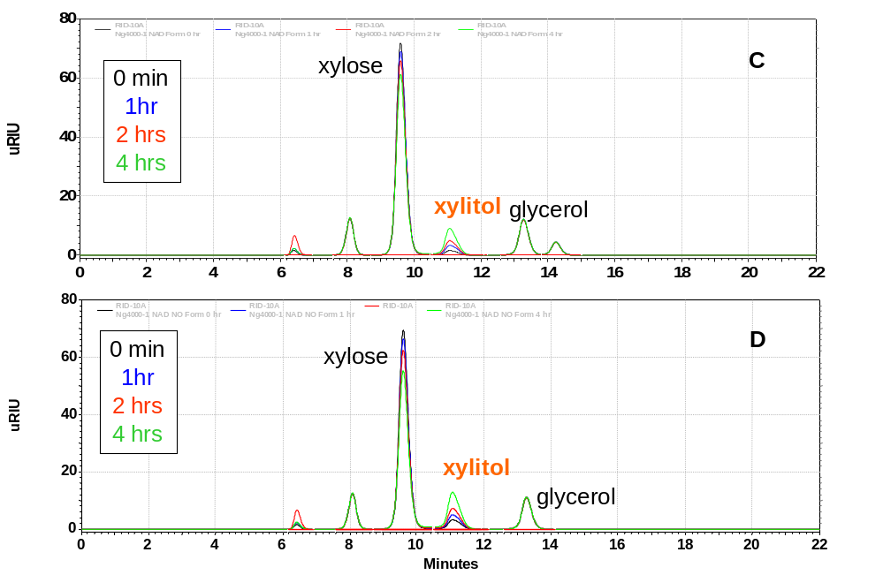
80
A
60
mAU
40
20
0
0
1
2
3
4
5
6
7
8
9
10
8
12
8
14
8
16
8
18
8
20
8
22
40
B
mAU
20
0
0
1
2
3
4
5
6
7
8
9
10
8
12
8
14
8
16
8
18
8
20
8
22
80
60
C
40
mAU
20
0
0
1
2
3
4
5
6
7
8
9
10
8
12
8
14
8
16
8
18
8
20
8
22
80
60
D
mAU
40
20
0
0
1
2
3
4
5
6
7
8
9
10
8
12
8
14
8
16
8
18
8
20
8
22
Minutes

