Slide 1
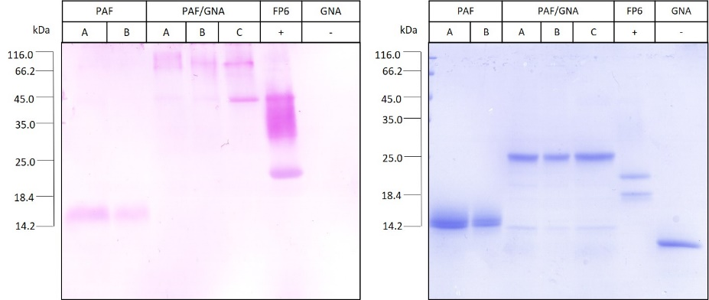
Additional File 1: Schiff blot to detect glycosylation status of recombinant PAF and PAF/GNA from fermented yeast cultures.
(a)
(b)
(a) Schiff Blot 10 µg protein loaded in each lane. (b) Coomassie Stained SDS-PAGE gel, 5 µg loaded in each lane. A, B, and C depict samples from different fermentations. FP6 denotes positive control recombinant fusion protein PI1a/GNA²¹. GNA: Commercially purified GNA (Sigma-Aldrich). Position of protein marker mix run on the same gel is depicted on the left-hand side.

