Slide 1
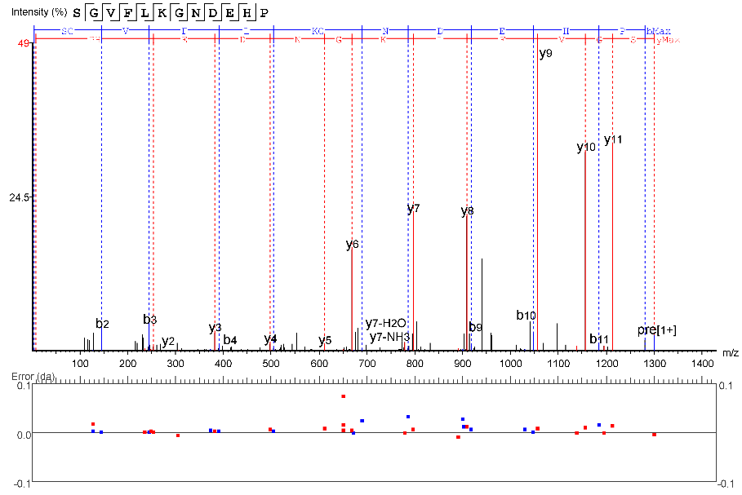
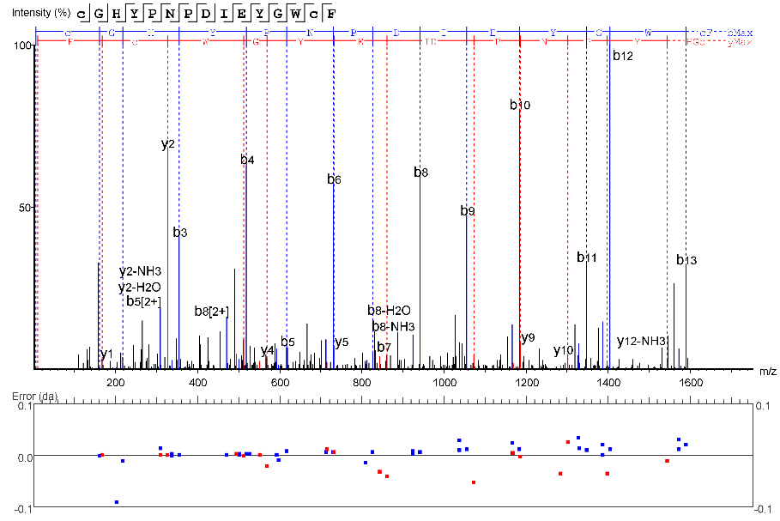
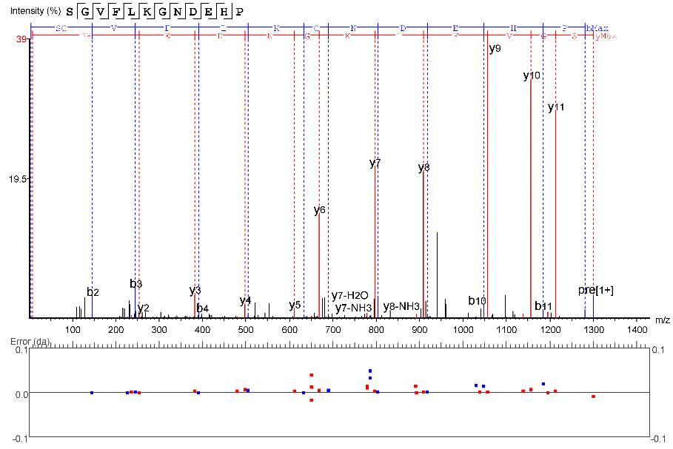
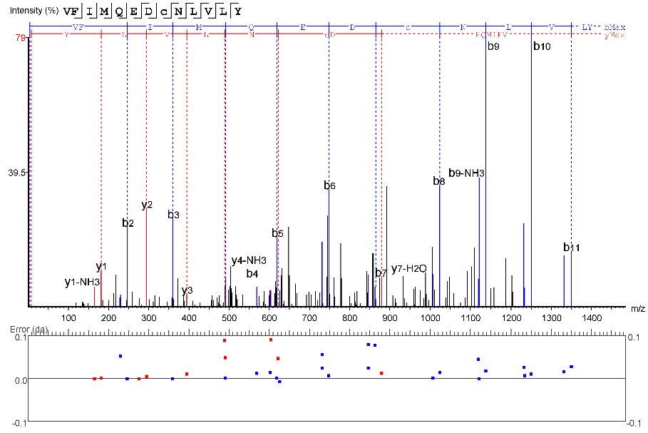
Additional File 3 : Examples of LC-MS spectra obtained following fragmentation of recombinant PAF and PAF/GNA proteins.
3a. PAF
residues 42-53
(ProAlanase peptide)
3b. PAF
residues 71-85
(Chymotrypsin peptide)
3c. PAF/GNA
residues 42-53
(ProAlanase peptide)
3d. PAF/GNA
residues 135-147
(Chymotrypsin peptide)

