Slide 1
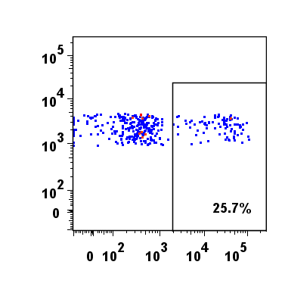
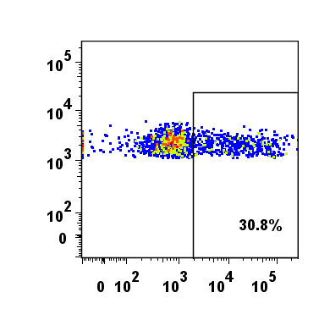
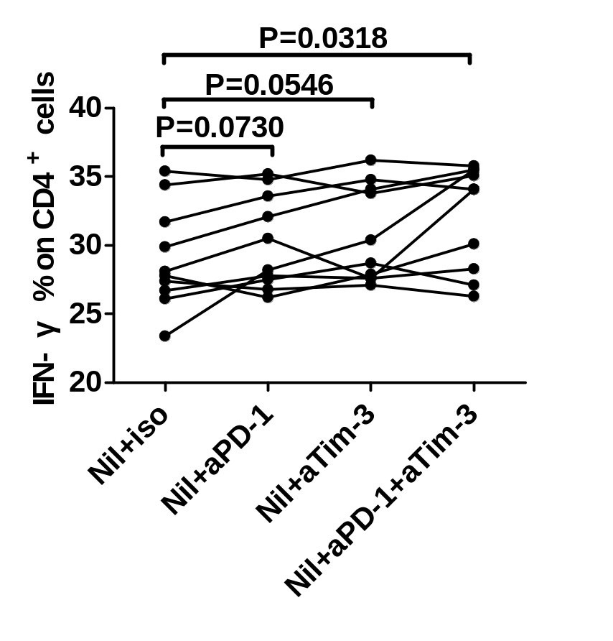
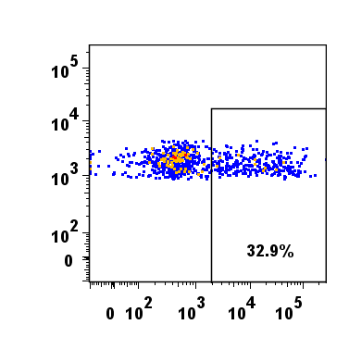
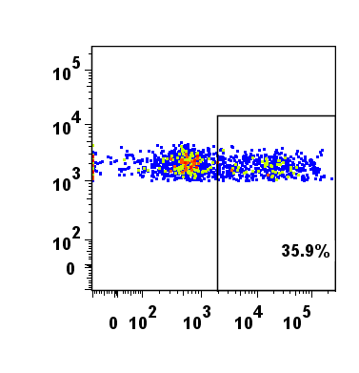
Fig S3.
A Nil+isotype antibody Nil+aPD-1 B
Nil+aTim-3 Nil+aPD-1 +aTim-3
CD4-PerCP-Cy5.5
IFN-γ-APC

