Slide 1
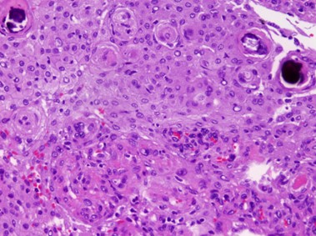
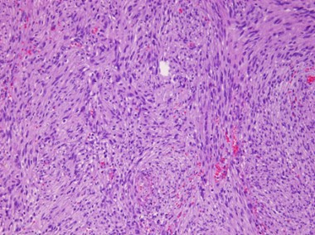
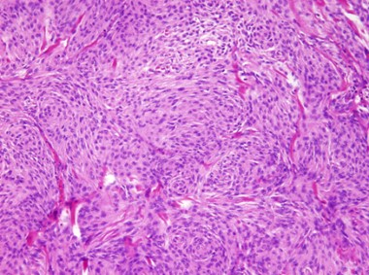
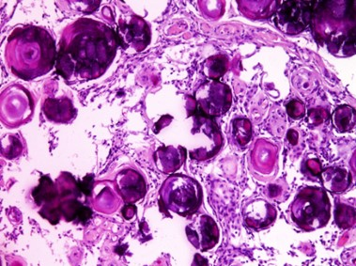
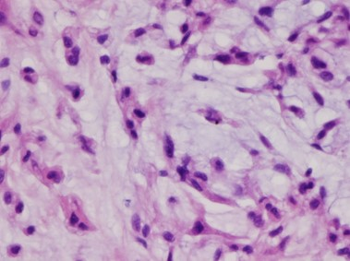
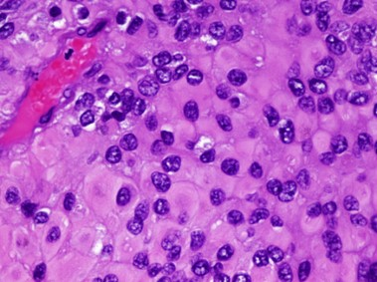
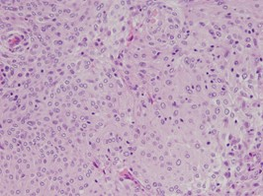
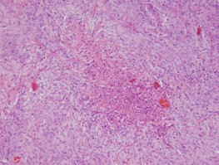
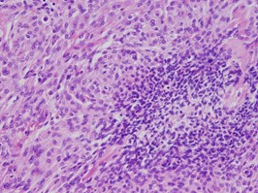
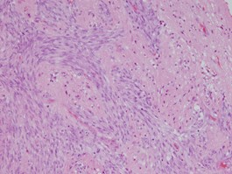
A
Jed39_MN, Meningothelial
x20
Jed40_MN, Fibroblastic
x10
Jed38_MN, Transitional
x10
Jed43_MN, Psammomatous
x10
Jed79_MN, Chordoid
x40
Jed29_MN, Rhabdoid
x40
B
Jed72_MN
x20
Jed58_MN
x10
Jed58_MN
x20
Jed13_MN
x20
Patternless growth (sheeting)
Necrosis
Small cells with high N/C ratio
Brain invasion

