Slide 1
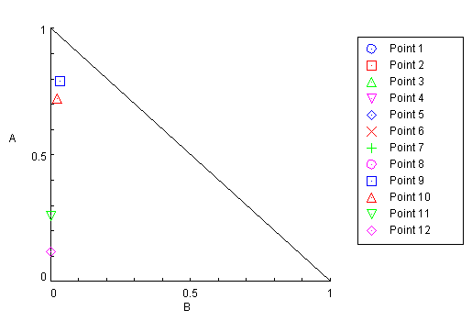
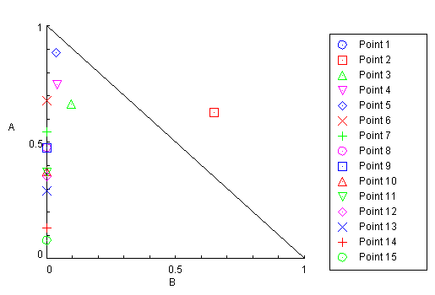
LNCaP xenografts
Day | Effect | CI
1.0 | 1 | 9.33459
2.0 | 0.936 | 4.50396
3.0 | 0.875 | 2.06281
4.0 | 0.8429 | 1.59809
5.0 | 0.8326 | 1.69576
6.0 | 0.8394 | 2.26619
7.0 | 0.791 | 1.27195
8.0 | 0.815 | 2.07039
9.0 | 0.743 | 0.82874
10.0 | 0.728 | 0.74610
11.0 | 0.649 | 0.26232
12.0 | 0.592 | 0.11759
Day 1
Day 2
Day 3
Day 4
Day 5
Day 6
Day 7
Day 8
Day 9
Day 10
Day 11
Day 12
Docetaxel
Capsaicin
PC3 xenografts
Day | Effect | CI
1.0 | 1 | 5.53947
2.0 | 0.896 | 1.28066
3.0 | 0.816 | 0.76203
4.0 | 0.779 | 0.78772
5.0 | 0.768 | 0.92152
6.0 | 0.68 | 0.68005
7.0 | 0.614 | 0.54433
8.0 | 0.571 | 0.47744
9.0 | 0.552 | 0.47503
10.0 | 0.502 | 0.37443
11.0 | 0.488 | 0.37196
12.0 | 0.47 | 0.35446
13.0 | 0.435 | 0.29091
14.0 | 0.342 | 0.13297
15.0 | 0.287 | 0.07664
Day 1
Day 2
Day 3
Day 4
Day 5
Day 6
Day 7
Day 8
Day 9
Day 10
Day 11
Day 12
Day 13
Day 14
Day 15
Docetaxel
Capsaicin
Figure S1. Isobologram and combination index (CI) of the combined treatment (DTX+CAP) inhibitory effect on LNCaP and PC3 xenograft tumor growth.

