Slide 1
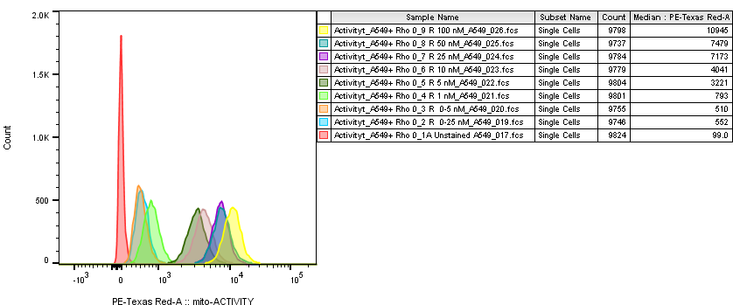
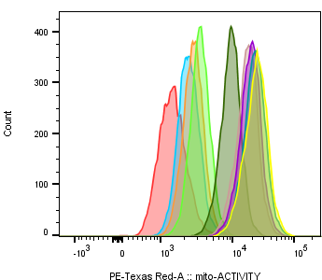
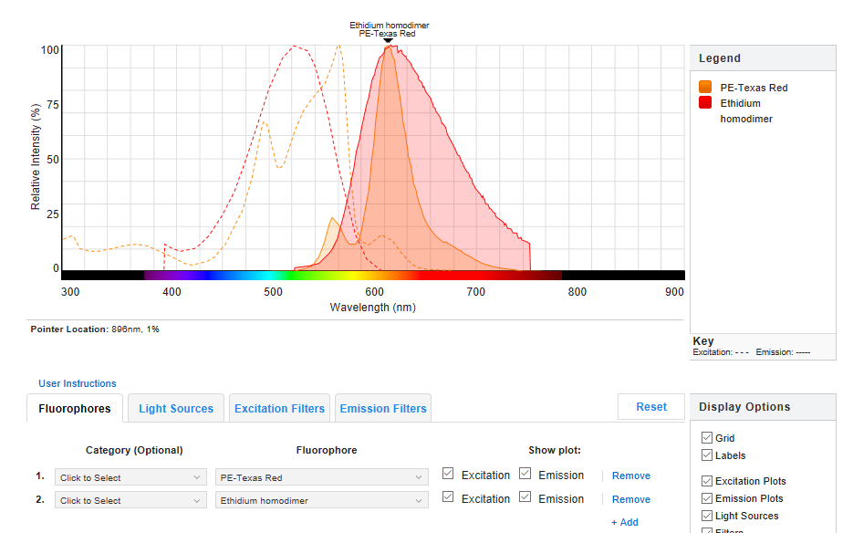
Supplementary Figure S2
Figure S2
a
A549
A549 Rho 0
b
Notes:
Titration and Toxicity Assay of MitoTracker

