Slide 1
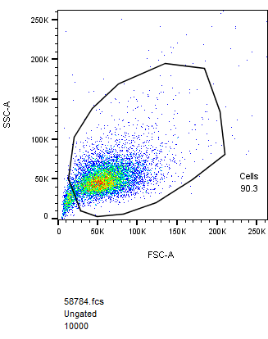
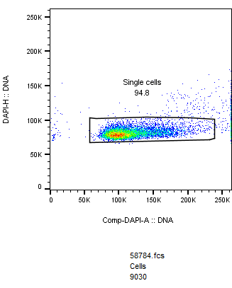
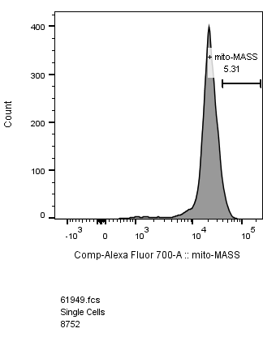
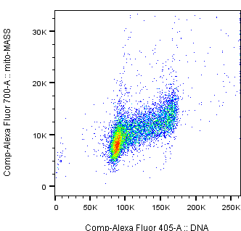
Supplementary Figure S3
Figure S3
a
Parental A549
b
G1 S G2
Notes:
MTA Treatment Increased Mitochondrial Mass

