Slide 1
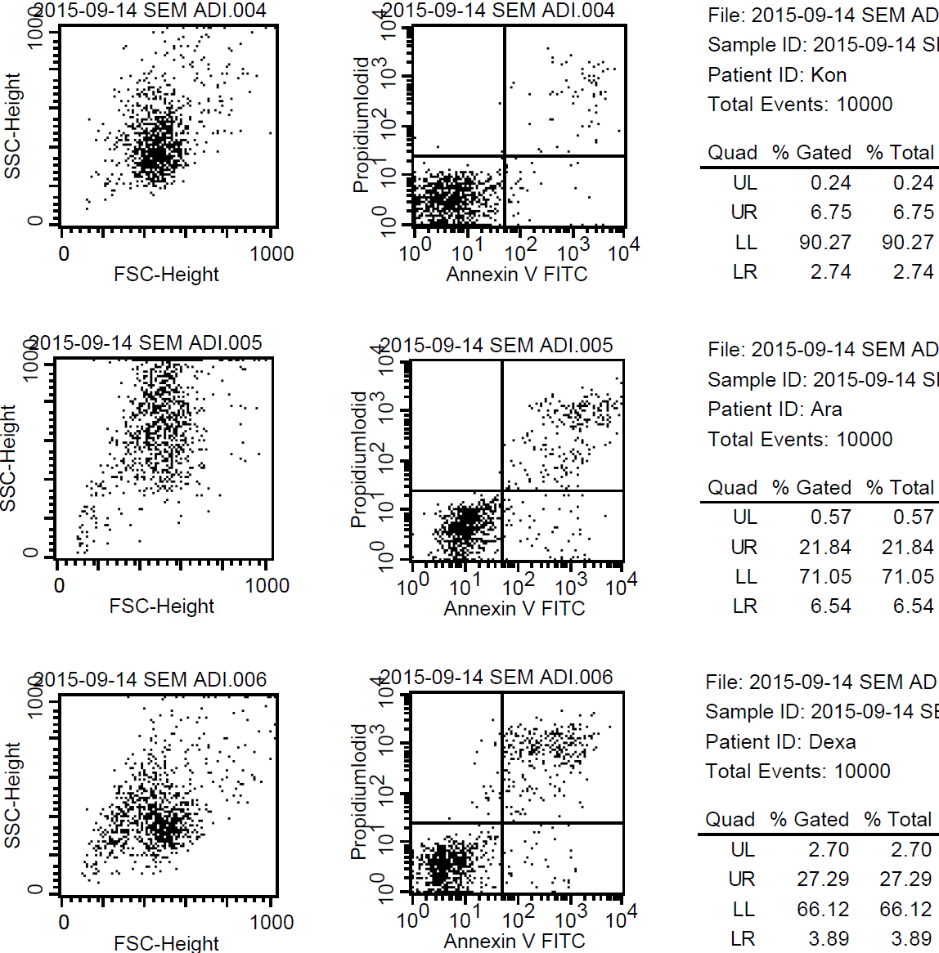
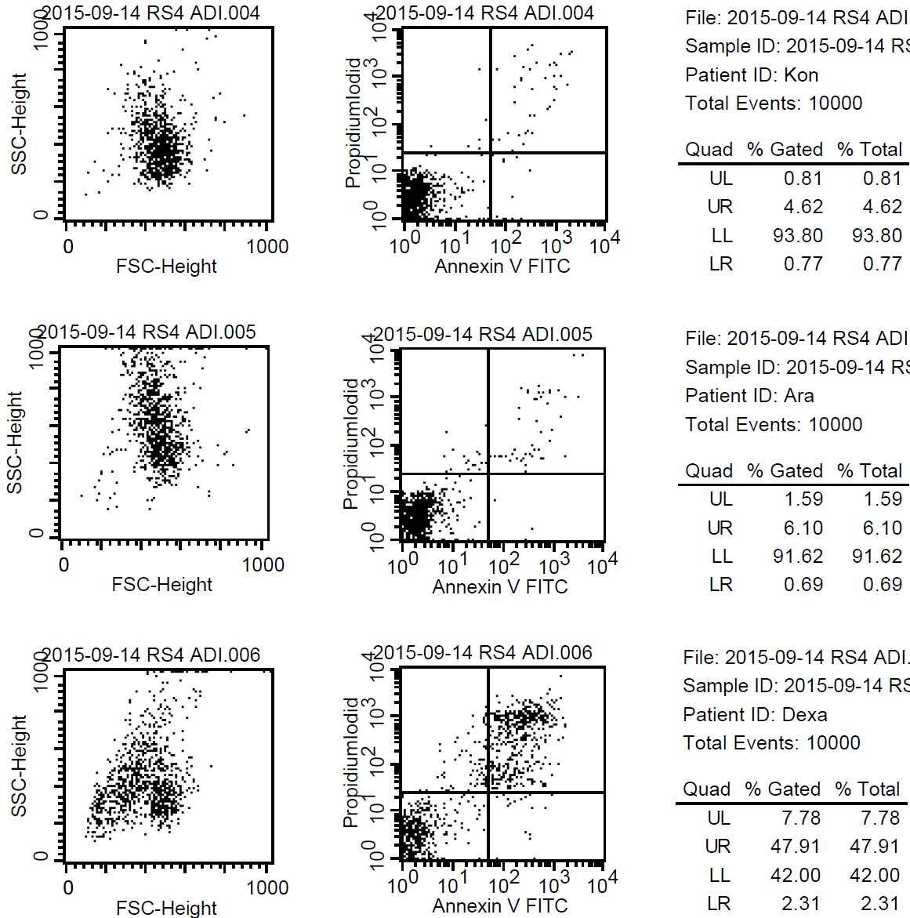

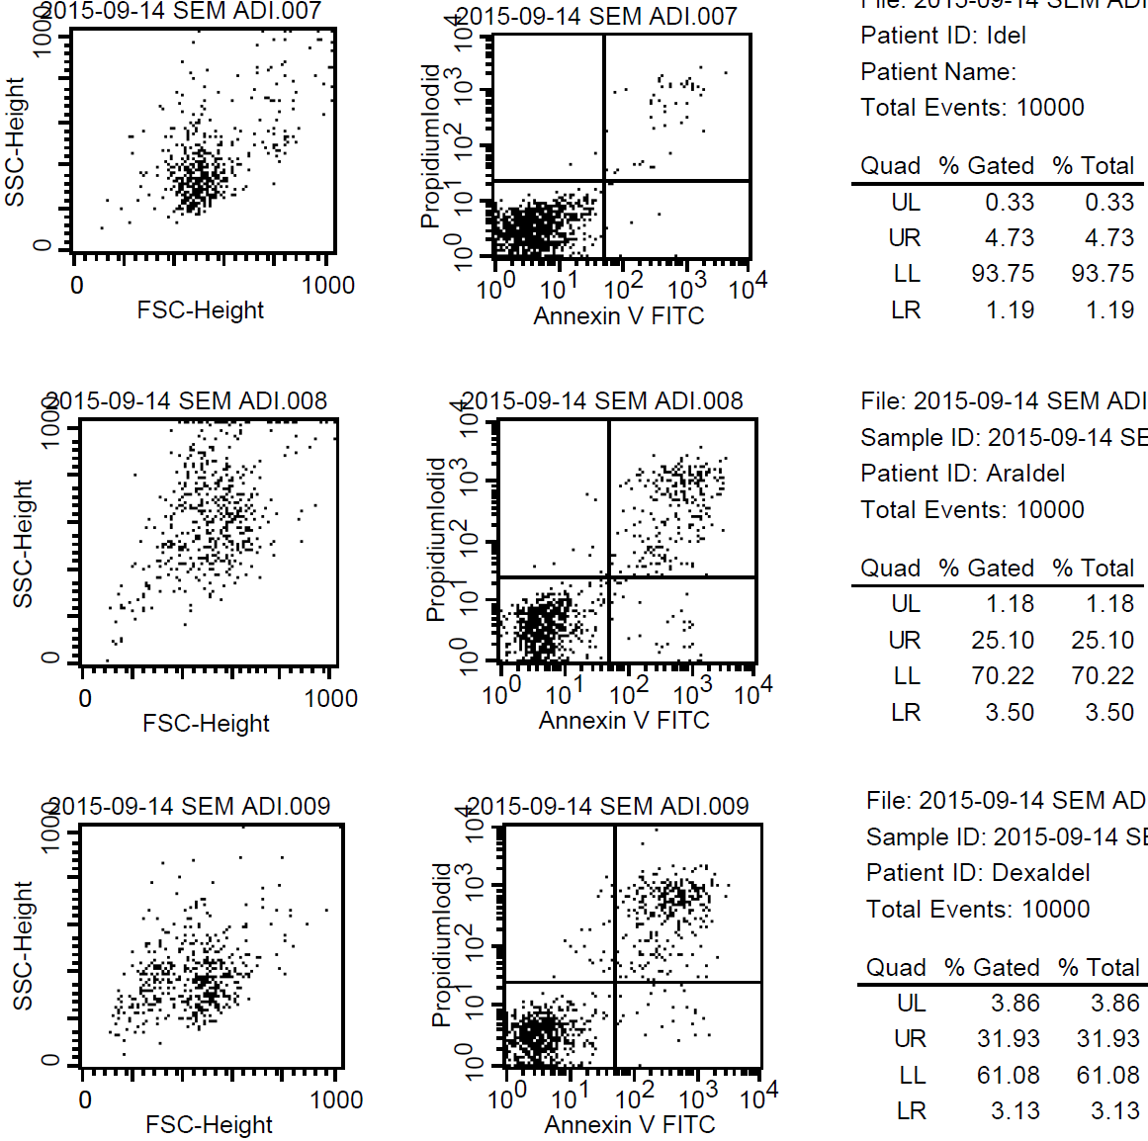
SEM
control
control
control
IDEL
IDEL
IDEL
AraC
AraC
AraC
AraC+IDEL
AraC+IDEL
AraC+IDEL
DEX
DEX
DEX
DEX+IDEL
DEX+IDEL
DEX+IDEL
Notes:
sem 14.09.

Slide 2
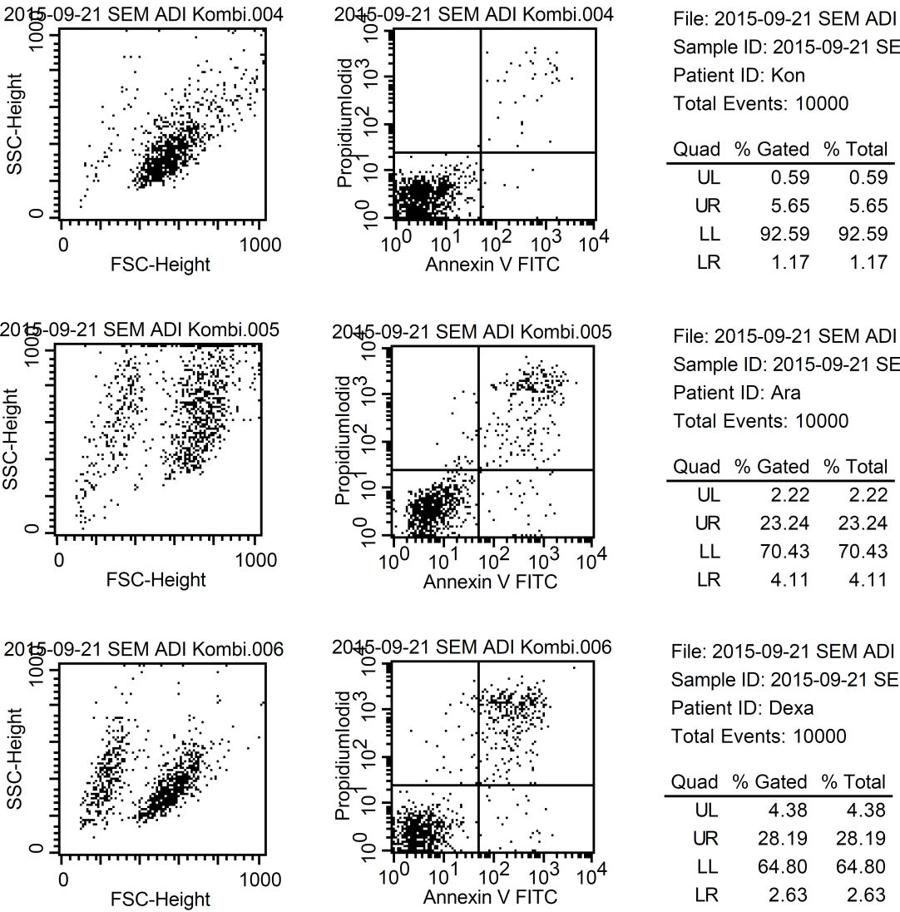
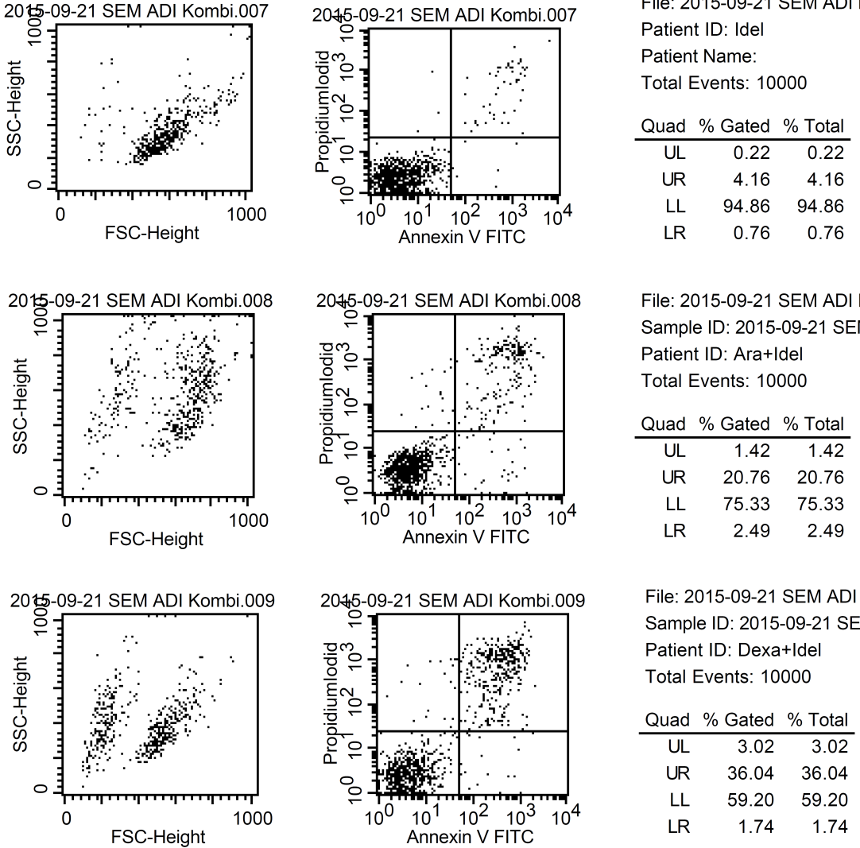
SEM
control
control
control
IDEL
IDEL
IDEL
AraC
AraC
AraC
AraC+IDEL
AraC+IDEL
AraC+IDEL
DEX
DEX
DEX
DEX+IDEL
DEX+IDEL
DEX+IDEL

Slide 3
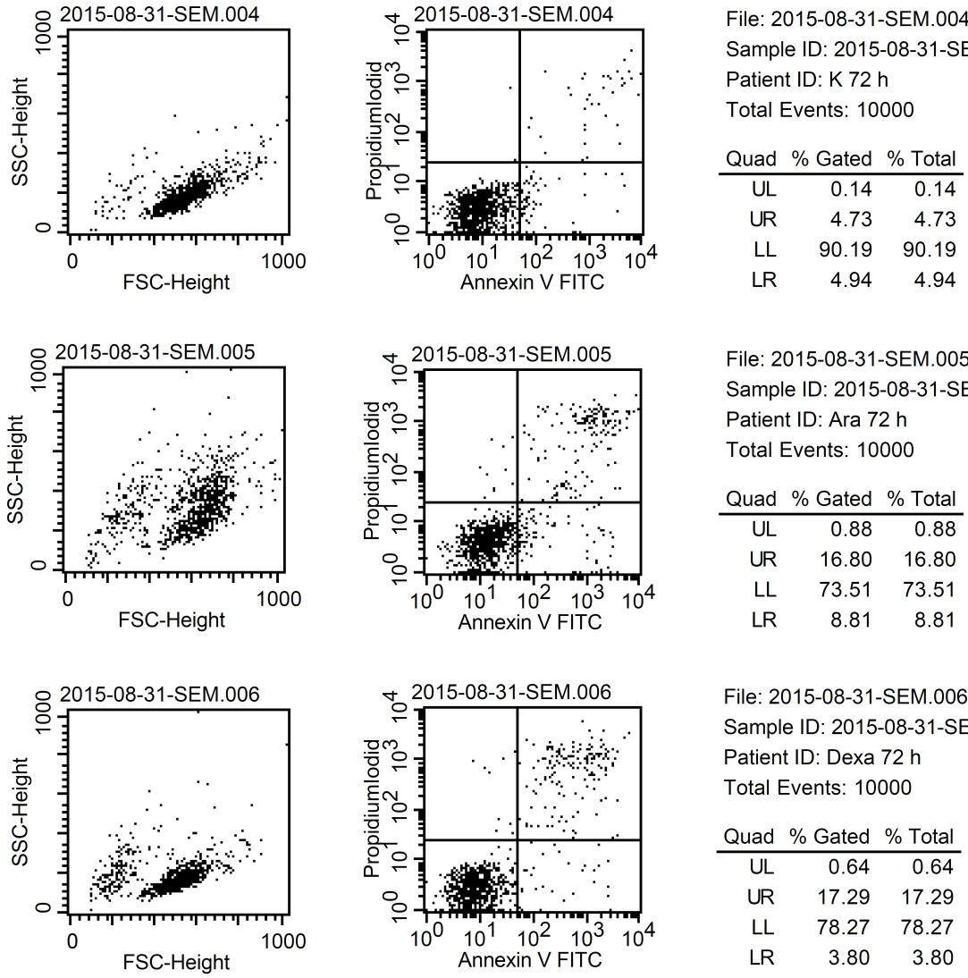
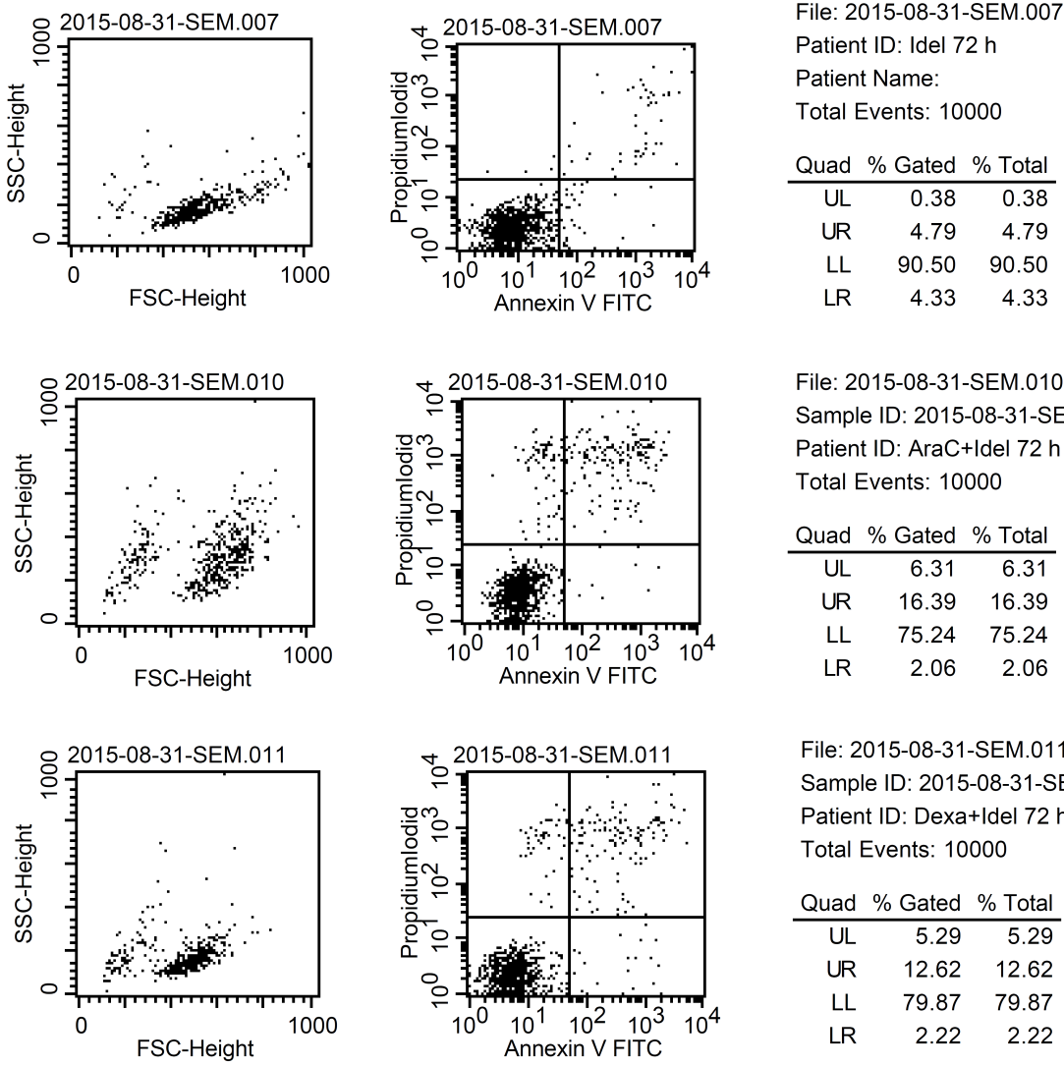
SEM
control
control
control
IDEL
IDEL
IDEL
AraC
AraC
AraC
AraC+IDEL
AraC+IDEL
AraC+IDEL
DEX
DEX
DEX
DEX+IDEL
DEX+IDEL
DEX+IDEL
Notes:
sem 31.8.

Slide 4
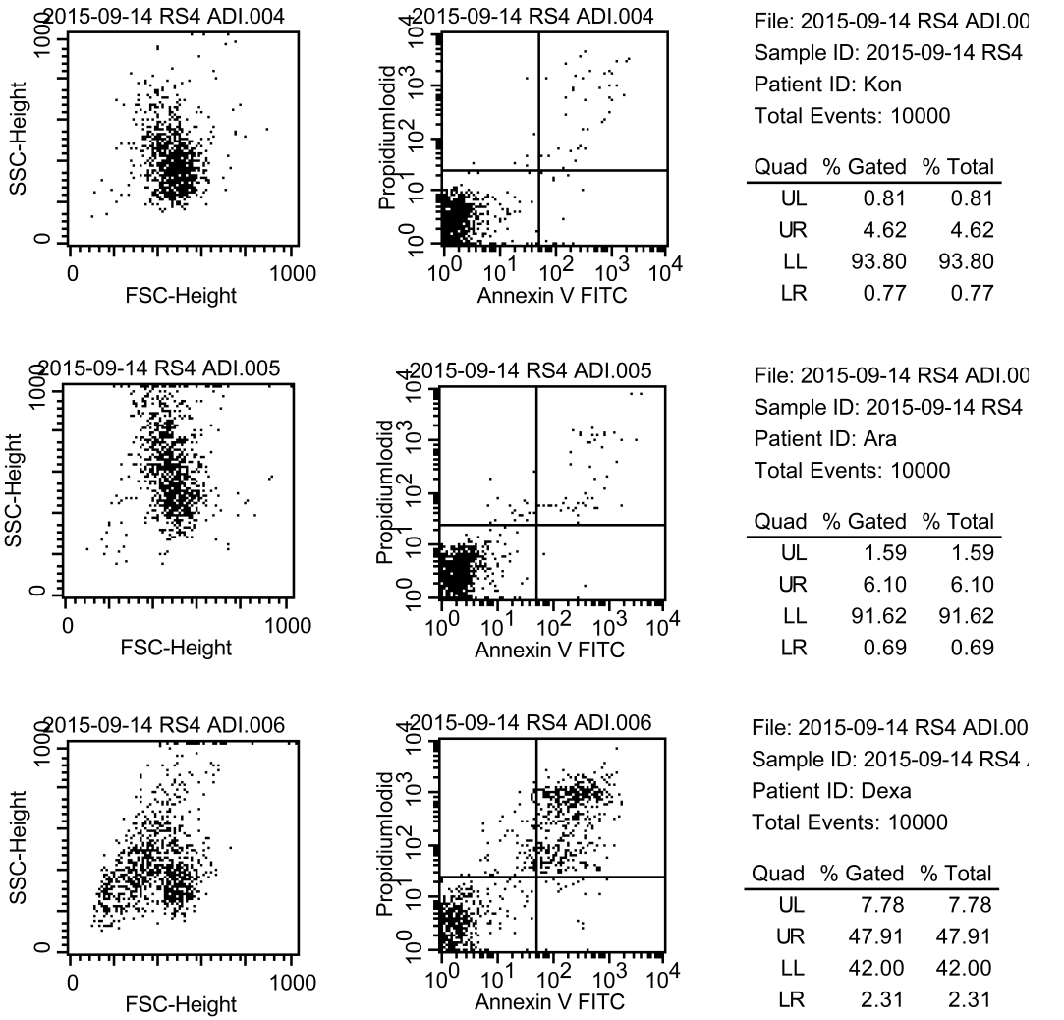
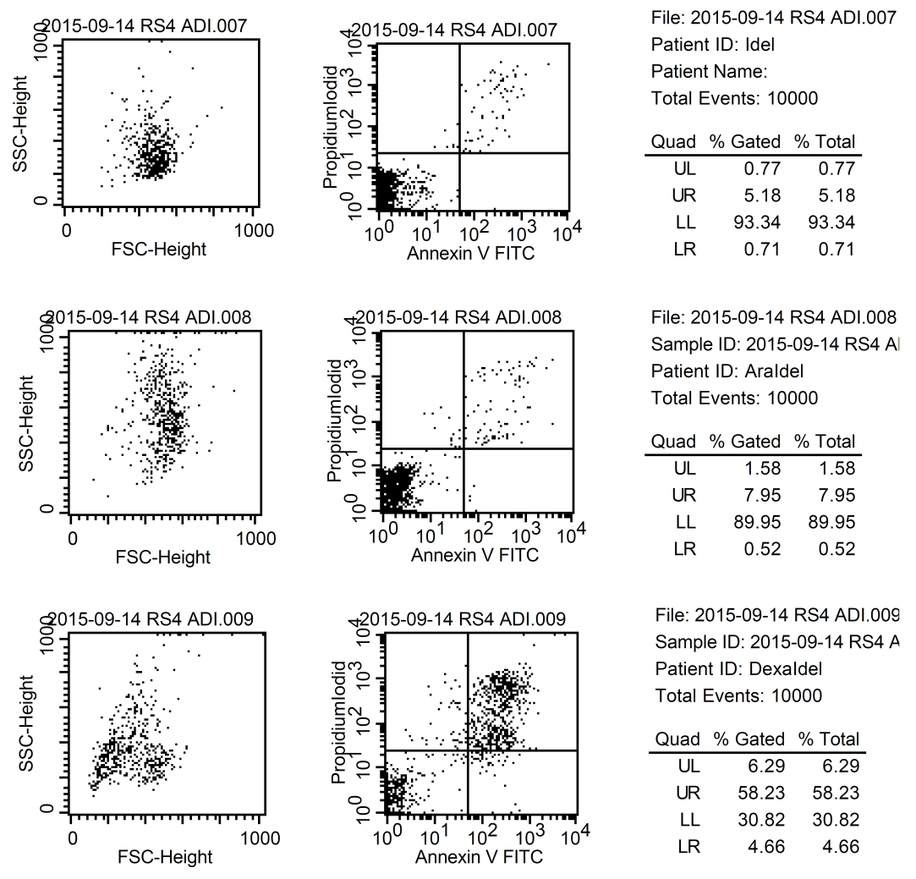
RS4;11
control
control
control
IDEL
IDEL
IDEL
AraC
AraC
AraC
AraC+IDEL
AraC+IDEL
AraC+IDEL
DEX
DEX
DEX
DEX+IDEL
DEX+IDEL
DEX+IDEL
Notes:
rs4 14.09.

Slide 5
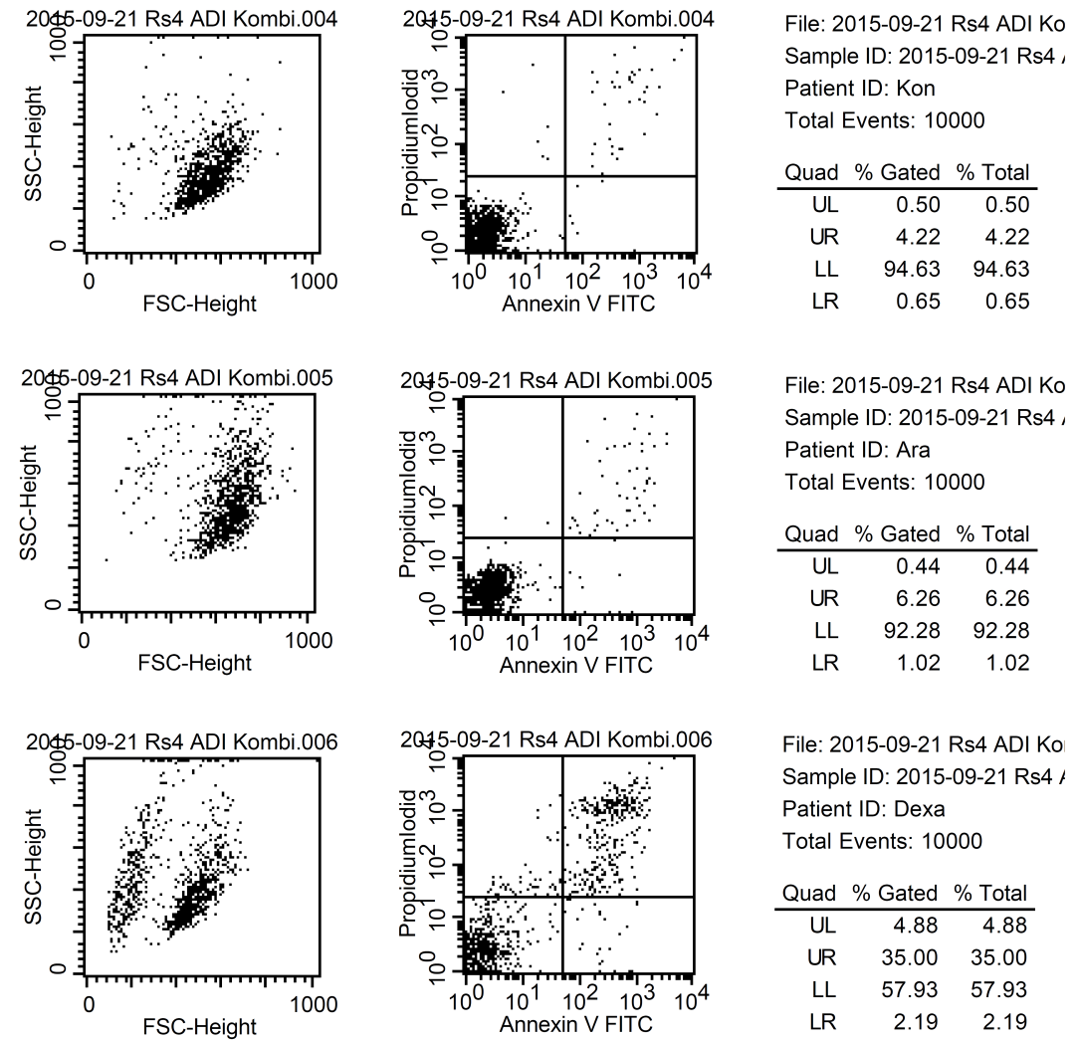
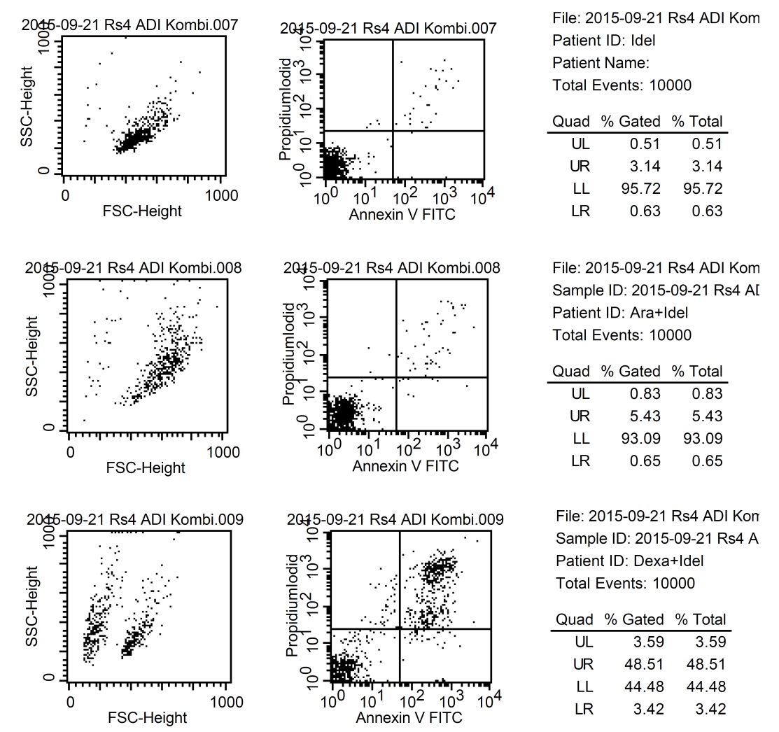
RS4;11
control
control
control
IDEL
IDEL
IDEL
AraC
AraC
AraC
AraC+IDEL
AraC+IDEL
AraC+IDEL
DEX
DEX
DEX
DEX+IDEL
DEX+IDEL
DEX+IDEL
Notes:
rs4 21.09.

Slide 6
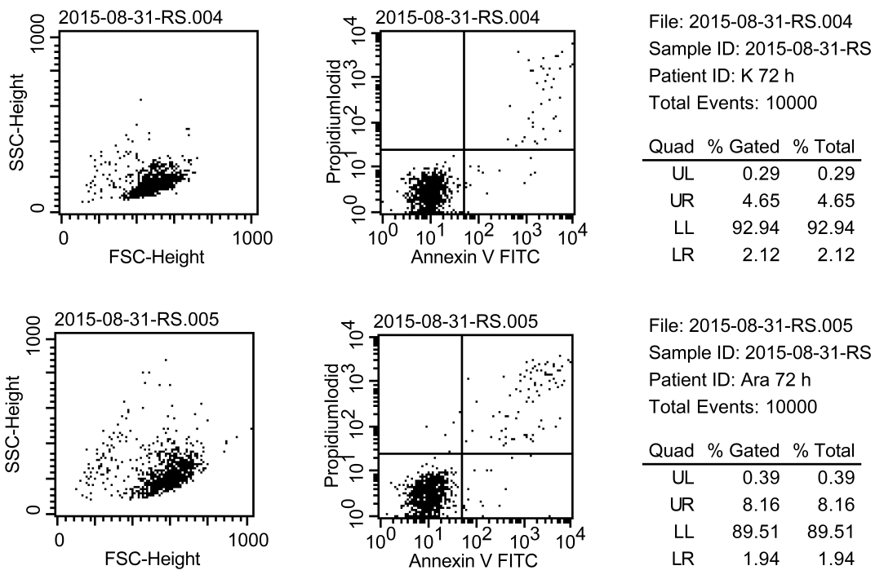
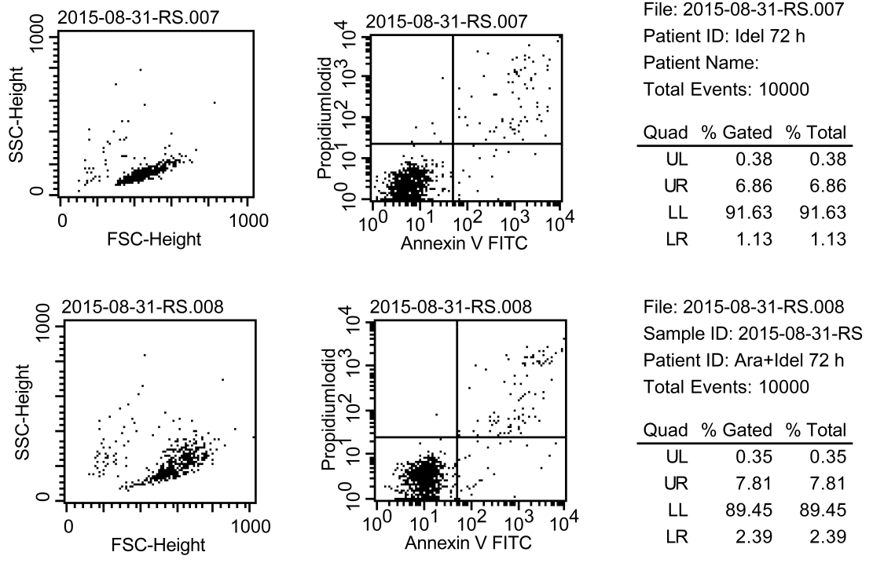
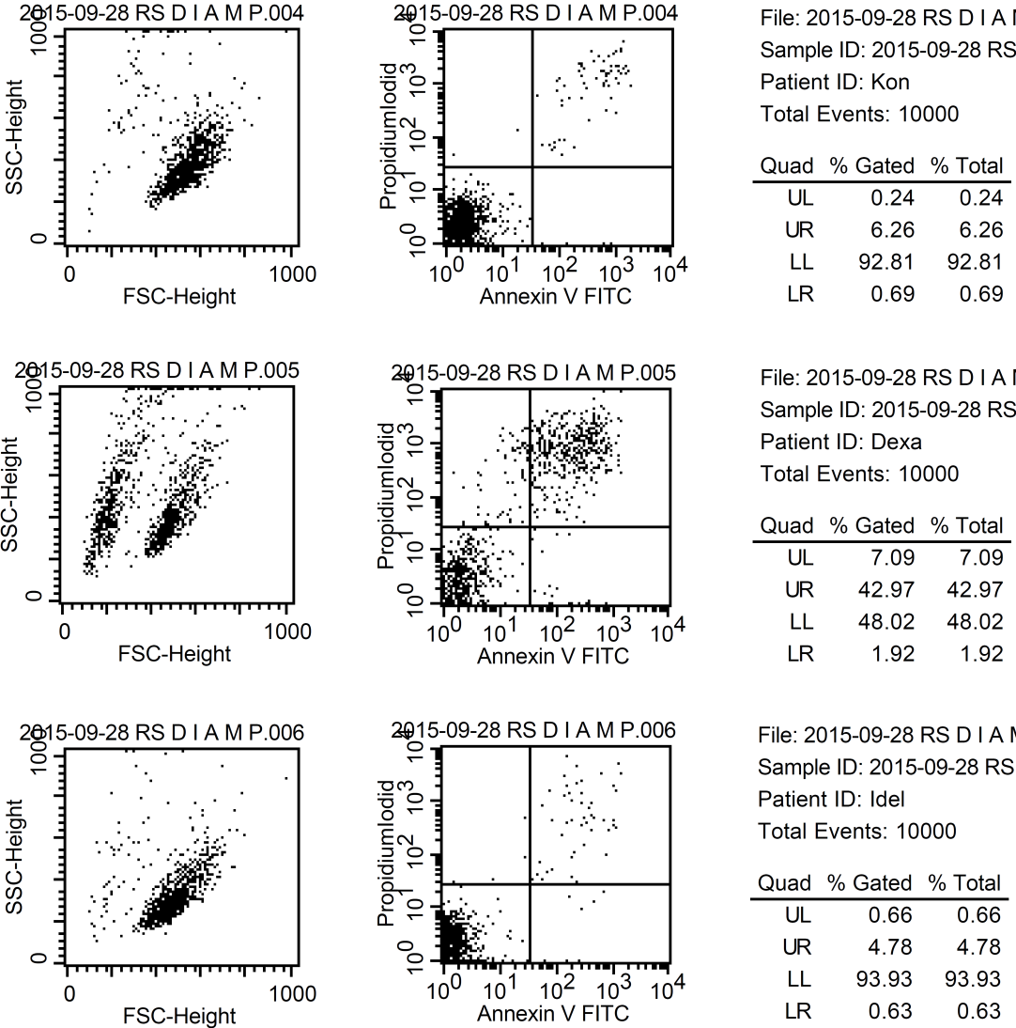
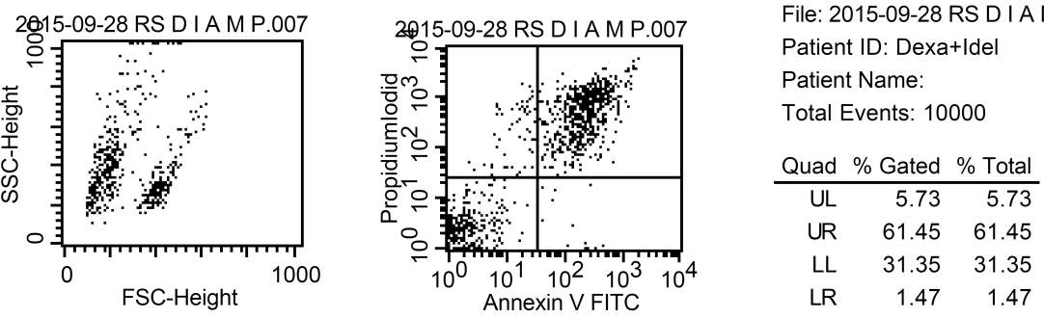
RS4;11
control
control
control
IDEL
IDEL
IDEL
AraC
AraC
AraC
AraC+IDEL
AraC+IDEL
AraC+IDEL
control
control
control
IDEL
IDEL
IDEL
DEX
DEX
DEX
DEX+IDEL
DEX+IDEL
DEX+IDEL
Notes:
rs4 31.08.

