Slide 1
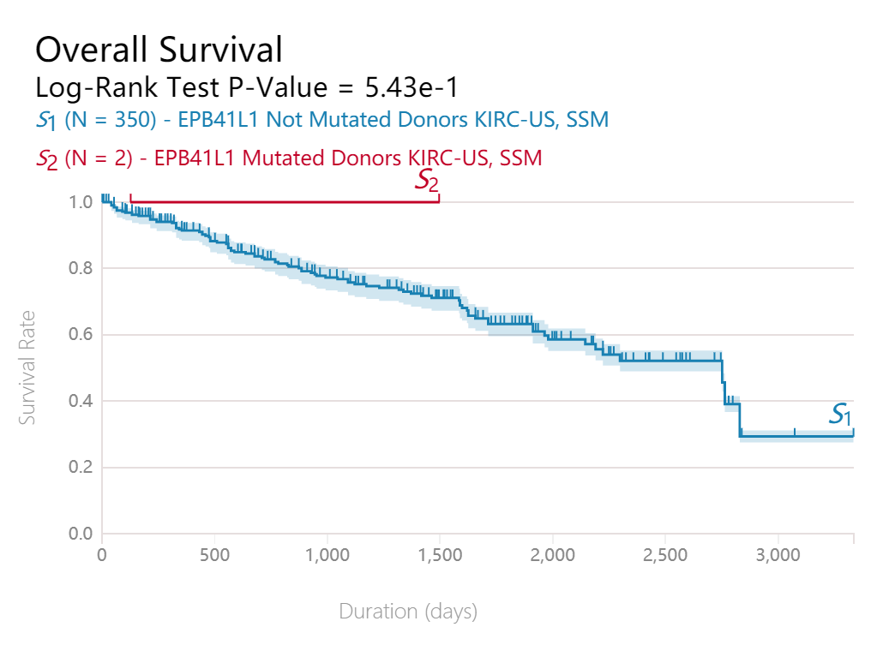
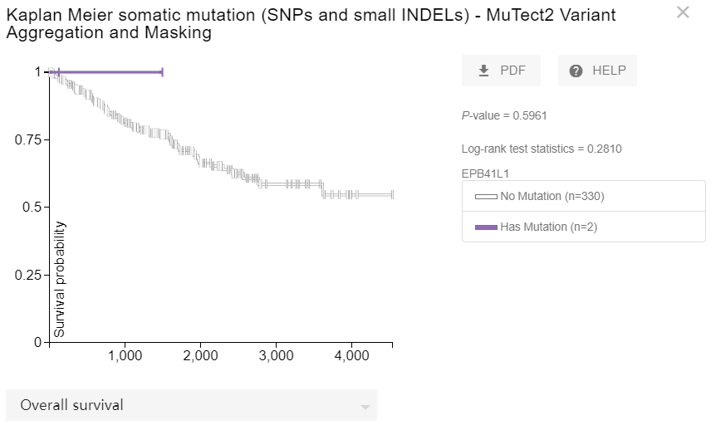
Figure S1
a
b
Figure S1: KM survival curves for overall survival in normal and overall KIRC patients by ICGC (a) and UCSC Xena database (b).

