Slide 1
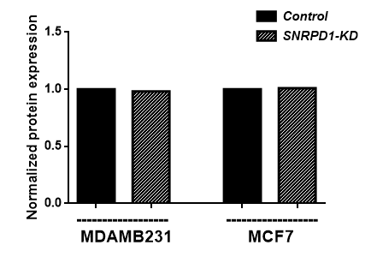
Supplementary Figure 1: SNRPE
Control
SNRPD1-KD
Control
SNRPD1-KD
SNRPE
1 0.99
1 1.01
GAPDH
MDAMB231
MCF7

Slide 2
Supplementary Figure 2: MYC
A
B

Slide 3
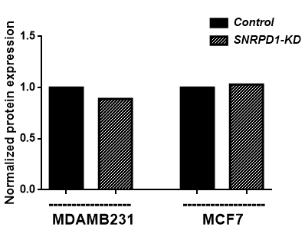
Supplementary Figure 3: vegf
Control
SNRPD1-KD
Control
SNRPD1-KD
VEGFR2
1 0.89
1 1.03
GAPDH
MDAMB231
MCF7

