Slide 1
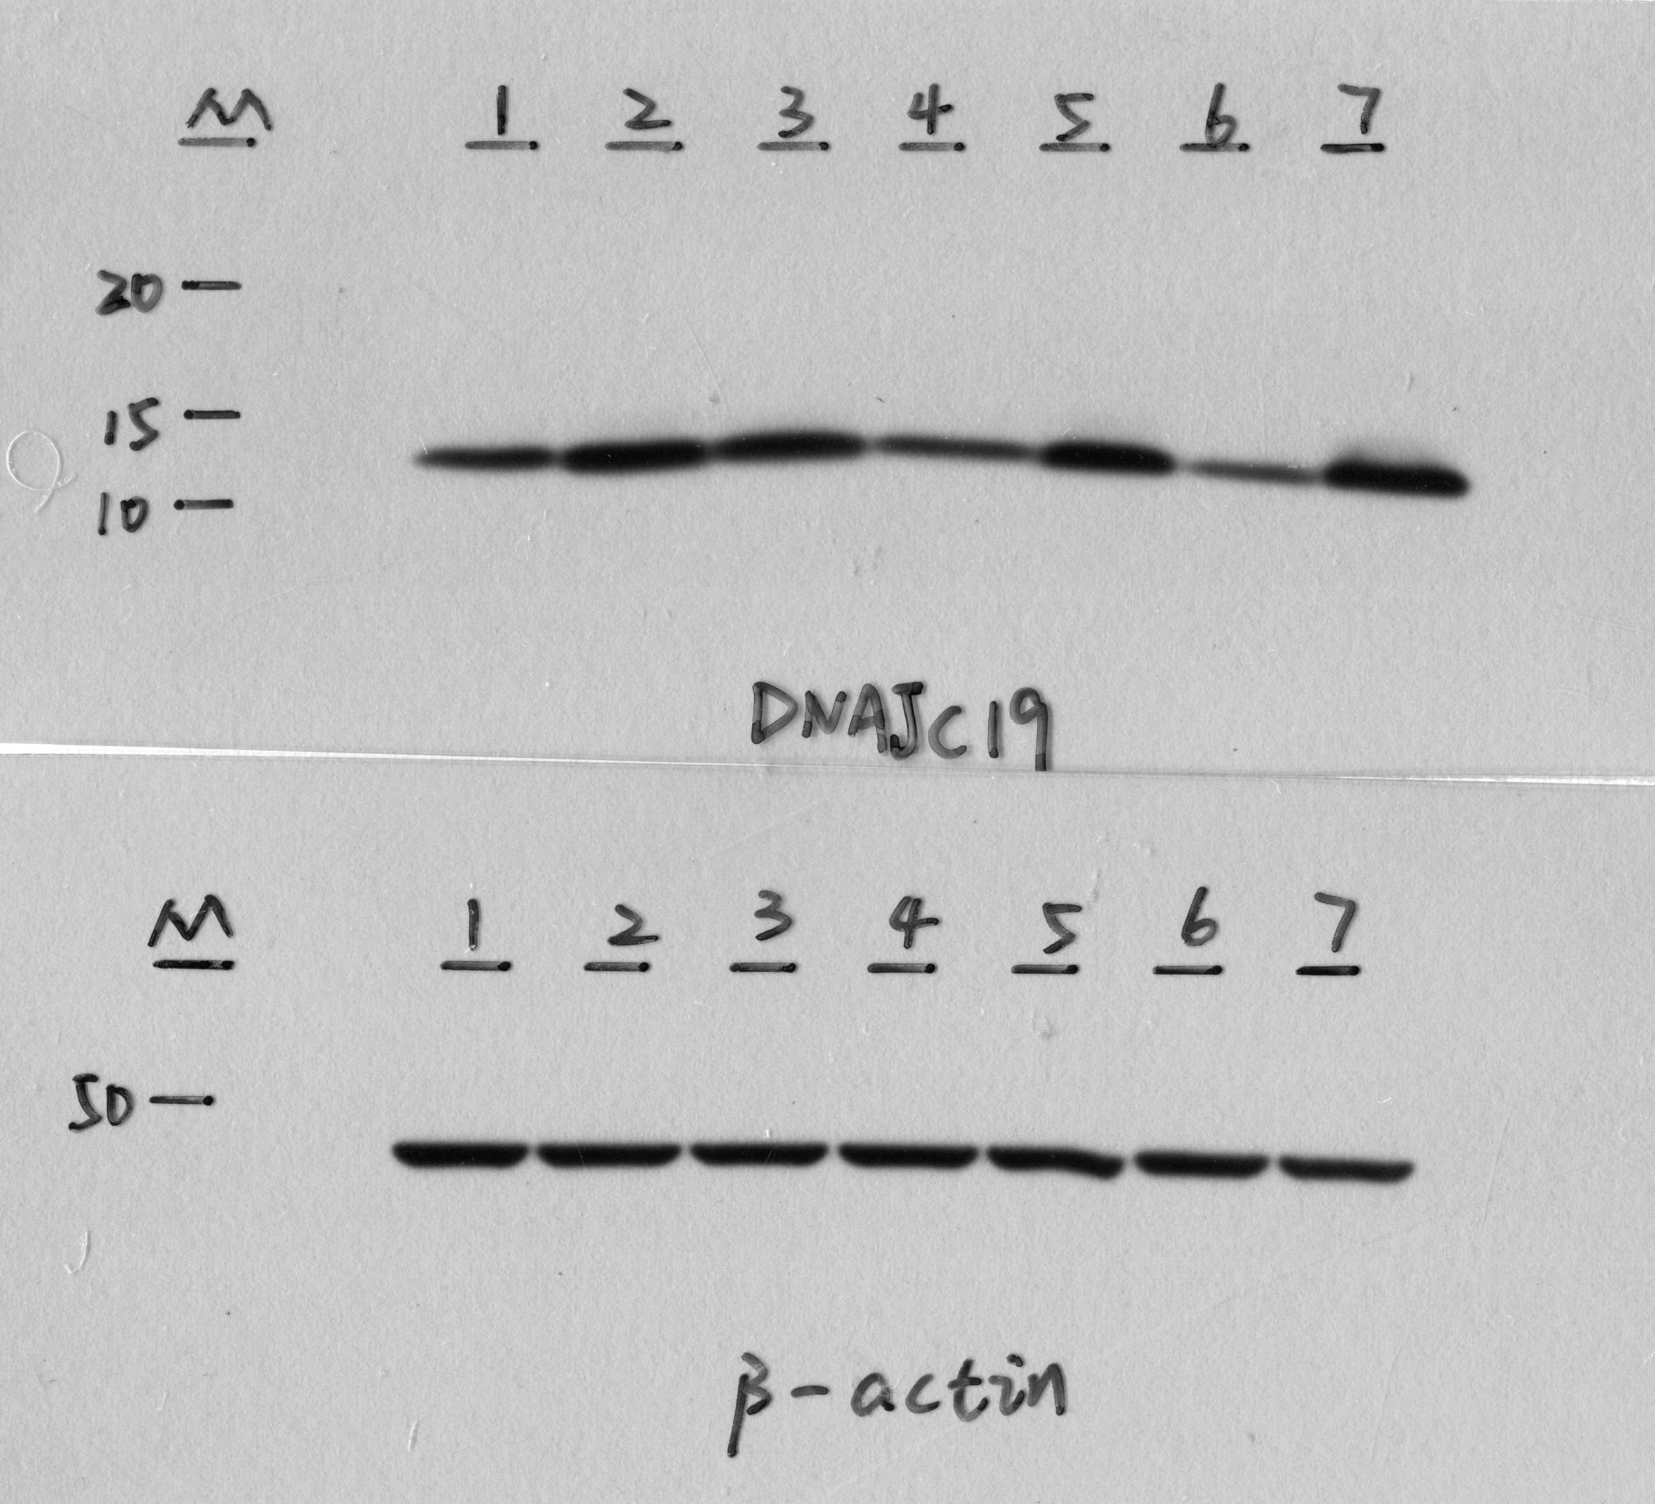
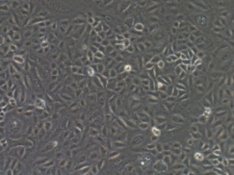
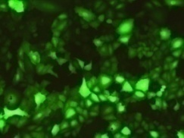
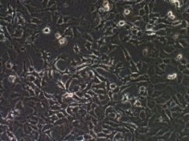
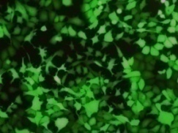
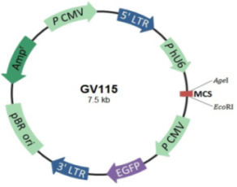
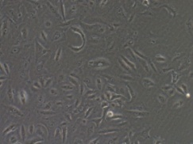
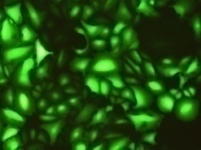
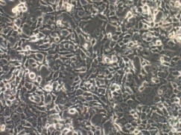
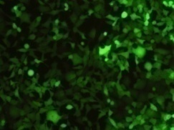
A
D
A549 cells
NCI-H1299
A549
NCI-H1795
MRC-5
95-D
NCI-H1299
Hela
SiHa
Bright-field
Fluorescence
Bright-field
Fluorescence
DNAJC19
12 kDa
shCtrl
β-actin
43 kDa
B
Vector Code | GV115
Components | hU6-MCS-CMV-EGFP
Control insertion sequence | TTCTCCGAACGTGTCACGT
Bacterial strain | TOP10 E. Coli competent cells（TIANGEN, Cat. #CB104-03）
shDNAJC19
E
A549 cells
NCI-H1299 cells
*P=0.013
***P=0.000
C
Virus code | Group | Virus titer (TU/ml) | Virus dosage (μl)
PSC3741 | shCtrl | 6×10⁸ | 3.33
LVpGCSIL-004PSC44454-1 | shDNAJC19 | 7X10⁸ | 2.86
Interfering target sequence | TTTGCAGGCCGTTACGTTT
57.8%
66.0%
Supplemental Fig. 1

