Slide 1
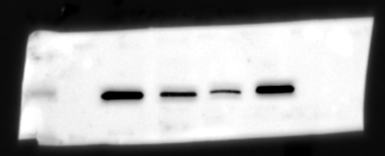
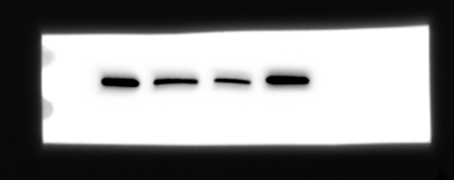
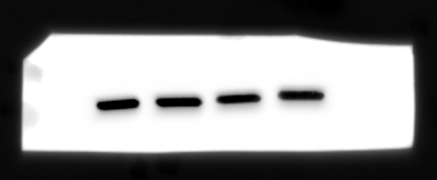
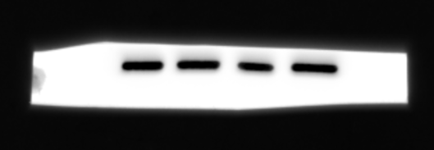
H1229
A549
65 kDa
KPNA2
57KD
KPNA2
57KD
55 kDa
57 kDa
55 kDa
57 kDa
45 kDa
GAPDH
37KD
GAPDH
37KD
35 kDa
37 kDa
37 kDa
35 kDa
si-NC
si-NC
si-circ1
si-circ1
si-anti ctrl
si-anti ctrl
si-anti miR-495-3p
si-anti miR-495-3p
Supplementary WB for Figure 5B (upper panel in A549 and H1229 cells)

