Slide 1
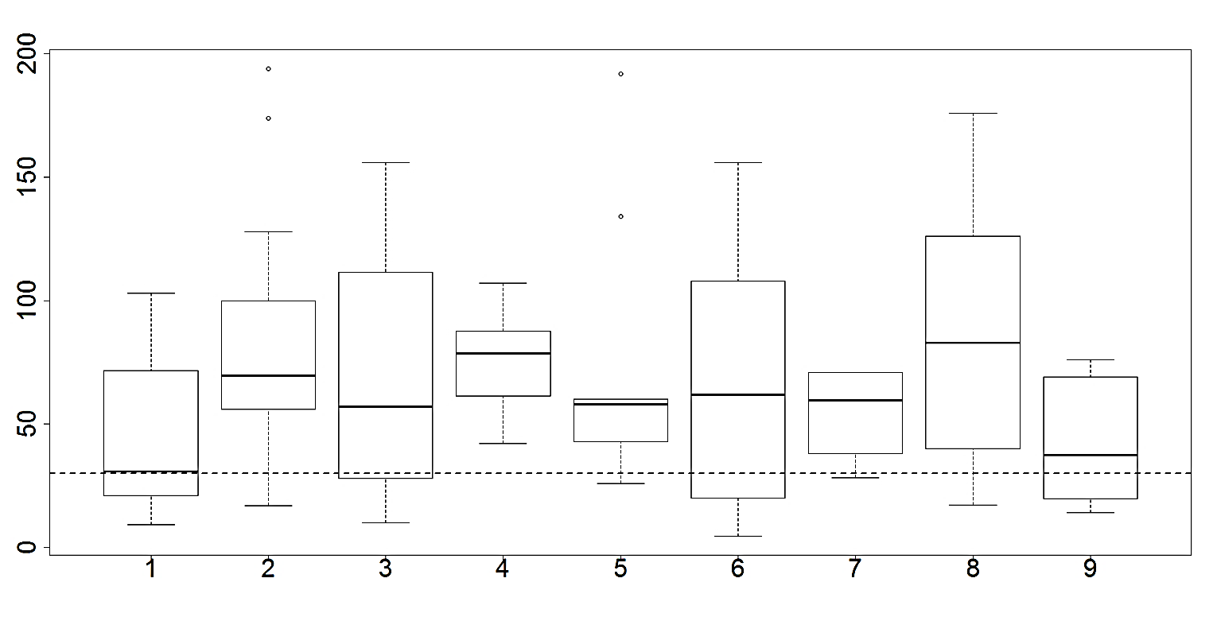
Additional file 13
Mefloquine susceptibility per conserved groups
Cluster groups
(Kruskal: p-value=0.05629)
IC₅₀
(nM)
30nM

