Slide 1
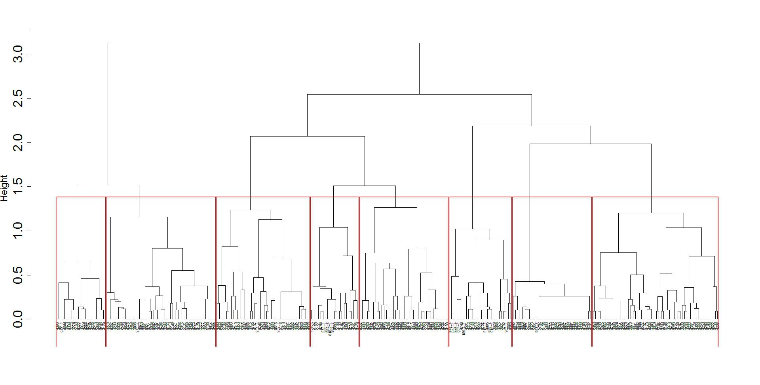
Additional file 5
A.

Slide 2
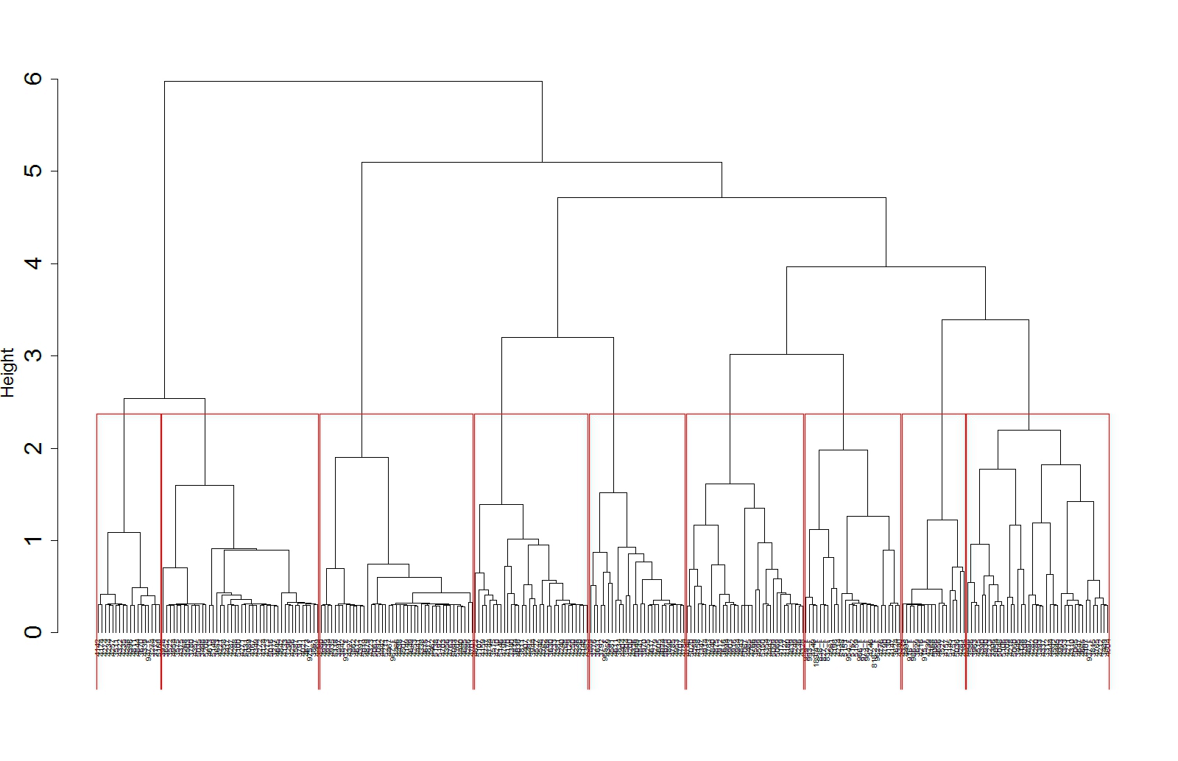
Additional file 5
B.

