Slide 1
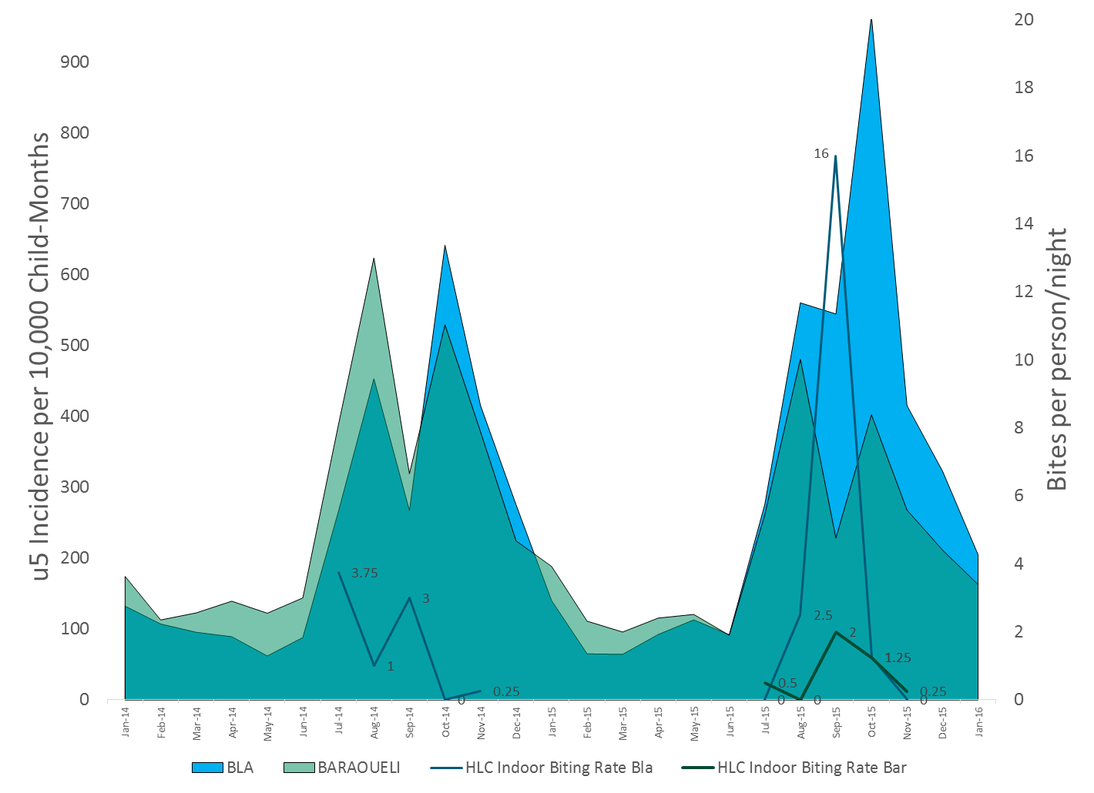
Additional file 3. Increased malaria incidence corresponds to increased mosquito collection densities in Bla, 2014 to 2015. HLC results were not available for Barouéli in 2014, but the 2015 results are included for reference. The background curves show the monthly under-5 year old malaria incidence rates from Bla (blue) and Barouéli (green).

