Slide 1
Suppl. 4. Rarefaction depth and plots
This supplementary material shows the number of ASVs for each pool of mosquito per developmental stage and microbial niche, along with the ASV depth at which rarefaction (random sampling without replacement) was performed. Rarefaction plots of Shannon diversity indices for each pool plateaus before the depth of rarefaction, indicating that further sampling efforts resulted in no/negligible change in Shannon indices. The rarefaction plots show average Shannon diversity index and range (boxplots: minimum, median and mean) for 10 iterations

Slide 2
Number of ASVs (min-max) per developmental stage and microbial niche
*three samples from El Terrero had ASV counts below the rarefaction depth and were excluded from alpha diversity analysis
 | Internal | Cuticle surface | Rarefaction depth
Larvae | 38715-170469 | 3277-197132* | 10000
Adults | 17227-139973 | 21817-223222 | 17000

Slide 3
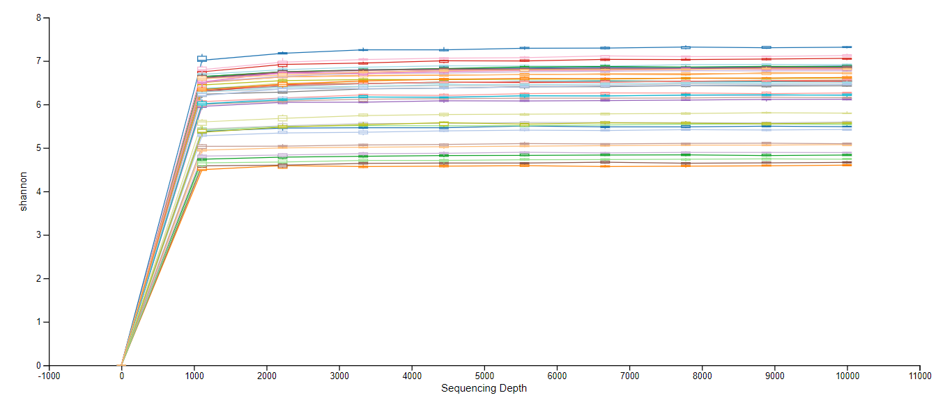
Larvae internal

Slide 4
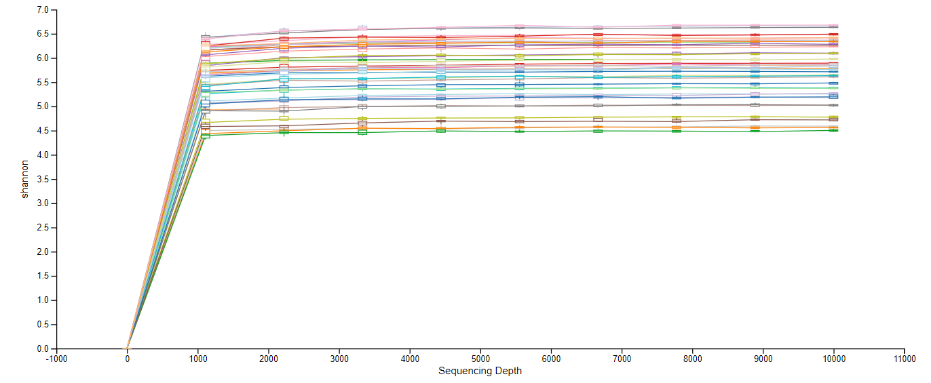
Larvae cuticle surface
Shannon index
Sequencing depth

Slide 5
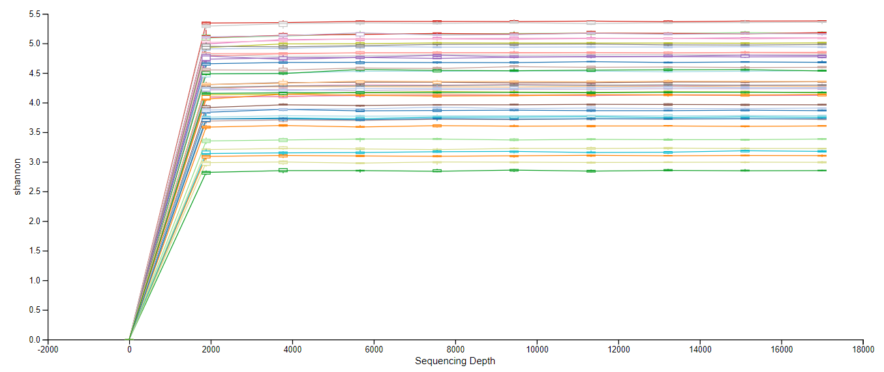
Adults internal
Shannon index
Sequencing depth

Slide 6
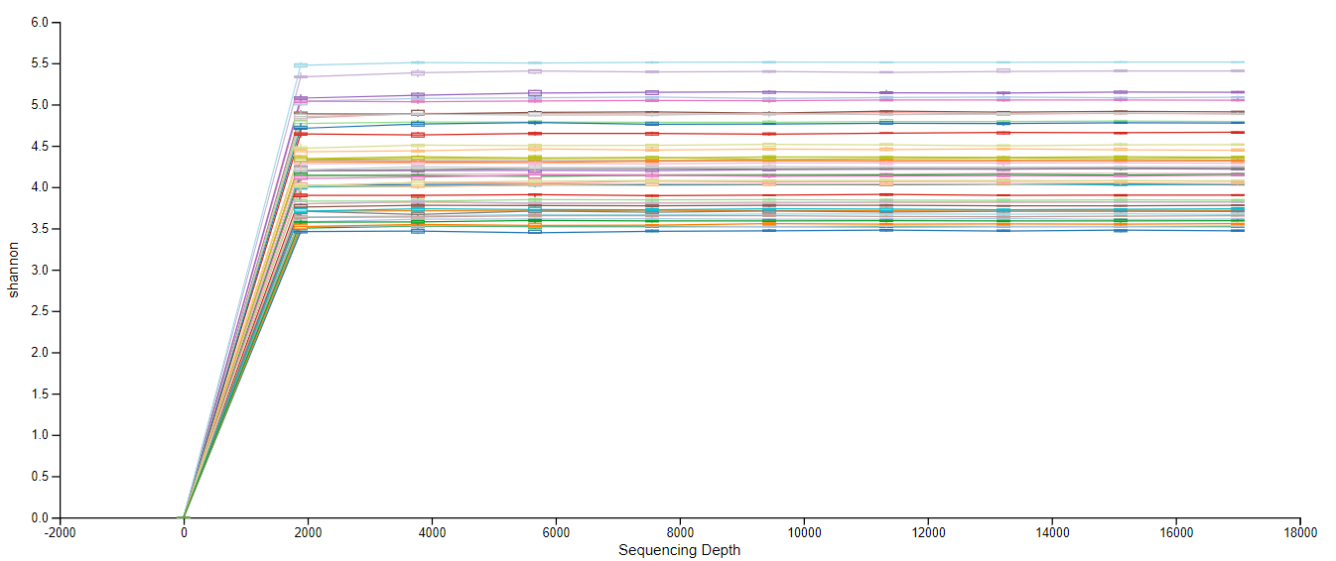
Adults cuticle surface
Shannon index
Sequencing depth

