Slide 1
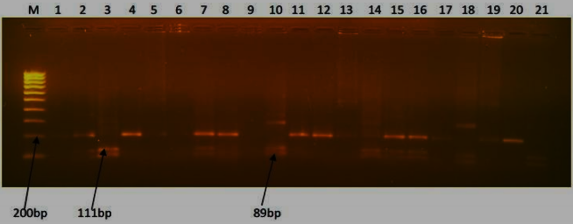
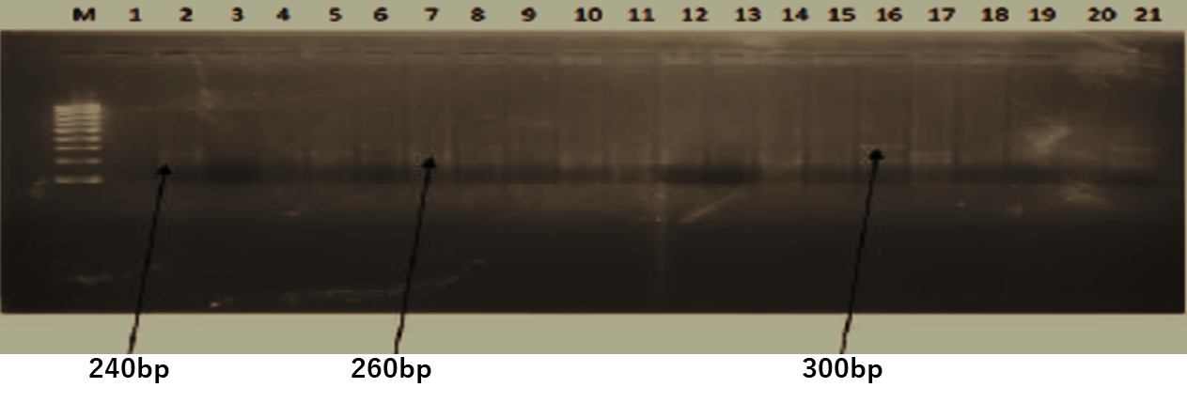
RFLP for Pfcrt 76
RFLP for Pfmdr1 86
Additional Figure 1:
Notes:
1

