Slide 1
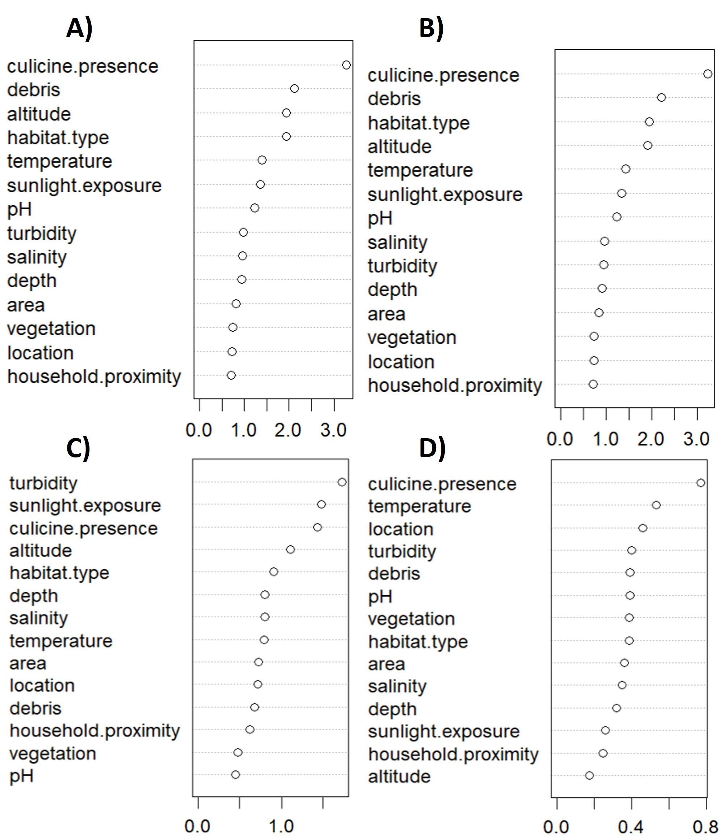
Variable importance plots to illustrate the relative predictive importance of physico-chemical properties and location of mosquito breeding sites surveyed in urban and periurban areas in south-south Nigeria (September to November 2022). Arranged from top to bottom in order of decreasing importance, predictors are assessed for their relative ability to determine the presence of larvae of a) Anopheles species, b) An. coluzzii, c) An. gambiae ss, and d) An. arabiensis in water bodies.

