Slide 1
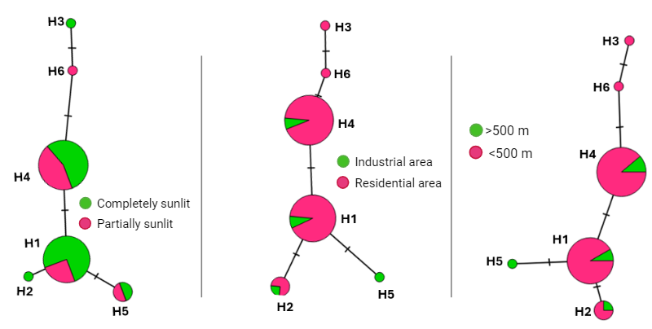
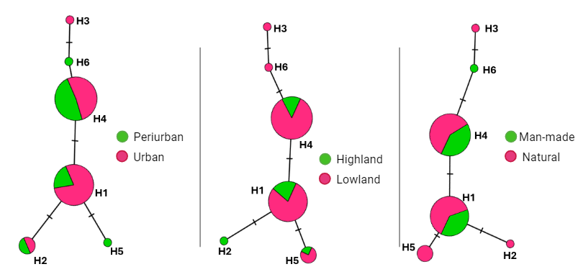
A)
B)
C)
D)
E)
F)

Slide 2
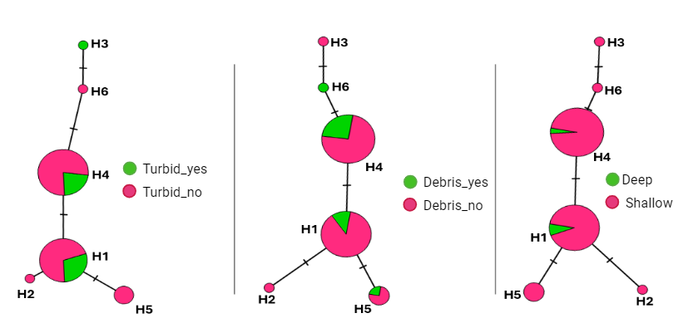
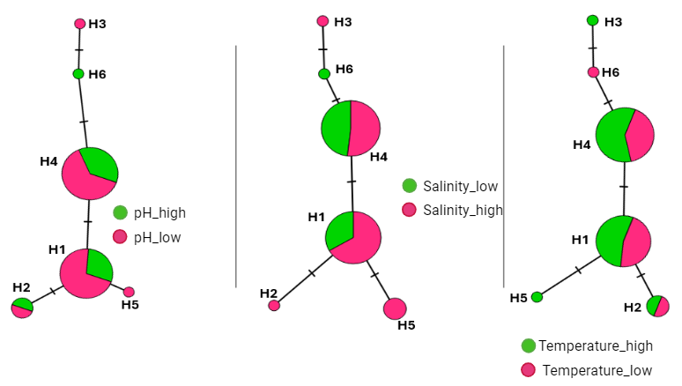

G)
H)
I)
Supplementary file 6: Median-Joining Networks of An. coluzzii populations in southern Nigeria. The alphabet ‘H’ next to each circle represents haplotype. The circle sizes are proportional to the haplotype frequencies. Hatched marks between haplotypes have been used to indicate the number of mutation which in each case is one mutation. The networks are arranged in the following order: A) exposure to sunlight; B) area (industrial & residential); C) distance from household; D) location (urban & periurban); E) altitude; F) habitat type; G) turbidity; H) presence of debris; I) depth of water body; J) pH; K) salinity; and L) temperature.
J)
K)
L)

