Slide 1
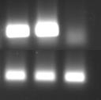
SCC
mel014
mel33B1
MelanA
hB2M

