Slide 1
A
SF1
B
Supplementary Figure 1- A. Representative photograph showing overall distribution of miR-21 and let-7a in tissues from normal controls. There were total 5 samples which were outliers in this group. B. Representative photograph showing miR-21 and let-7a expression levels in cytologicaly normal, cervicitis HPV-negative and cervicitis HPV-positive control tissues.

Slide 2
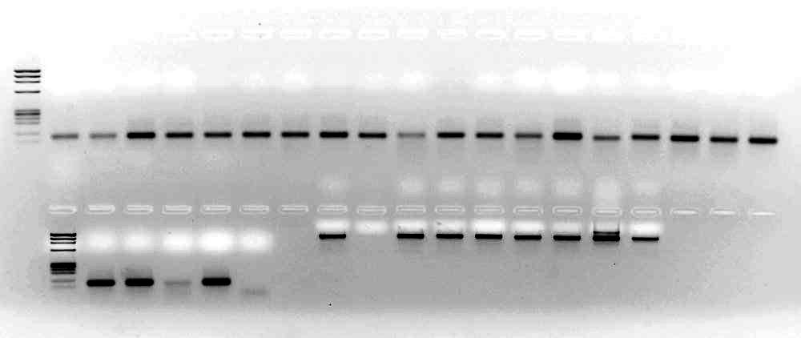
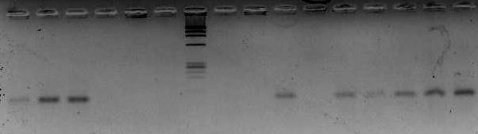
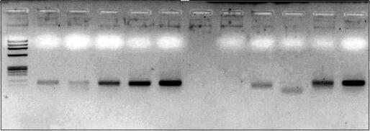
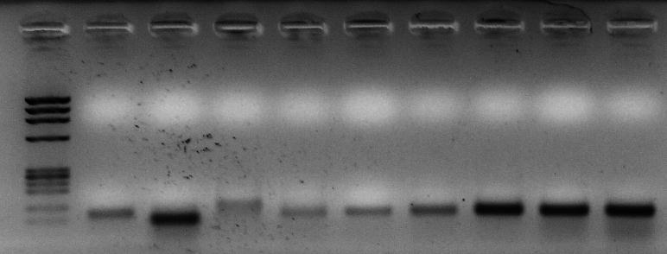
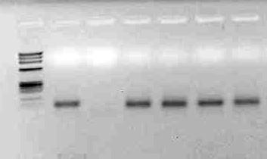
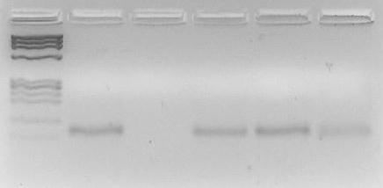
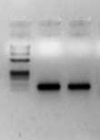
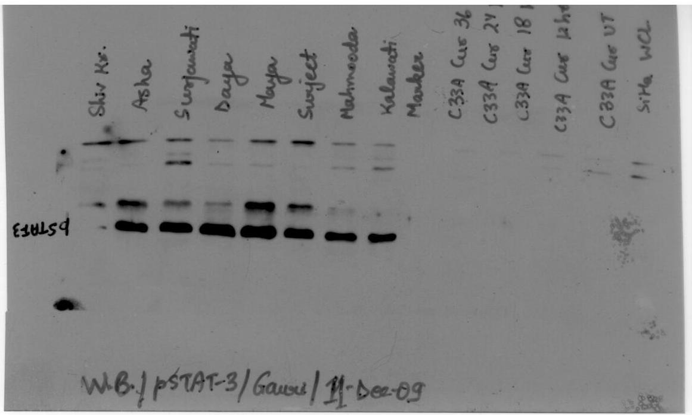
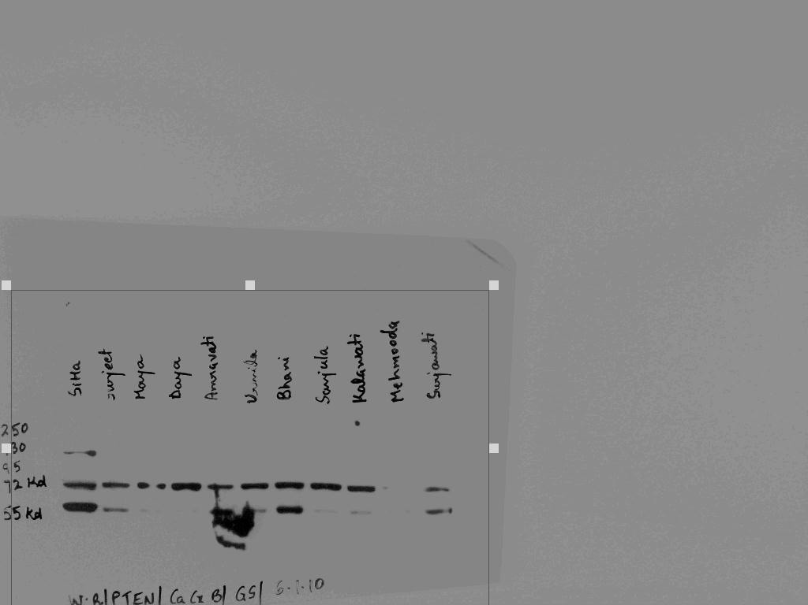
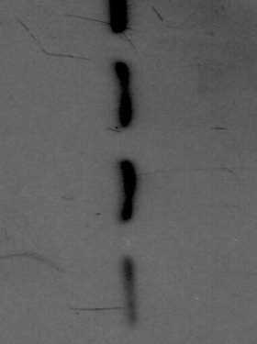
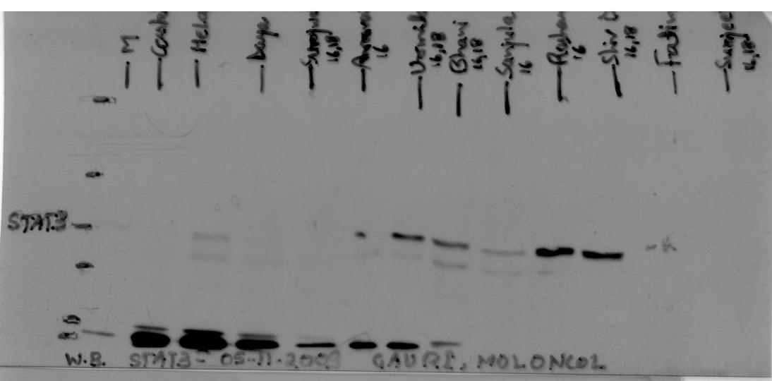
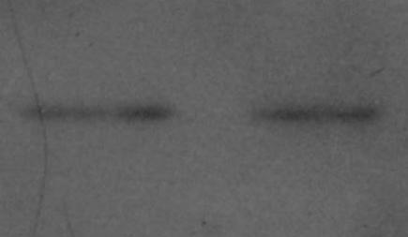
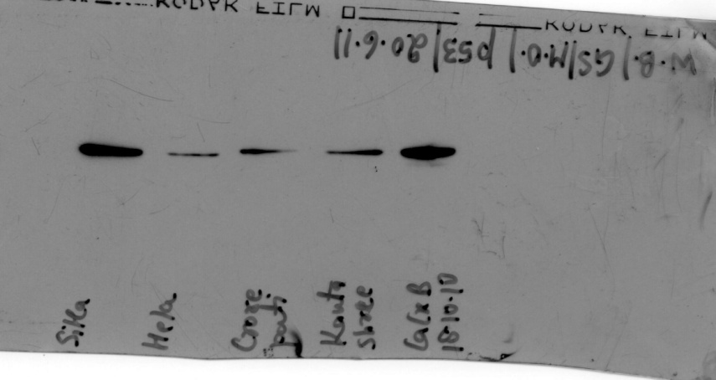
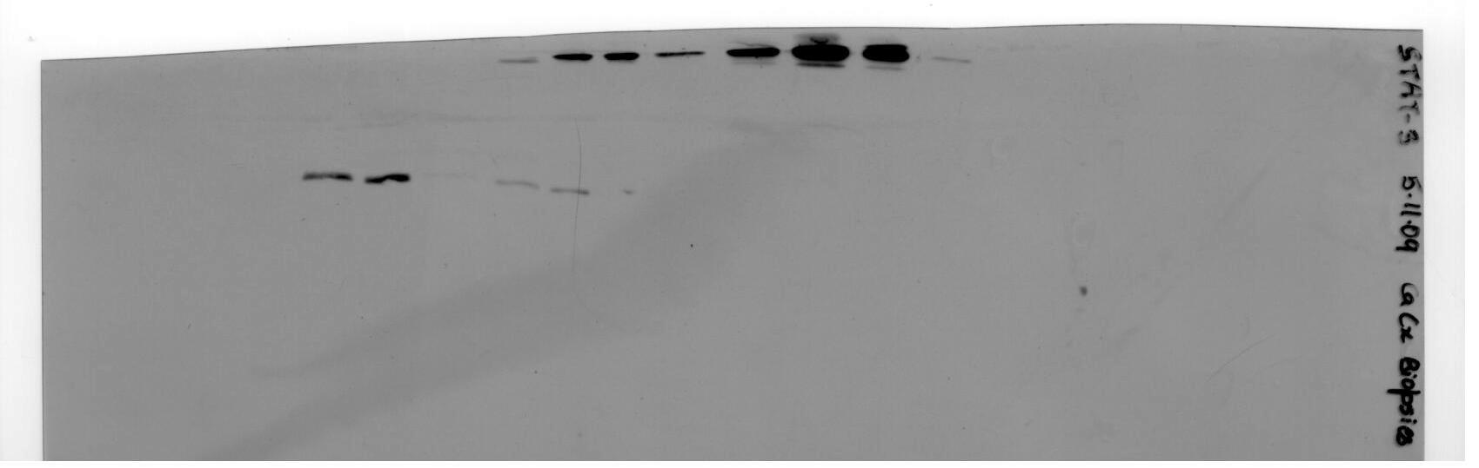
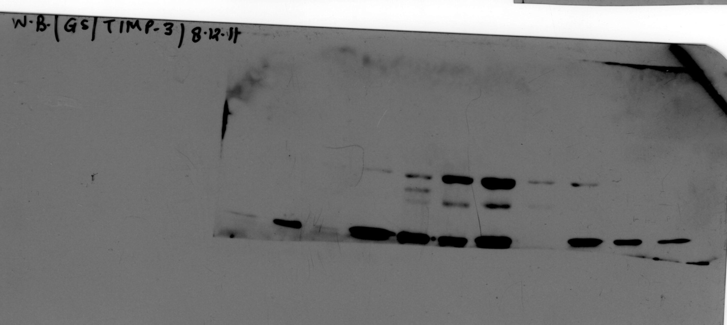
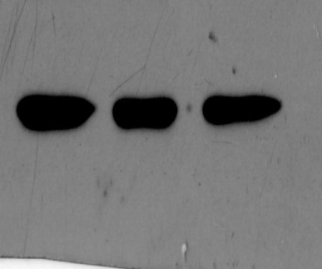
WDSCC
MDSCC
PDSCC
A
B
SF2
Low STAT3/pSTAT3
High STAT3/pSTAT3
C1 C2
C3 C4
miR-21
miR-21
Let-7a
Let-7a
U6
U6
STAT3
pSTAT3
STAT3
β actin
pSTAT3
β actin
Supplementary Figure 2- A. Representative photographs showing differential levels of miR-21 and let-7a in tissues from cancer lesions expressing either low or high levels of STAT3/pSTAT3. U6 amplification and β-actin levels were used as input control. B. Representative photographs showing levels of miR-21 and let-7a in tumor tissues of different histopathological grades along with their corresponding STAT3 levels.

