Slide 1
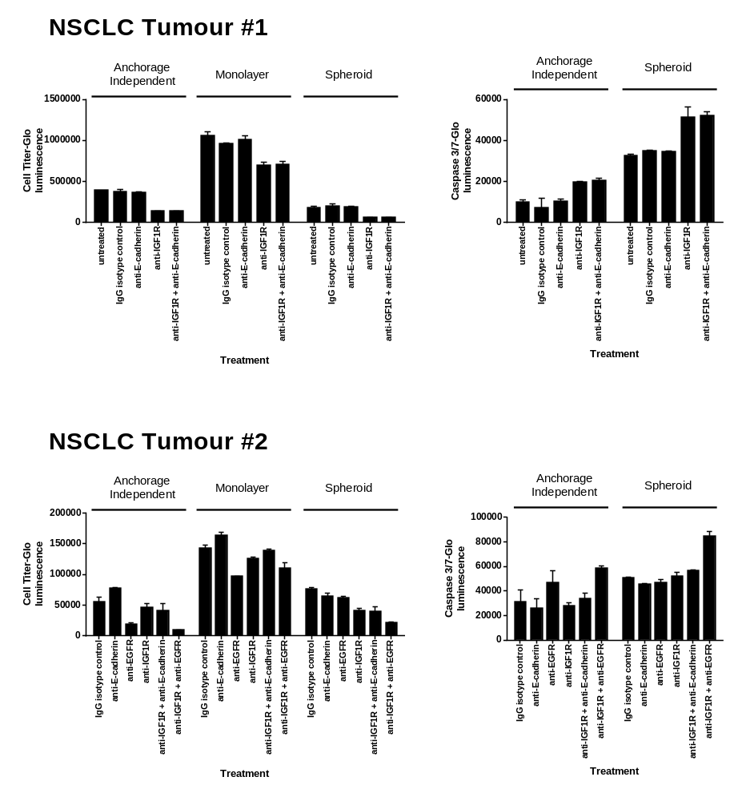
A
B
C
D
Notes:
Legend: Top - cells from two NSCLC tumors were dissociated from tumors and cultured under monolayer, anoikis and spheroid conditions. Images taken using a 5X magnification objective were taken under each culture condition. Below – characterising cells from tumour # 1 for in vitro screening of antibodies. Total cell number, measured by Cell Titre-Glo luminescent assay (Promega) shows tumour #1 is sensitive to anti-IGF1R in all three assay formats. Anti-IGF1R treatment also induced apoptosis pathways (measured by caspase 3/7-Glo luminescence (Promega)) in the spheroid and anchorage-independent assay formats.
Potentially a supplementary figure. Data = T031. Dose reponse could be sup info.
Figure X: Screening for inhibition of primary NSCLC tumour 1 cells grown in three different culture formats, as measured by cell titre-glo (CTG) luminescence. Antibodies and DARPins selected by cell-surface phage display against primary NSCLC cells were expressed as scFv-Fc and DARPin-Fc fusions, then added (without equalising their concentrations) to cells cultured in 96-well plates. A-C: scFv-Fc antibodies in monolayer culture, anchorage-independent (“anoikis”) culture and spheroid culture; D-F: DARPin-Fcs in the same culture formats: each data point represents a single scFv-Fc antibody/DARPin-Fc, or a single replicate of the controls (anti-IGF1R antibody, isotype control IgG). Horizontal bars indicate the mean signal for each sample class. Panels G-I: comparison of scFv-Fc effects across different culture conditions.

