Slide 1
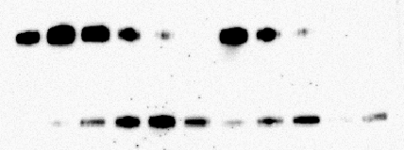
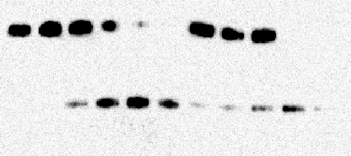
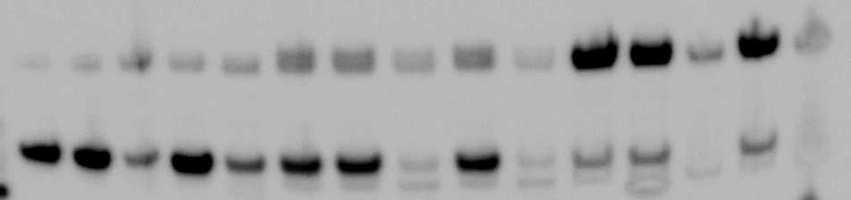
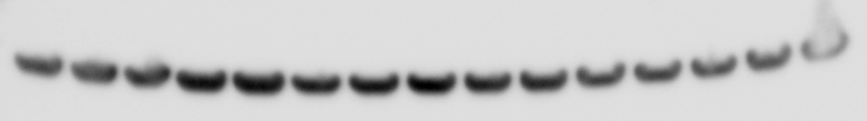
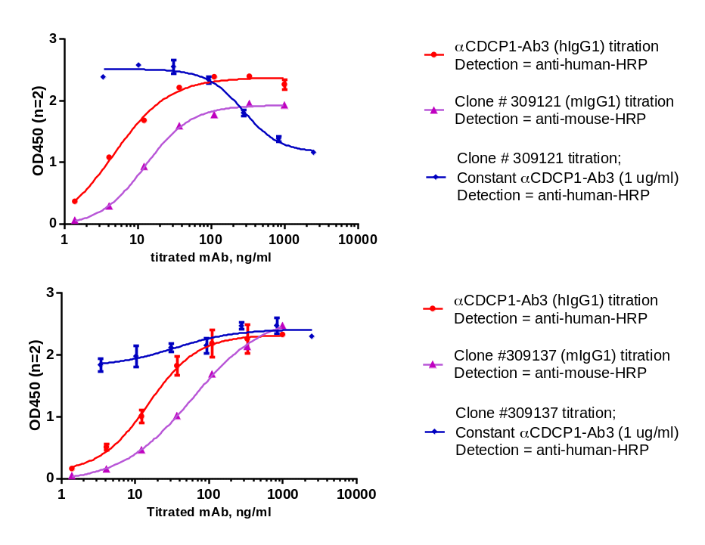
A
CDCP1 ECD alone
CDCP1 ECD + αCDCP1-Ab3
CDCP1 ECD + αCDCP1-Ab1
CDCP1 ECD + aprotinin
CDCP1 ECD-Flag-His₁₀
+
+
+
+
+
+
+
+
+
+
+
+
+
+
+
+
+
+
+
+
+
+
Matriptase catalytic domain
–
+
+
+
+
+
+
+
+
+
+
–
+
+
+
+
+
+
+
+
+
+
Incubation time (mins)
0
10
30
60
o/n
10
30
60
o/n
o/n
0
10
30
60
o/n
10
30
60
o/n
o/n
Detection = anti-FLAG
B
DU-145
NCI-H358
HCT116
Negative control IgG
Negative control IgG
Negative control IgG
Clone 309137
Clone 309121
Clone 309137
Clone 309121
Clone 309137
untreated
αCDCP1-Ab3
untreated
αCDCP1-Ab3
untreated
αCDCP1-Ab3
Clone 309121
160
Intact CDCP1
110
80
CDCP1
(cleaved form)
60
40
actin
C
D

