Slide 1
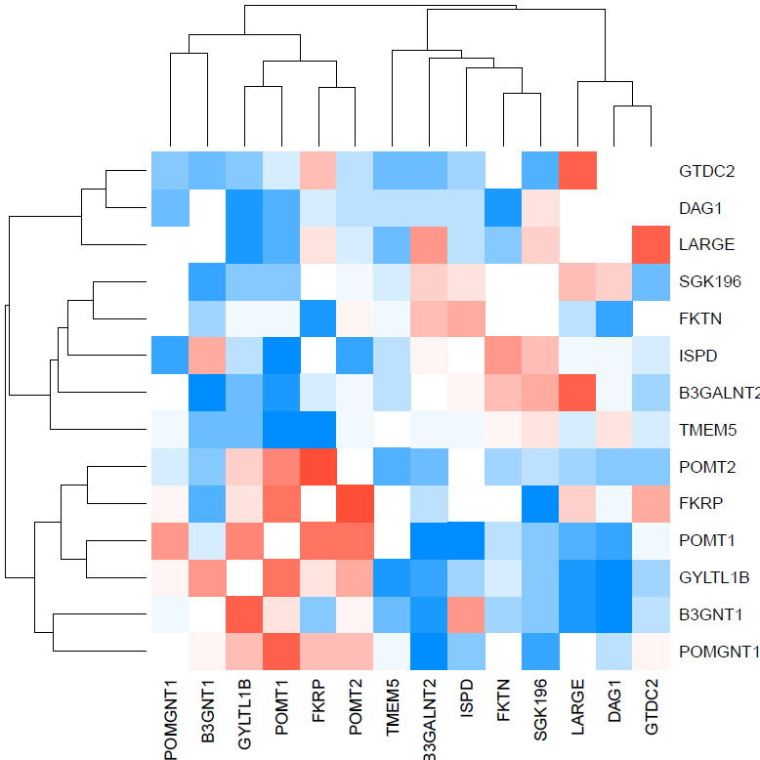
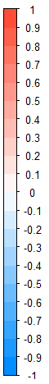
POMGNT2
DAG1
LARGE
SGK196
FKTN
ISPD
B3GALNT2
TMEM5
POMT2
FKRP
POMT1
GYLTL1B
B3GNT1
POMGNT1
FKRP
ISPD
FKTN
DAG1
POMT1
POMT2
LARGE
B3GNT1
TMEM5
SGK196
POMGNT1
GYLTL1B
B3GALNT2
POMGNT2

