Slide 1
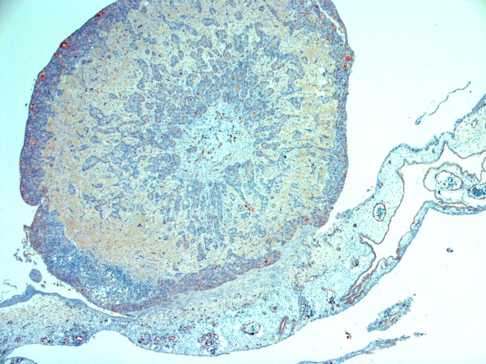
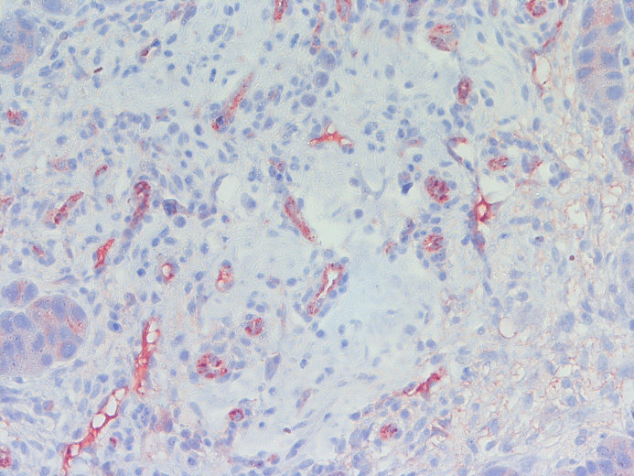
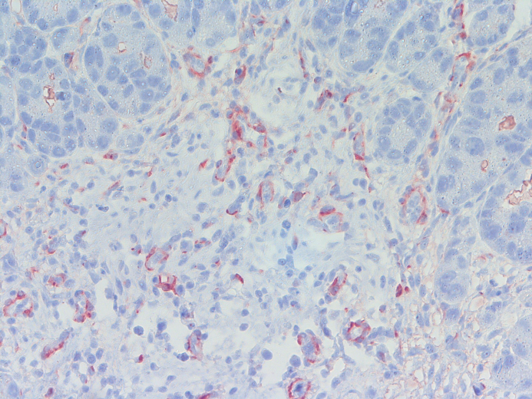
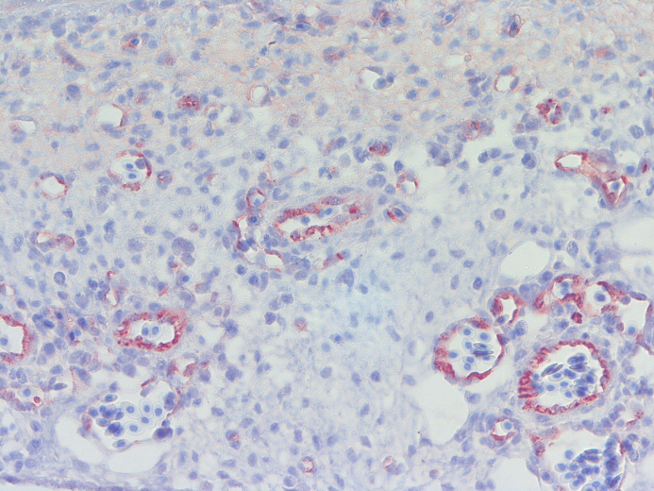
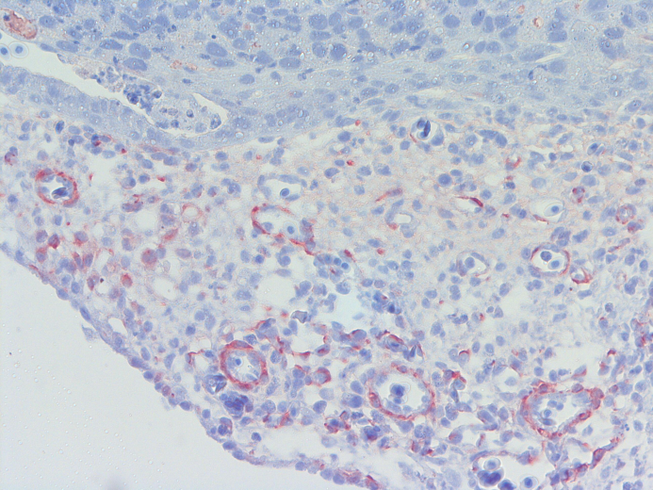
Supplem S2
BxPC3
vWF
Desmin
intratumoral
intratumoral
extratumoral
extratumoral
intratumoral
intratumoral
extratumoral
extratumoral
Notes:
vWF

