Slide 1
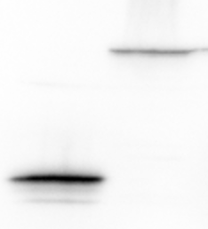

Supplem S6
A
B
C
PaTu2
No
Hy
PaTu2
PaTu2
p=0.0004
No
Hy
p=0.0001
GFP-empty
p=0.0288
p=0.0014
YFP-p65
p=0.0114
p<0.0001
100
p65
72
55
45
β-actin
-
+
+
shPKM2 #4
-
#2
#4
#2
#4
shPKM2
-
-
+
p65
-
-
-
+
+
p65

