Slide 1
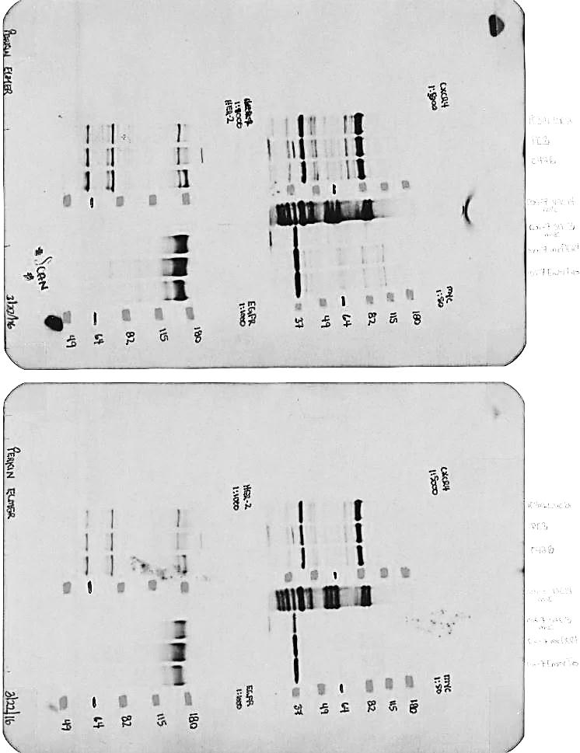


Supplementary figure 1
PC-3M-luc2
C4-2B
PC3
EGFR
Fold
0.96
1.00
1.06
CXCR4
Fold
1.24
1.00
1.51
Beta-Tubulin

Slide 2
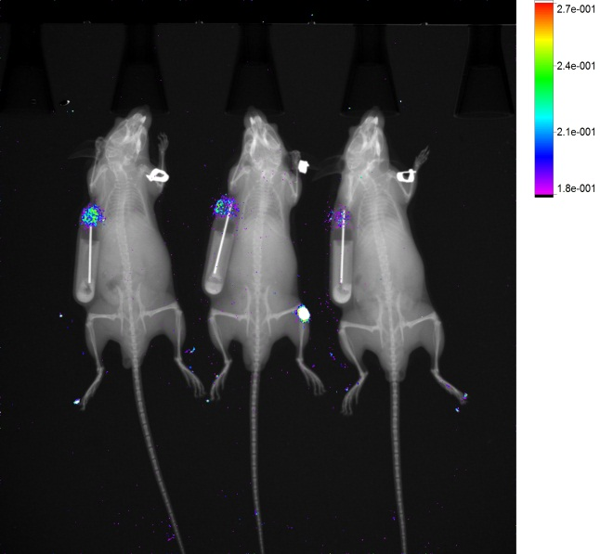

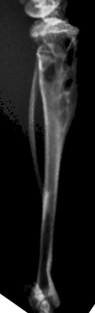
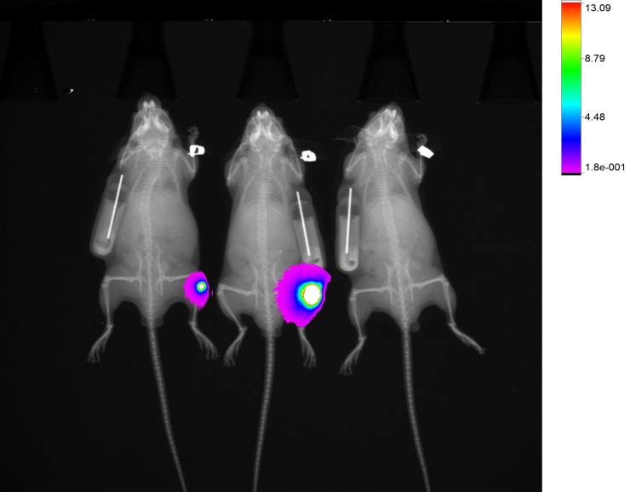

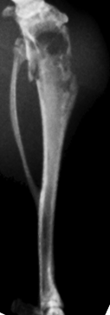
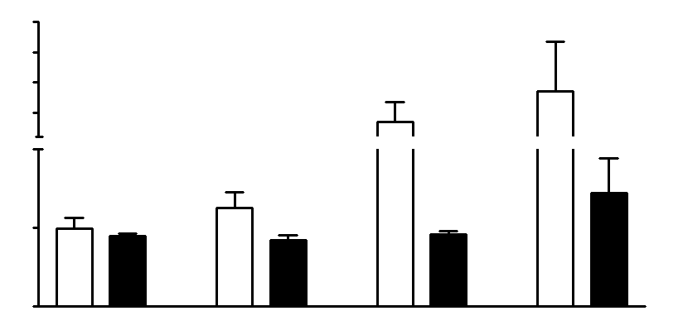

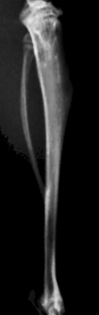

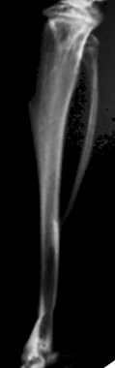
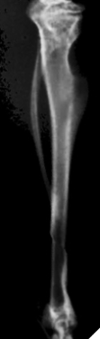
Supplementary figure 2
A.
Tumor cell injection
and Saline/Plerixafor
treatment
Luciferase imaging
X-Rays
Days 0 12 19 26 33
B.
Saline
C.
4.0x10⁰⁶
Saline
3.0x10⁰⁶
Plerixafor
2.0x10⁰⁶
1.0x10⁰⁶
1.0x10⁰⁵
Sum P/s/mm^2
Left
Right
Left
Right
Plerixafor
5.0x10⁰⁴
0.0
12 Days
19 Days
26 Days
33 Days
Left
Right
Left
Right

